Slide 1
Frontal Precipitation/weather

Slide 2
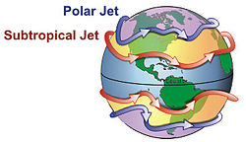
Jet Stream.
“river” of high winds (up to 200mph)
9-16KM up (more or less at the tropopause)
The strongest form the border between warmer temperate air moving north and cold polar air heading south – the polar front. Which influences US weather bigly.
More info at https://www.livescience.com/27825-jet-stream.html

Slide 5
Frontal Precip
Interactions between air masses.
Relative temperature and humidity.
As always, must force air to rise
The faster the rise, the faster the cooling, and therefore, the faster the precip

Slide 6
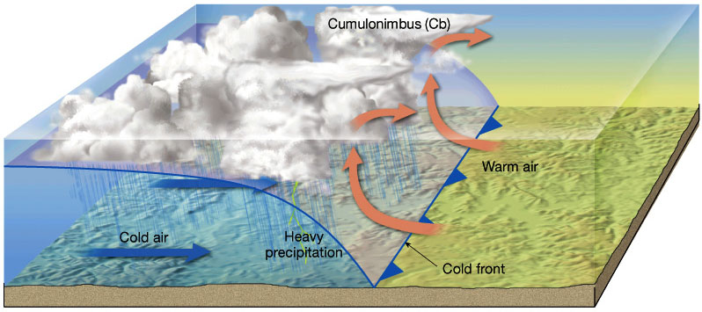
Cold fronts

Slide 7
Characteristics of cold fronts
Precip at or behind the front itself
Heavy precipitation because of rapid rise of air
The faster the front is moving, the steeper the incline and the faster the rise/cool

Slide 8
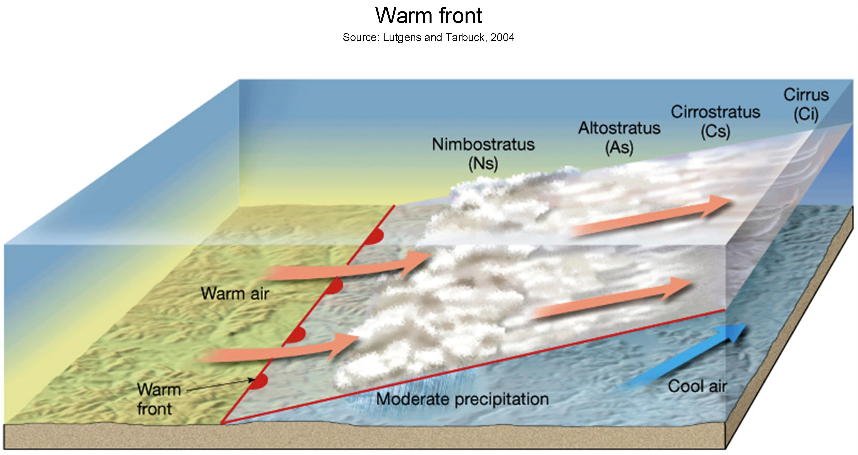
Warm front

Slide 9
Characteristics of a warm front
Relatively slow rise of air
Low to moderate precipitation
Precip in front of the front itself.

Slide 10
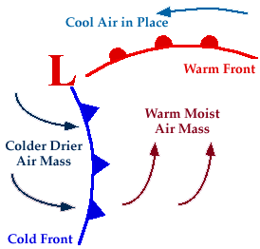
OK. How to tie these together

Slide 11
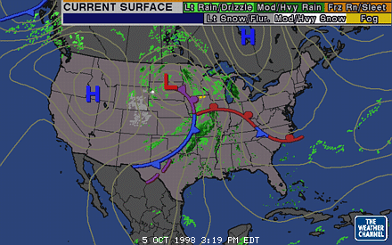

Slide 12
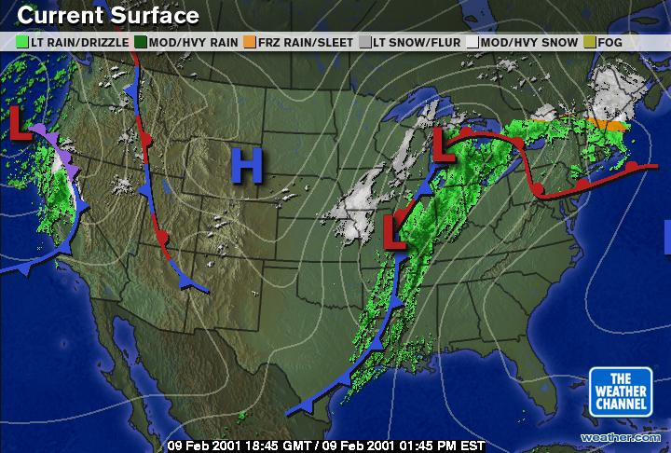

Slide 13
Current weather
http://www.weather.com/maps/currentusweather
http://www.weather.com/maps/ustemperaturemap
https://www.windyty.com/?38.557,-97.635,5

Slide 14
Convectional precipitation
Thunderstorms!
Thunder, lightning, hail?
Hurricanes
Tornados
ITCZ
Remember, winds spiral INTO low pressure cells.

Slide 15
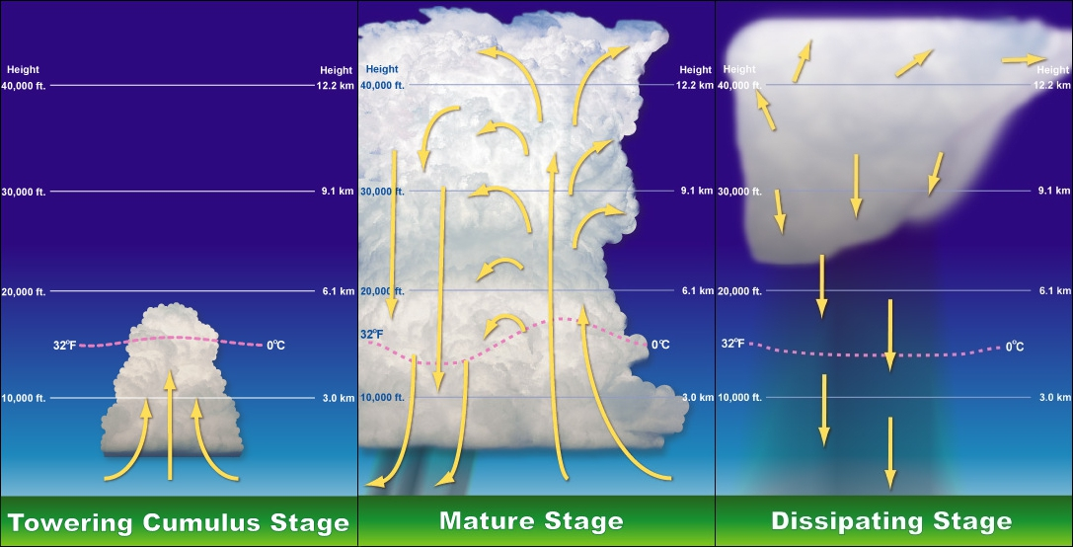

Slide 16
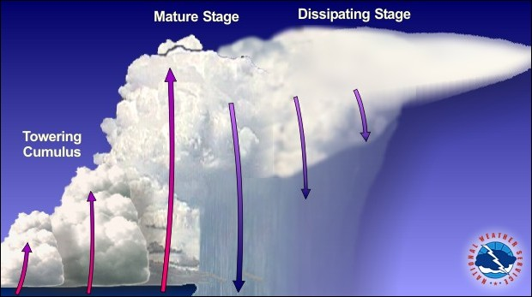

Slide 18
NB summer 2022

Slide 19
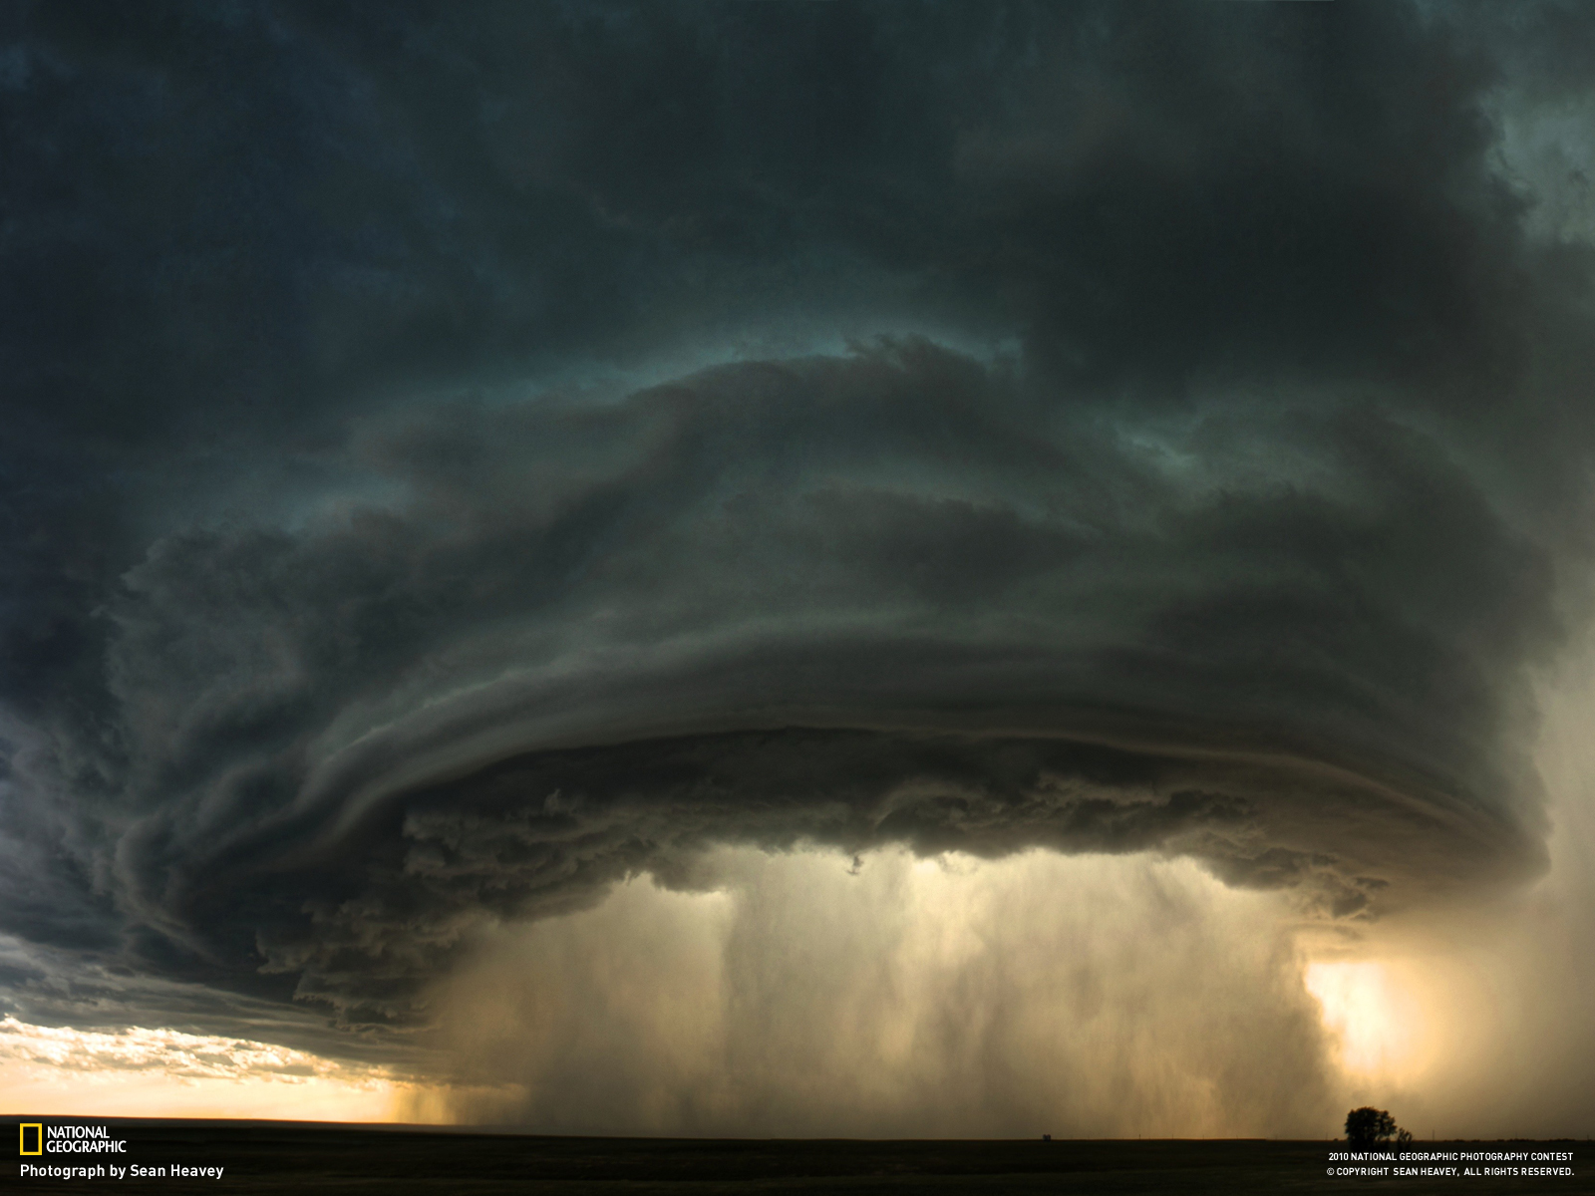

Slide 20
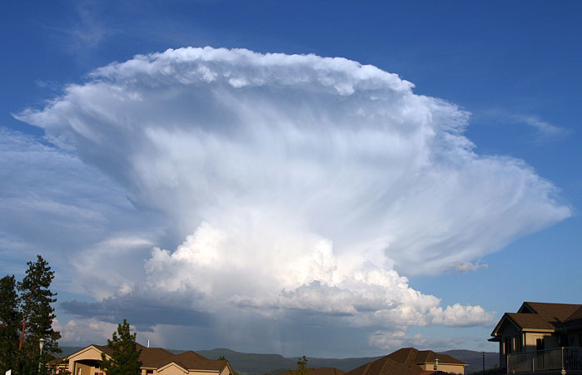

Slide 21
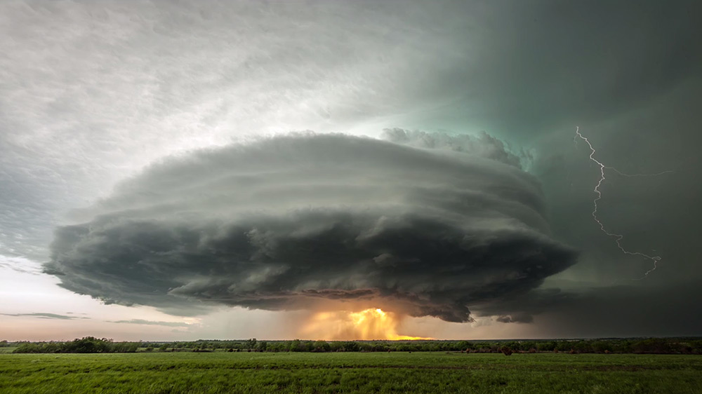
http://www.thisiscolossal.com/2014/05/supercell-thunderstorm-timelapse-over-kansas/

Slide 23
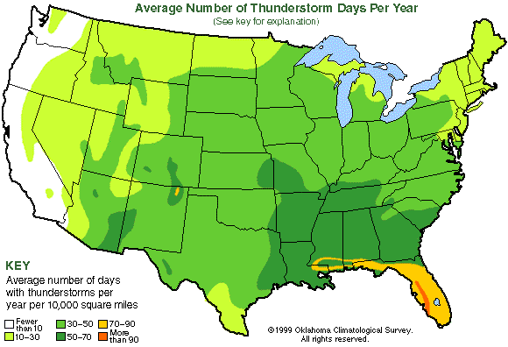

Slide 24
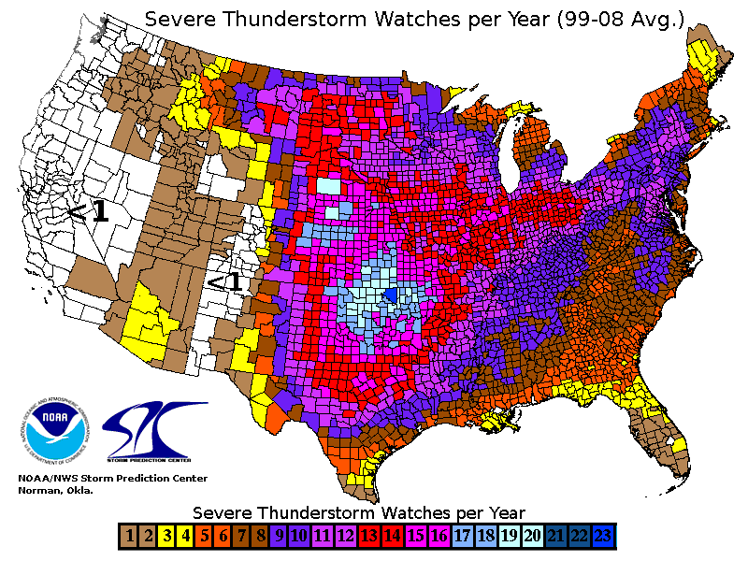

Slide 25
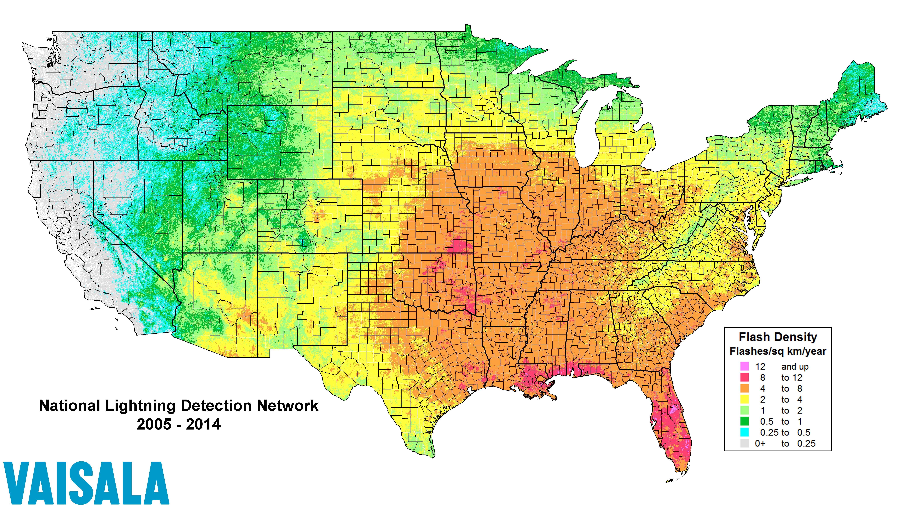

Slide 27
http://en.blitzortung.org/live_lightning_maps.php
https://en.wikipedia.org/wiki/1999_Sydney_hailstorm
https://www.newsmax.com/fastfeatures/hail-deadliest-storms/2016/07/08/id/737837/
https://www.severe-weather.eu/theory/hail-world-records-the-biggest-heaviest-and-deadliest-hail/
https://www.atlasobscura.com/articles/hail-no-an-account-of-the-worlds-biggest-deadliest-hailstorms
https://www.wunderground.com/cat6/record-hailstorms-and-hailstones-us

Slide 28
Tornados
Associated with intense thunderstorms
Extreme low pressure (the lowest)
Most – 110mph winds, 250’ across, might go a few miles.
Extremes – 300+mph, 2 miles across, might go dozens of miles.
No relationship to trailer parks. Yes, I’ve done the math.

Slide 29
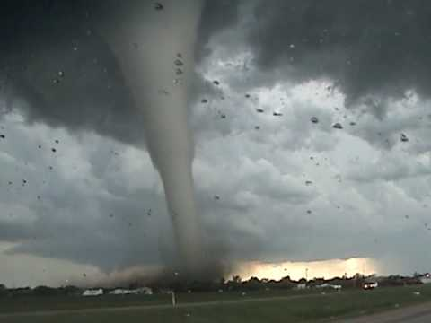

Slide 30
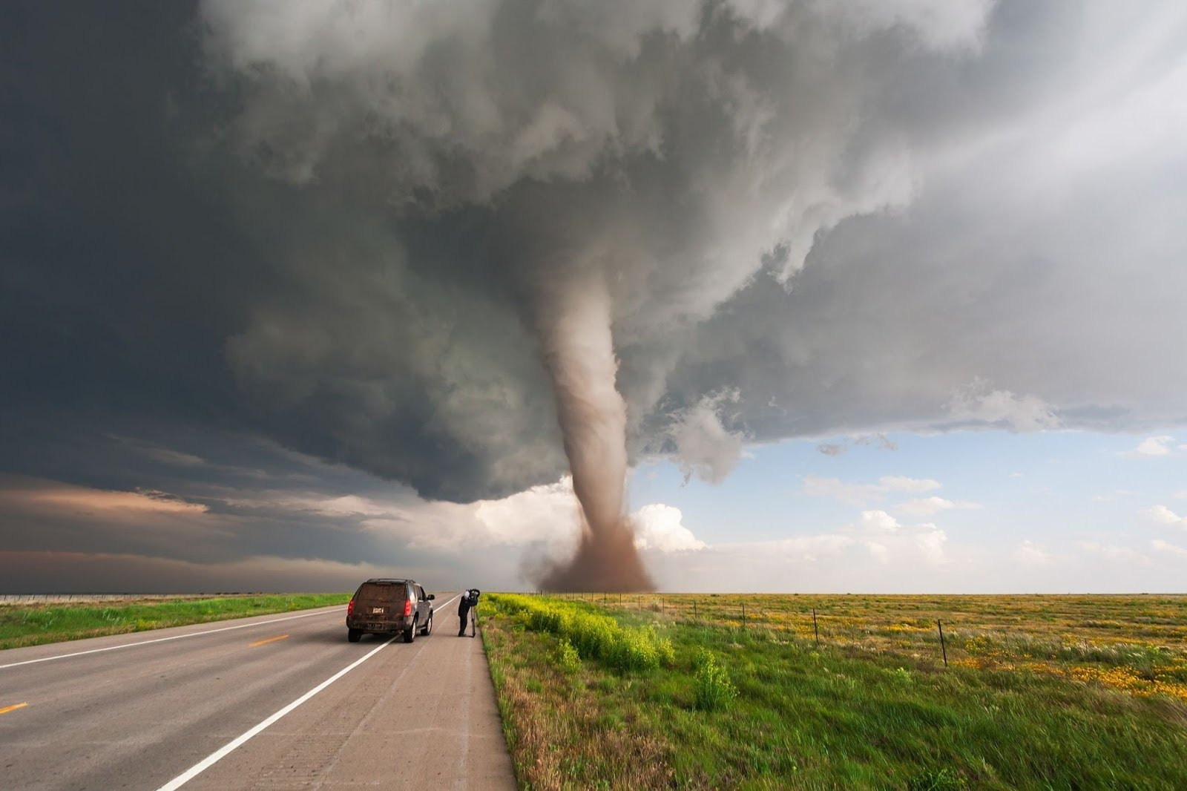

Slide 31
https://www.youtube.com/watch?v=XMF22_MEMJU
https://www.youtube.com/channel/UCAQpSHsgUcNt6uCOjpgD8kw

Slide 32
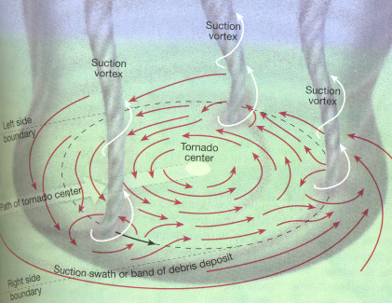
Often, multiple funnels
“multiple vortex tornadoes”

Slide 33
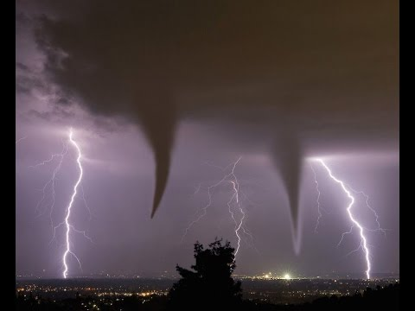

Slide 34
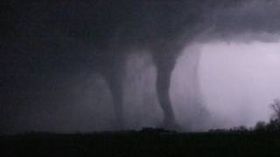

Slide 35
https://www.youtube.com/watch?v=CpxblAR3Ro0
https://www.youtube.com/watch?v=m54XJsaAwFA

Slide 36
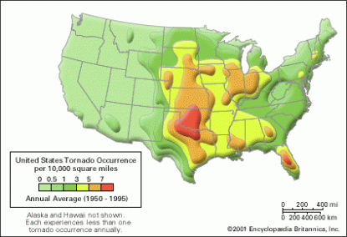
Tornado Alley

Slide 37
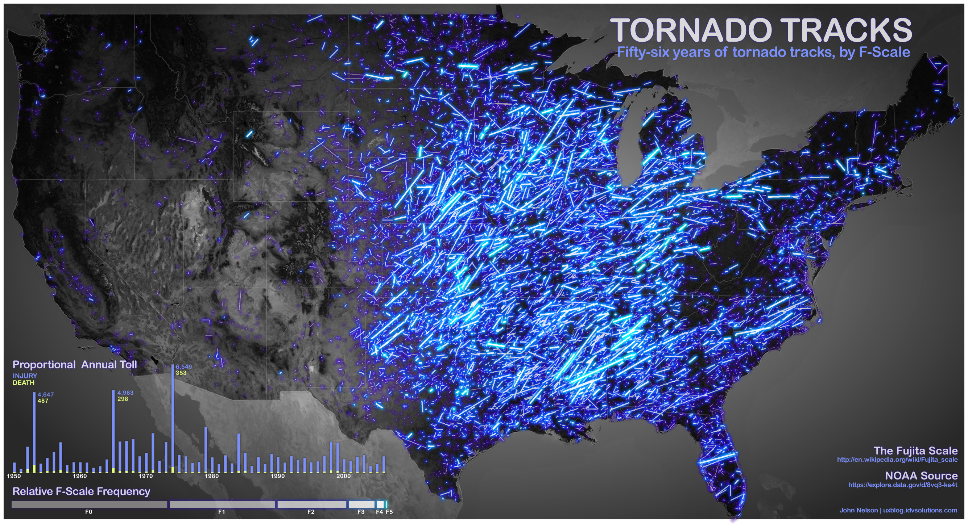

Slide 38
Hidden Valley area Kittitas County August, 2019

Slide 40
http://www.ustornadoes.com/2013/07/25/from-domestic-to-international-tornadoes-around-the-world/
https://www.iflscience.com/technology/this-incredible-video-lets-you-see-what-it-looks-like-inside-a-tornado/

