Slide 1
Global warming, greenhouse effect, and climate change

Slide 2
How Is the Earth’s Climate Changing?
Considerable scientific evidence indicates that the earth’s atmosphere (and ocean) is warming at a rapid rate that is likely to lead to significant climate disruption during this century
https://www.sciencealert.com/watch-global-temperatures-spiral-out-of-control-in-this-new-climate-change-animation

Slide 3
Definition: climate change
Alteration in the long-term patterns and statistical averages of meteorological events

Slide 4
Weather and Climate Are Not the Same
Weather is short-term changes
Temperature, air pressure, precipitation, wind
Climate is average conditions in a particular area over a long period of time
Temperature and precipitation
Fluctuations are normal – but the pace of change is MUCH slower (naturally)

Slide 5
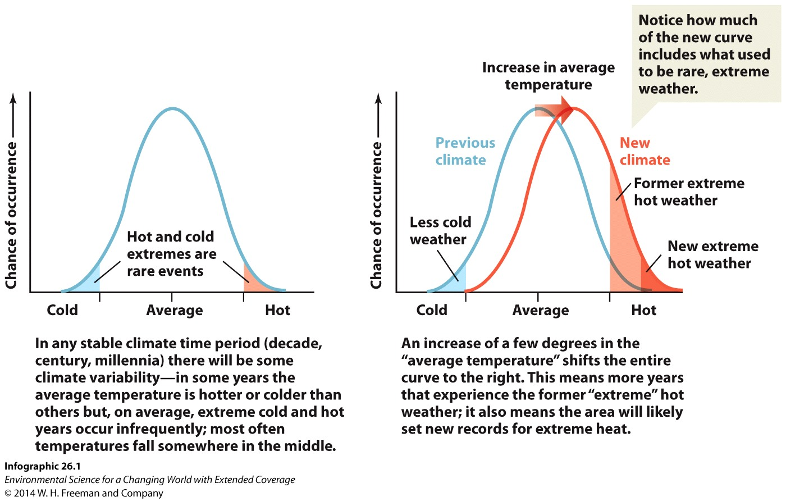
Whoop de whoop. Who cares?

Slide 6
Natural climate change
Volcanic eruptions and changes in solar irradiance (like sunspot cycles) are also considered natural forcers
Both have impacted climate in the past but only over short time frames
The big exception has been monster meteorite strikes.

Slide 7
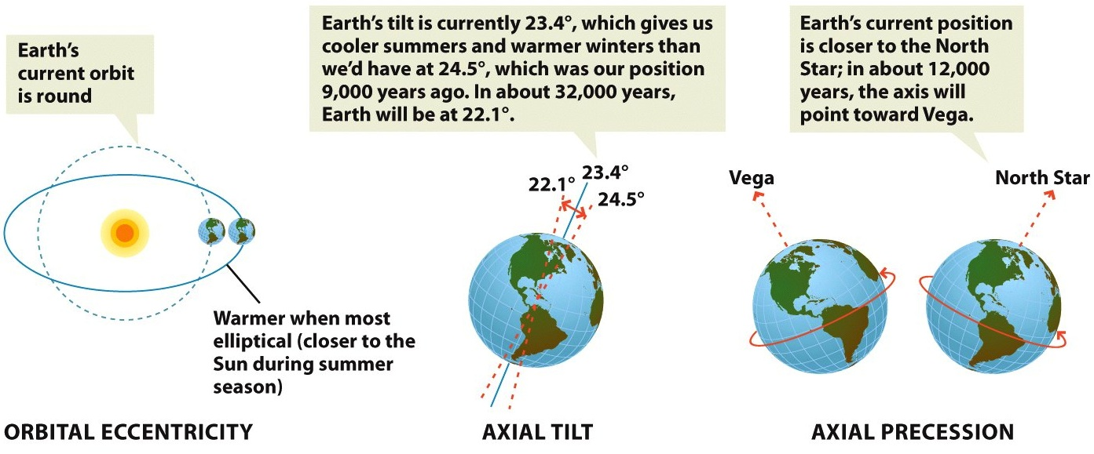
Milankovitch Cycles (long-term climate change)

Slide 8
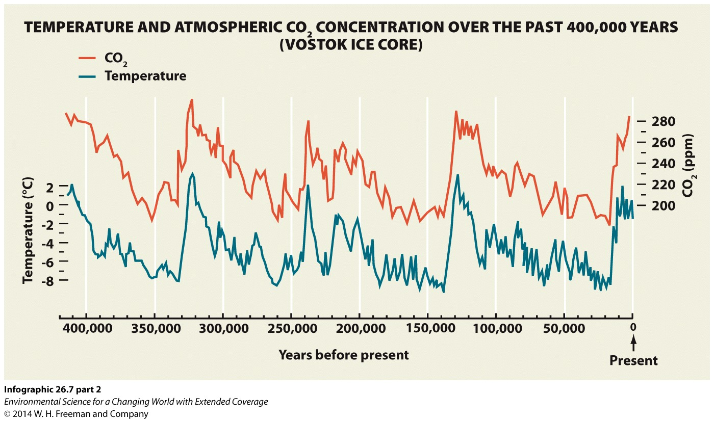

Slide 9
How do we get this info from ice cores?
Directly measure the CO2 content from air bubbles in the ice
For temp, looking at both H (1H and 2H)and O isotopes (16O and 18O) from the ice (water) itself (isotopic ratios).
https://www.scientificamerican.com/article/how-are-past-temperatures/ We can use ice cores to go back as far as 800 thousand years
“Ice core records can be used to reconstruct temperature, atmospheric circulation strength, precipitation, ocean volume, atmospheric dust, volcanic eruptions, solar variability, marine biological productivity, sea ice and desert extent, and forest fires.” https://climatechange.umaine.edu/icecores/Ice_Core_101.html

Slide 10
New evidence!!! (14 January, 2016)
http://www.nature.com/nature/journal/v529/n7585/full/nature16494.html#close
Human induced global warming may have prevented a natural ice age by keeping CO2 levels high as they would naturally decline.
Good, but only to a point.

Slide 11
Climate Change is Not New But Has Accelerated (cont’d.)
Over the past 10,000 years
Interglacial period
Over the past 1,000 years
Temperature stable
Since 1975
Temperature changes
Accelerating

Slide 12
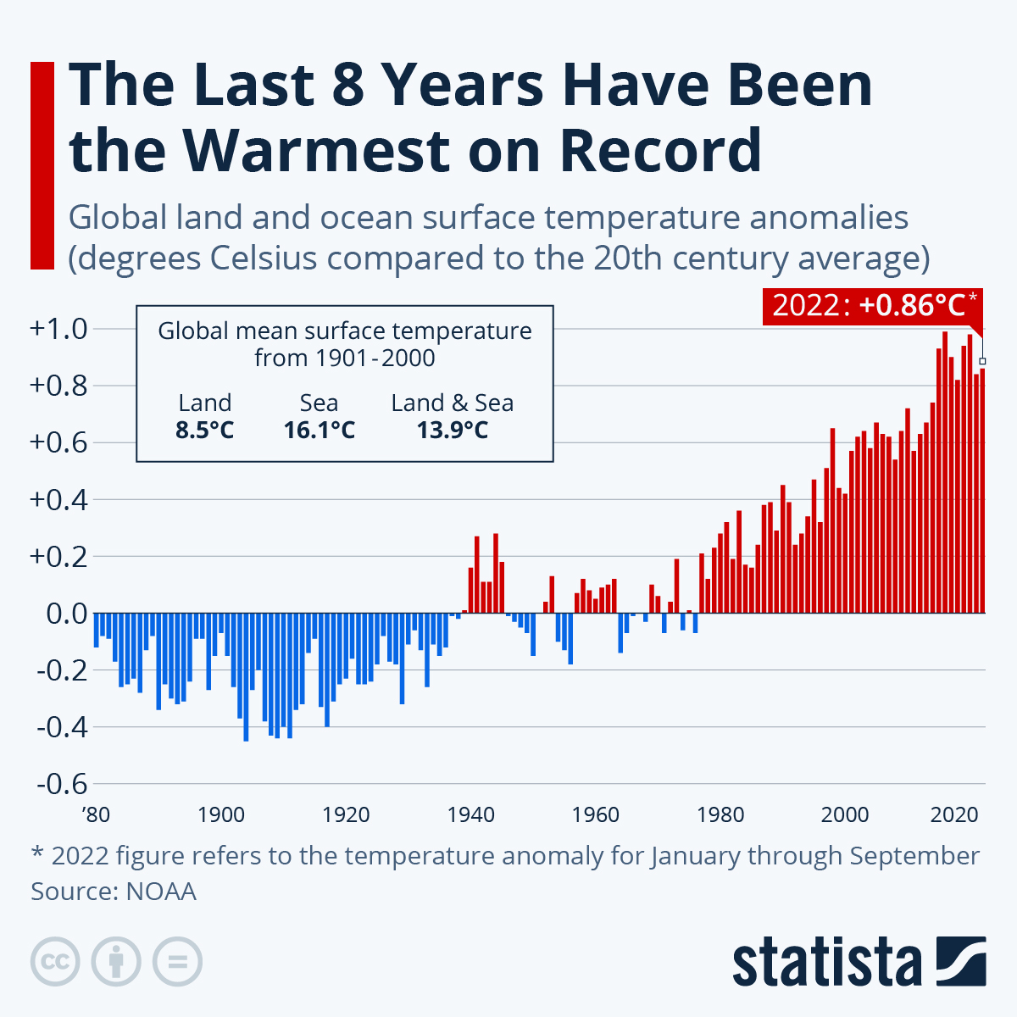

Slide 13
Record years
1 | 2016
2 | 2020
3 | 2019
4 | 2017
5 | 2015
6 | 2022
7 | 2021
8 | 2018
9 | 2014
10 | 2010
Ouch…

Slide 14
2023 on track to be the hottest year on record

Slide 15
Blob. ENSO

Slide 22
Let’s take a look at 2022

Slide 23
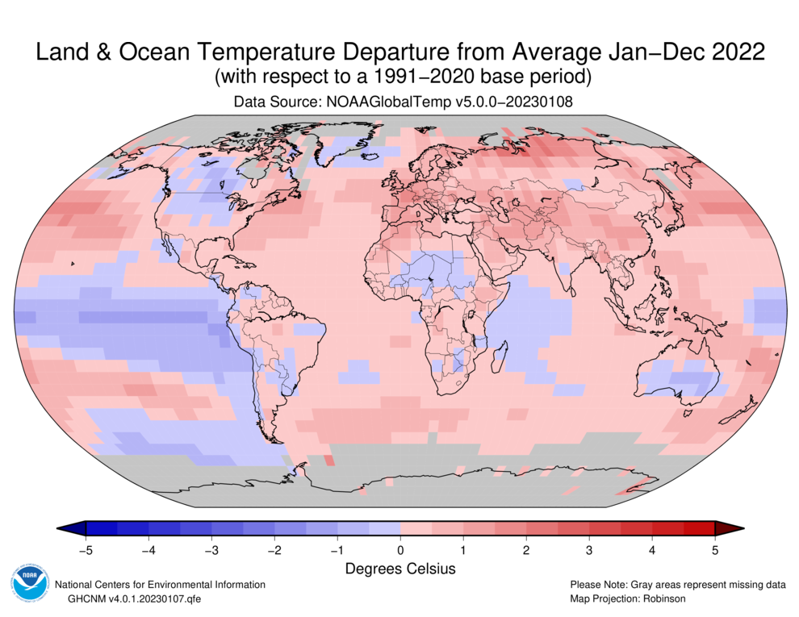

Slide 24
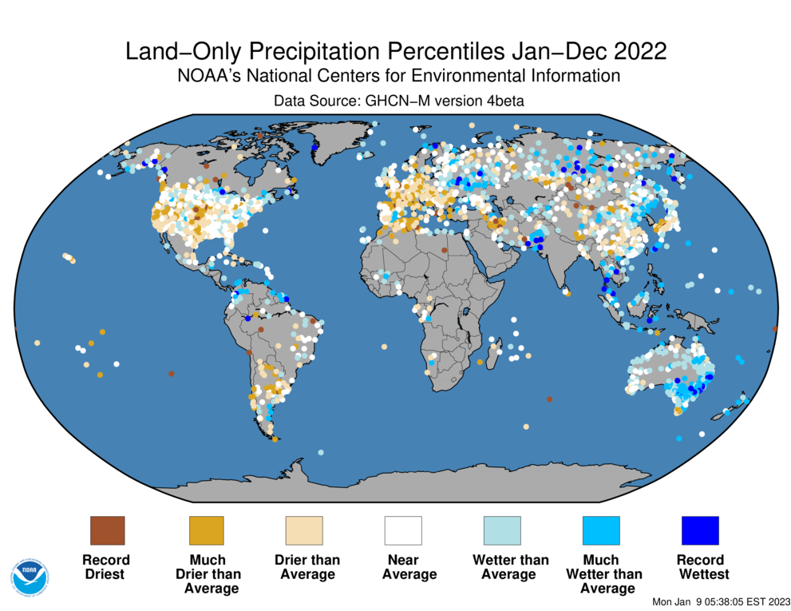

Slide 25
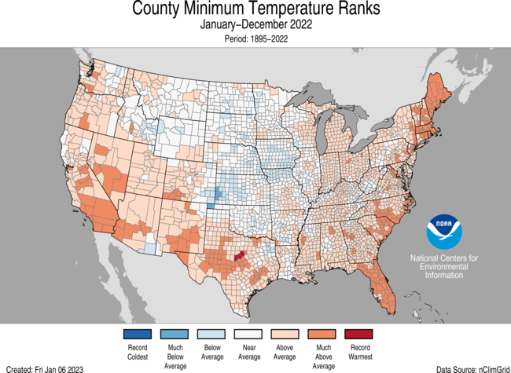
The US

Slide 26
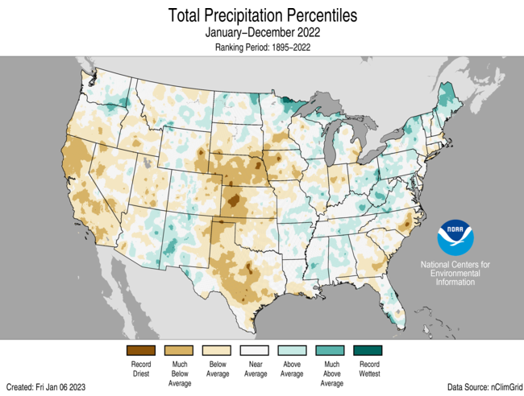

Slide 27
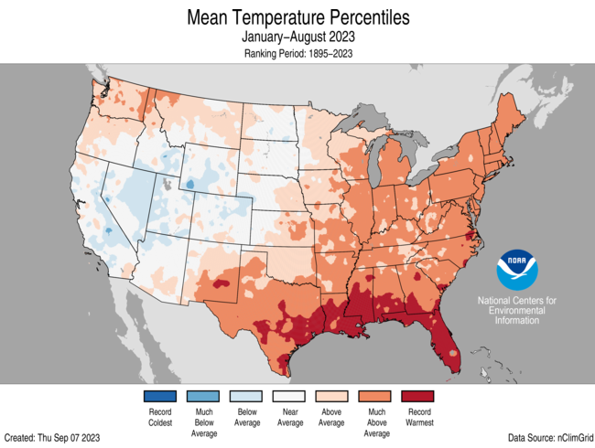
2023 so far

Slide 29
2016. #1 on hottest record

Slide 32
http://climate.nasa.gov/news/2537/nasa-noaa-data-show-2016-warmest-year-on-record-globally/
https://www.nytimes.com/interactive/2018/01/18/climate/hottest-year-2017.html
https://www.ncdc.noaa.gov/sotc/national/202013

Slide 33
OK. That’s the last few hundred years What about the last few thousand?
https://xkcd.com/1732/

Slide 34
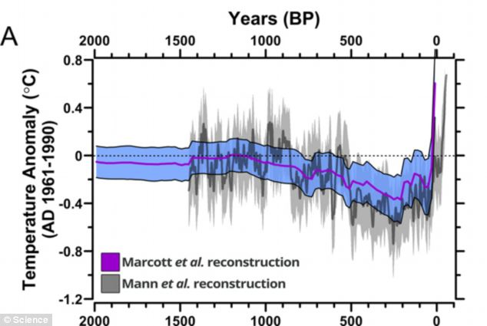
2013 paper in Science. Last 2000 years.
http://science.sciencemag.org/content/339/6124/1198.abstract

Slide 35
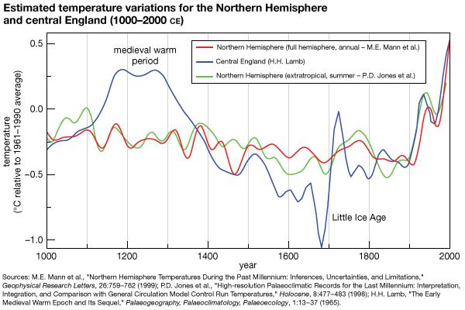
Note the difference between regional and global. Still only N hemisphere.

Slide 36
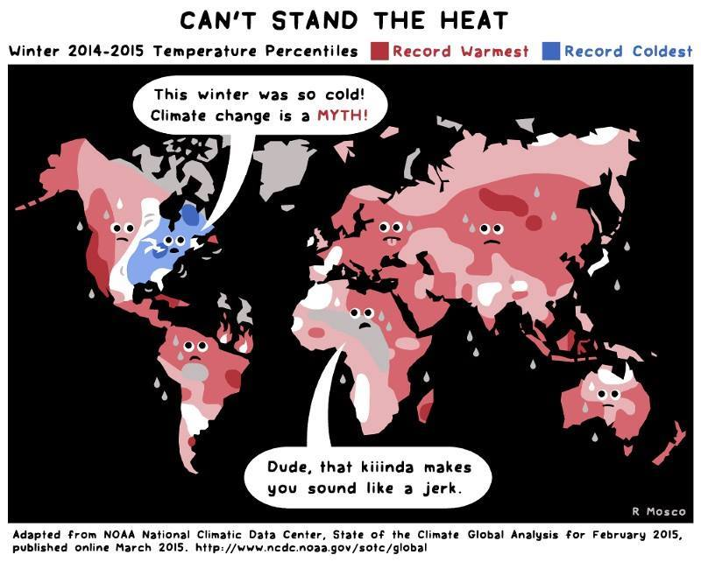

Slide 37
Why Is the Earth’s Climate Changing?
Primarily, it’s increasing CO2 in the atmosphere.
Also… Methane (CH4) and Nitrous Oxide (N2O)

Slide 38
What does this stuff do, though?
Insulation. Not to be confused with insolation.

Slide 39
The Natural Greenhouse Effect Plays a Key Role in Climate
Greenhouse gases absorb heat radiated by the earth
The gases then emit infrared radiation that warms the atmosphere
Without the natural greenhouse effect
We would have a cold, uninhabitable earth

Slide 40
Human Activities Play a Key Role in Atmospheric Warming
Since the Industrial Revolution (late 1700s)
CO₂, CH₄, and N₂O emissions have been higher
Main sources – agriculture, deforestation, and burning of fossil fuels
There is a correlation of rising CO₂ and CH₄ with rising global temperatures

Slide 42
http://www.wri.org/blog/2017/08/6-charts-understand-us-state-greenhouse-gas-emissions
http://www.fao.org/gleam/results/en/ - Protein and global warming. Good article, but only includes direct costs, not opportunities lost.

Slide 43
Which are the big energy absorbers? And how long do they last in the atmosphere?

Slide 44
Atmospheric Warming Potential
(over 100 years, as multiples of CO2 warming potential)
Nitrous oxide (N₂O)
300x
Methane (CH₄)
25x
Carbon dioxide (CO₂)
1x
Notes:
Figure 19.6 Atmospheric lifetimes and warming potentials for three major greenhouse gases.

Slide 45
Atmospheric lifetime
Nitrous oxide (N₂O)
114 yrs
Carbon dioxide (CO₂)
100 yrs (varies 50–200 yrs)
Methane (CH₄)
12 yrs
Notes:
Figure 19.6 Atmospheric lifetimes and warming potentials for three major greenhouse gases.

Slide 46
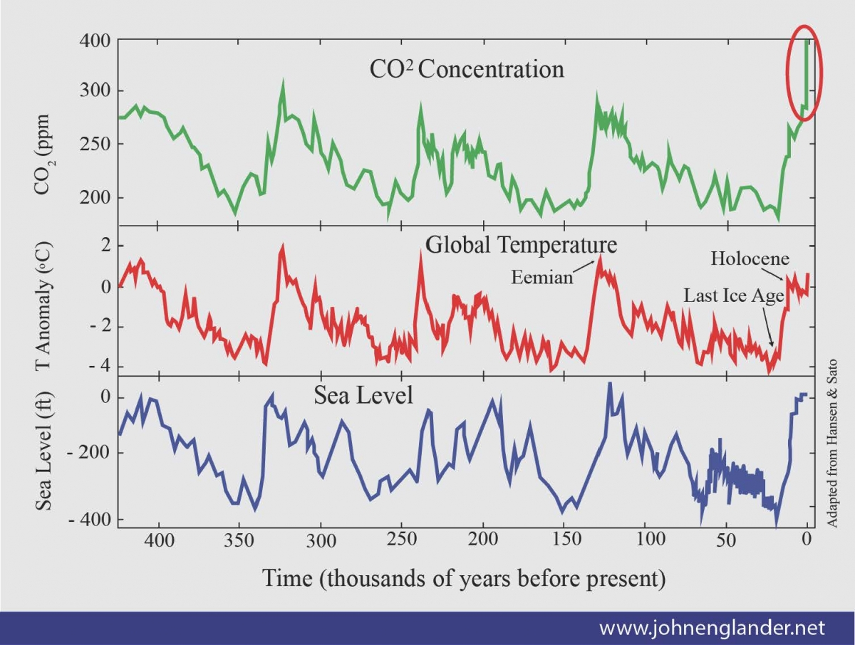
Notes:
Figure 19-7: Atmospheric levels of carbon dioxide (CO₂) and the global average temperature of the atmosphere near the earth’s surface have changed drastically over the past 400,000 years. These curves show a general correlation between these two sets of data but do not establish a direct relationship between them. Question: What are two conclusions that you can draw from these data?

Slide 47
Human Activities Play a Key Role in Atmospheric Warming (cont’d.)
Average atmospheric concentration of CO₂ rose from 280 ppm to 400 ppm since the beginning of the Industrial Revolution
70% of CH₄ emissions over the last 275 years results from human activities
2010 – U.S. and China accounted for 41% of the world’s greenhouse gas emissions
Human factors can amplify or dampen changes

Slide 48
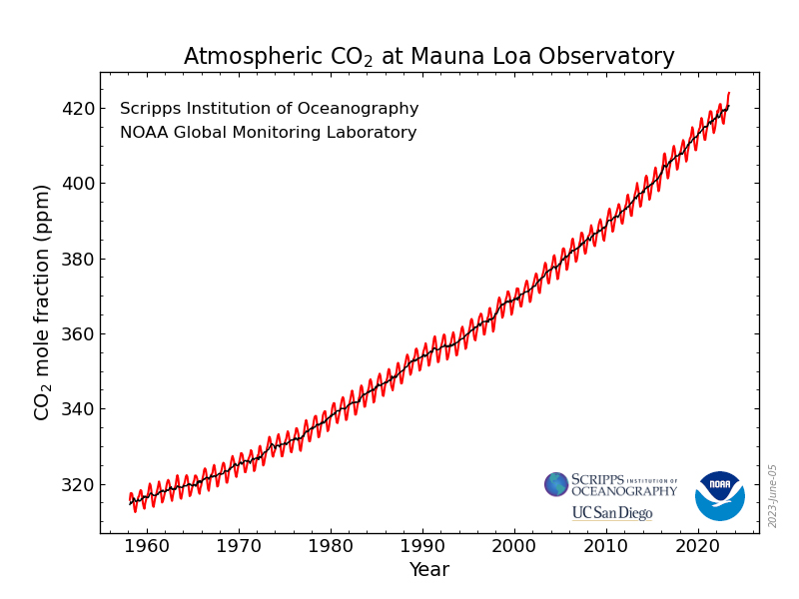
May 2023 424 ppm

Slide 49
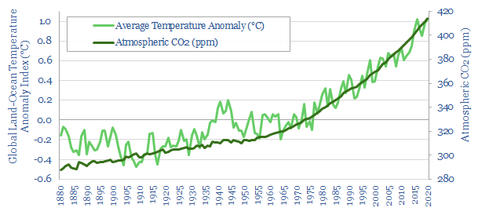
Notes:
Figure 19-8: Comparison of atmospheric concentrations of carbon dioxide (CO₂) and the atmosphere’s average temperature for the period 1880–2011. Temperature data show the fluctuating seasonal average temperatures (orange curve) as well as the mean, or average of these data (red curve). While the data show an apparent relationship between the mean temperature and CO₂ concentrations, they do not establish that these two variables are related.

Slide 50
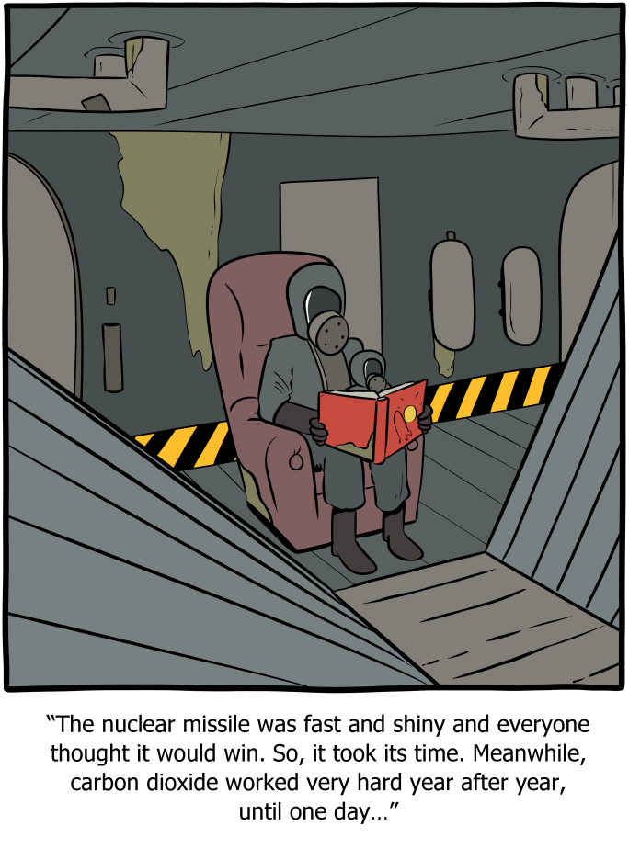

Slide 51
Other greenhouse forcers
Oceans (CO2 sink, slowing circulation, acidification)
Clouds
Pollution
Snow/ice/water
Ozone depletion
Permafrost

Slide 52
What Role Do the Oceans Play in Projected Climate Disruption?
CO₂ is soluble in ocean water – forms carbonic acid.
The warmer the water, the less soluble CO2 is.
Warmer oceans
Last century – ~1.3° C increase
Absorb less CO₂ and hasten atmospheric warming
CO₂ levels increase acidity – which decreases the ability for certain species to extract the carbon they need (foraminifera, corals, shellfish,phytoplankson, etc). Google coral reef die off and see the pics/stats).
Affect marine ecosystems: https://www.ipcc.ch/srocc/about/faq/final-faq-chapter-5/ https://www.conservation.org/blog/5-ways-that-climate-change-affects-the-ocean

Slide 53
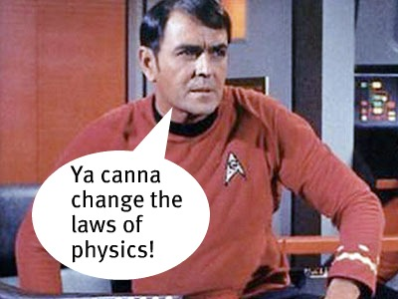

Slide 54
There Is Uncertainty about the Effects of Cloud Cover on Atmospheric Warming
Warmer temperatures create more clouds
Thick, low altitude cumulus clouds – decrease surface temperature
Thin, cirrus clouds at high altitudes – increase surface temperature

Slide 55
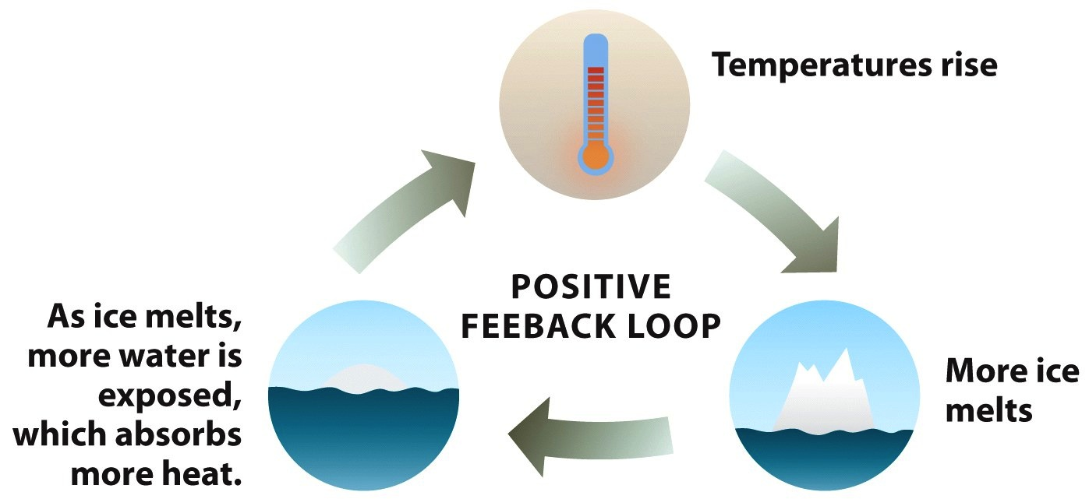
Snow/ice

Slide 56
Ozone?
The less ozone in the stratosphere, the more UV reaches the surface.
The more UV at the surface, the higher the temp
Not a big factor, and one that will, probably, be fixed over the next 30 years.

Slide 57
Permafrost Is Likely to Melt: Another Dangerous Scenario
What is permafrost?
If permafrost in Arctic region melts:
Methane, a greenhouse gas, will be released into the atmosphere
Accelerate projected warming
Methane in permafrost on Arctic Sea floor

Slide 58
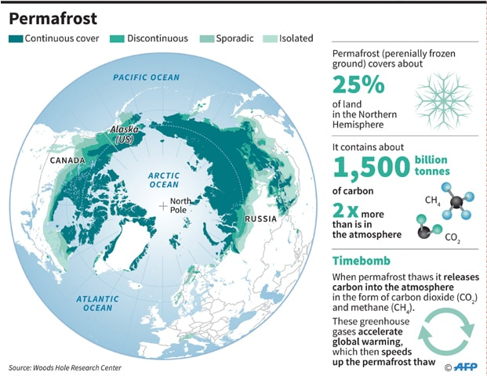
Notes:
Figure 19-13: Projected thaw of permafrost in the arctic tundra of eastern Russia between 2004 and 2100 as a result of atmospheric warming. Tall shrubs and trees
are likely to take over a growing area of the much warmer arctic tundra by the end of this century.

Slide 59
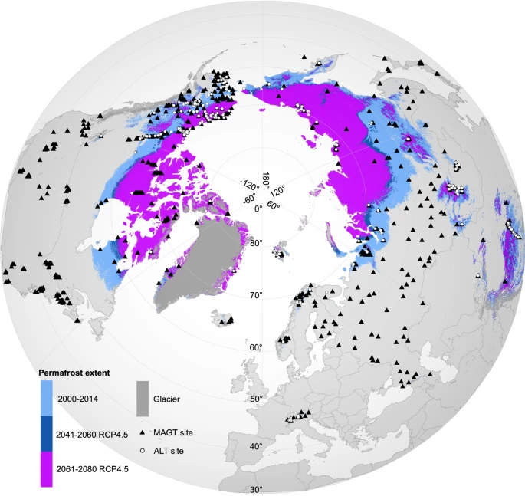
https://www.nature.com/articles/sdata201937

Slide 60
What does this warming mean?
According to the National Oceanic and Atmospheric Administration (NOAA):
-- the global land average temperature increased by 0.93°C (1.67°F) in July 2021, compared to the 20th-century average (which goes up every year)
-- sea surface temperatures have also increased, by as much as 5°F in some places.
Greater change toward poles!
Good, brief overview from Nature: https://www.nature.com/articles/d41586-021-02179-1

Slide 61
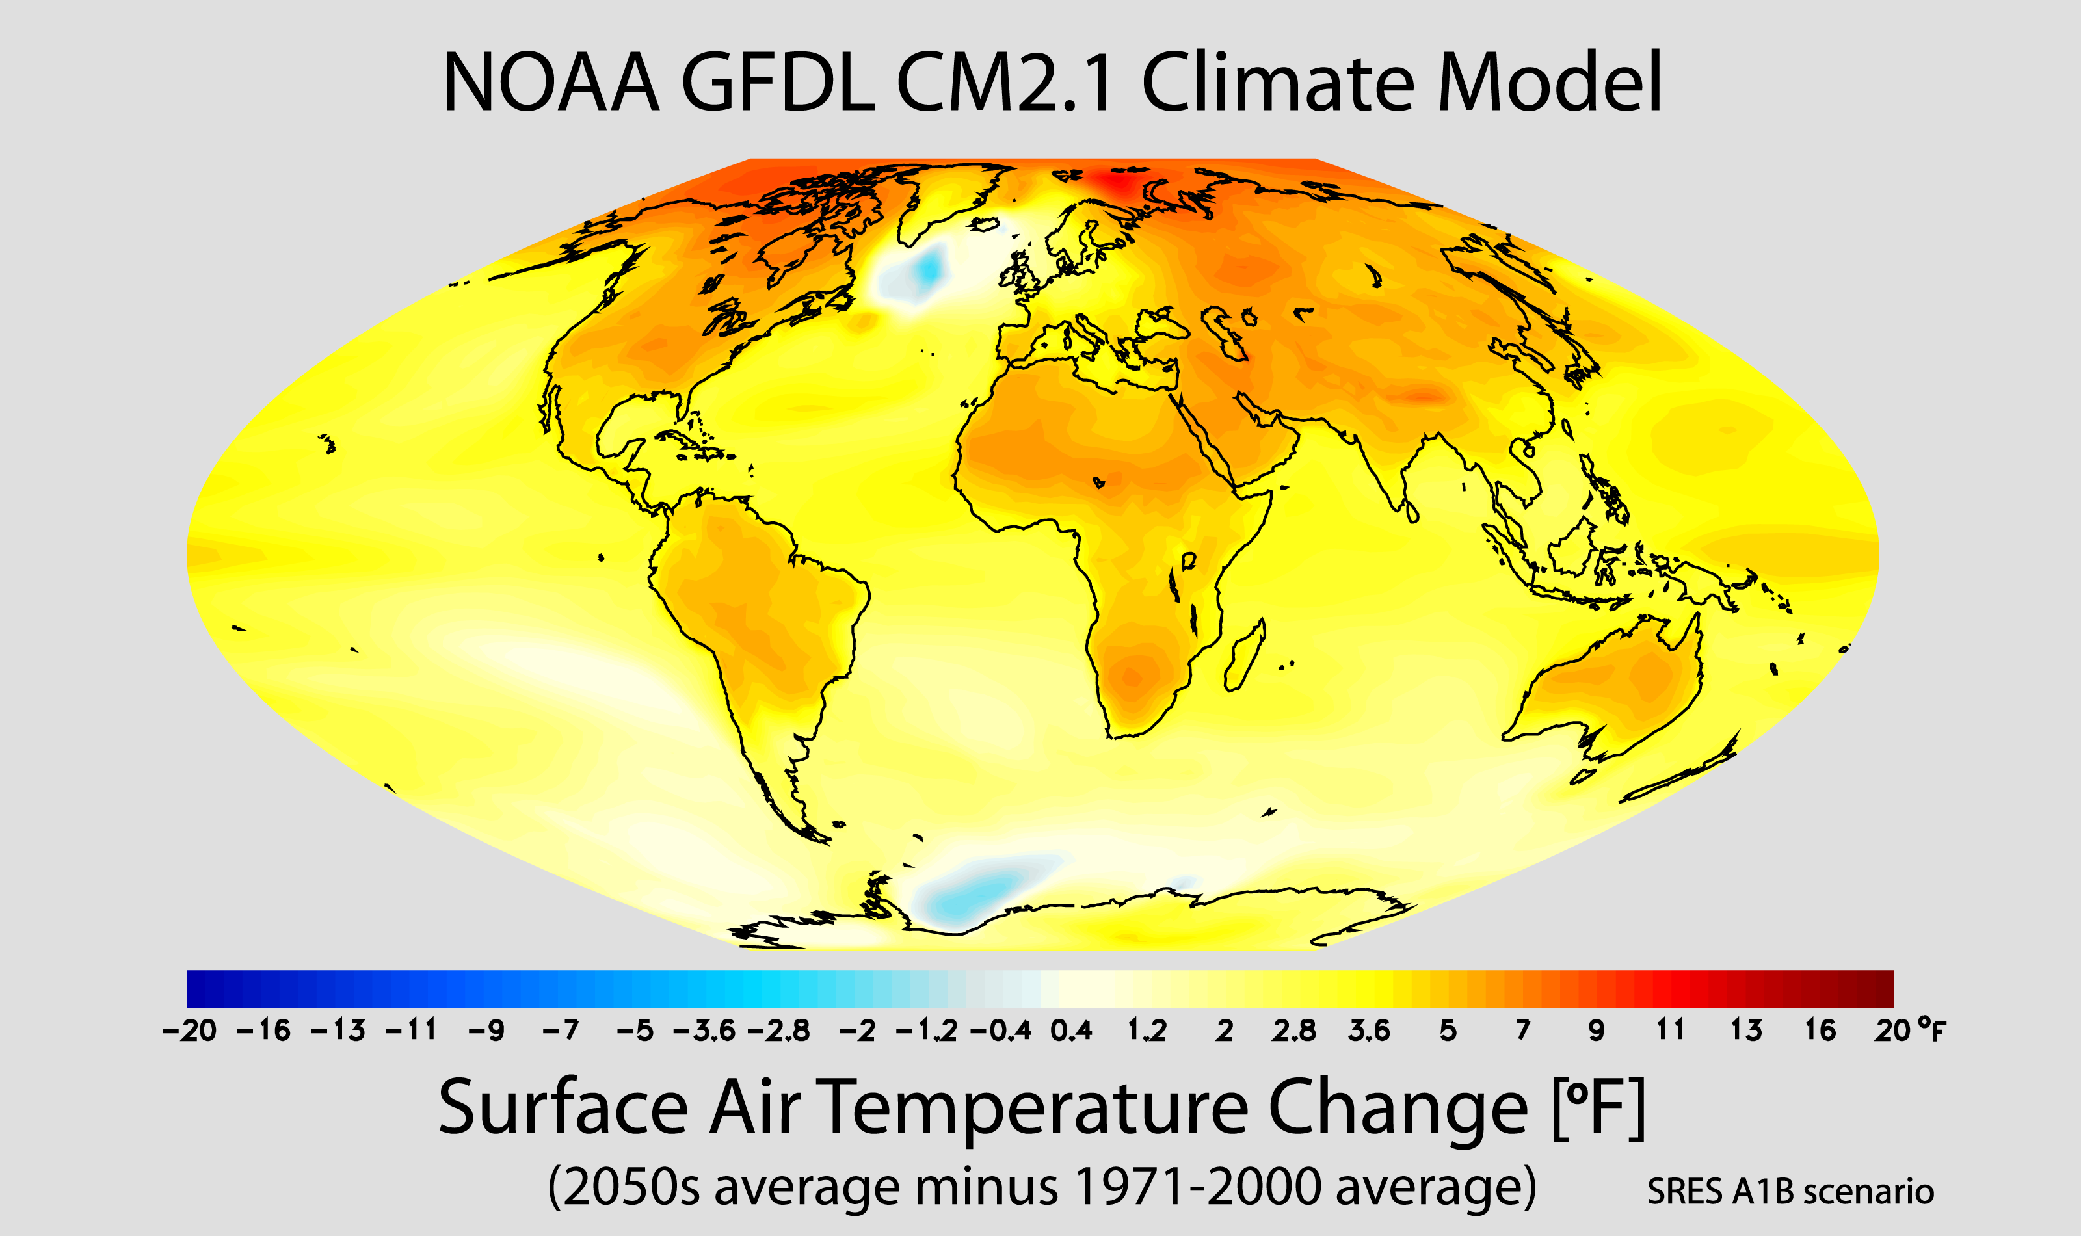

Slide 62
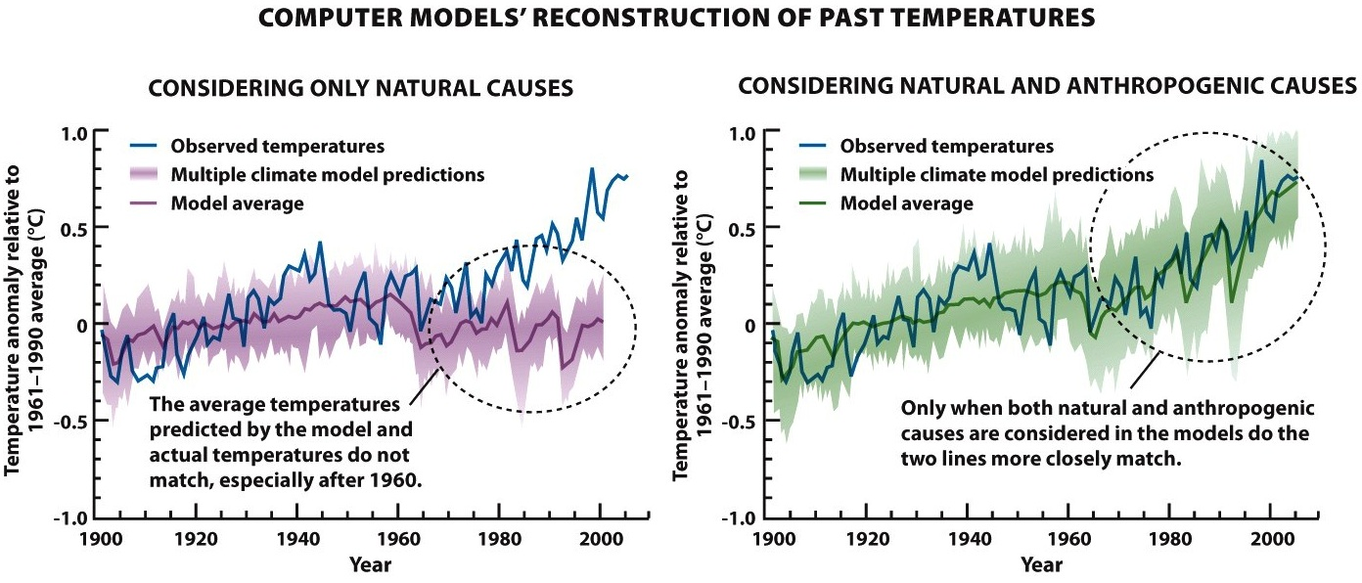
But how can we know that this is not part of a natural trend?

Slide 63
What Are the Possible Effects of a Warmer Atmosphere?
The projected rapid change in the atmosphere’s temperature could have severe and long-lasting consequences, including increased drought and flooding, rising sea levels, and shifts in the locations of croplands and wildlife habitats

Slide 64
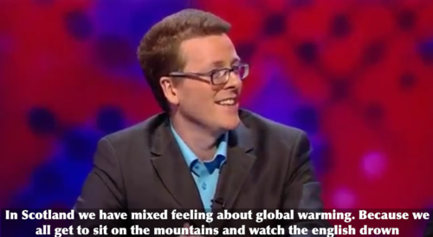

Slide 65
What do we see happening?
GLOBAL AVERAGE temperatures are increasing
CO2 (etc) concentrations are increasing
Sea level rise
Decreases in glaciers and sea ice
Acidification of oceans
Disruptions in ocean circulation
Increasing “severe” and/or variable weather
Diseases and stuff

Slide 66
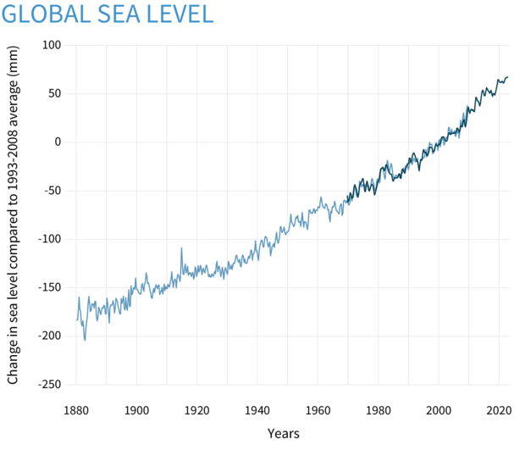
Sea Level Rise!

Slide 67
What’s it from?
Thermal expansion
Melting glaciers
Greenland (6m, 20ft)
Antarctica (60m, 200ft)

Slide 68
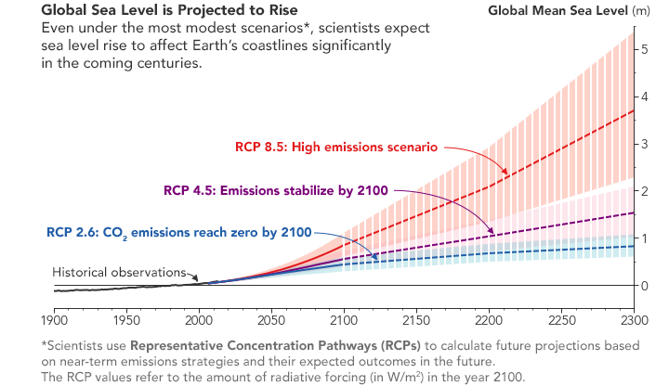
How much?

Slide 69
Melting Ice in Greenland
World’s largest island – 80% covered by glaciers
10% of the world’s fresh water
Glacial melting and movement accelerating
Effect on sea level if melting continues
1 meter rise by 2100

Slide 70
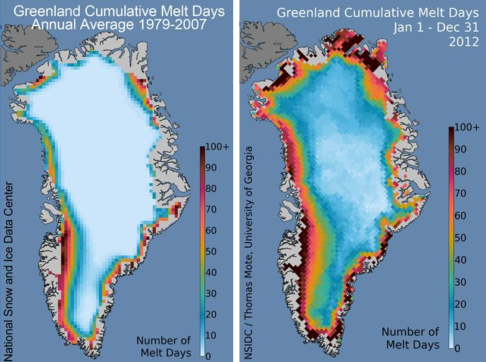

Slide 71
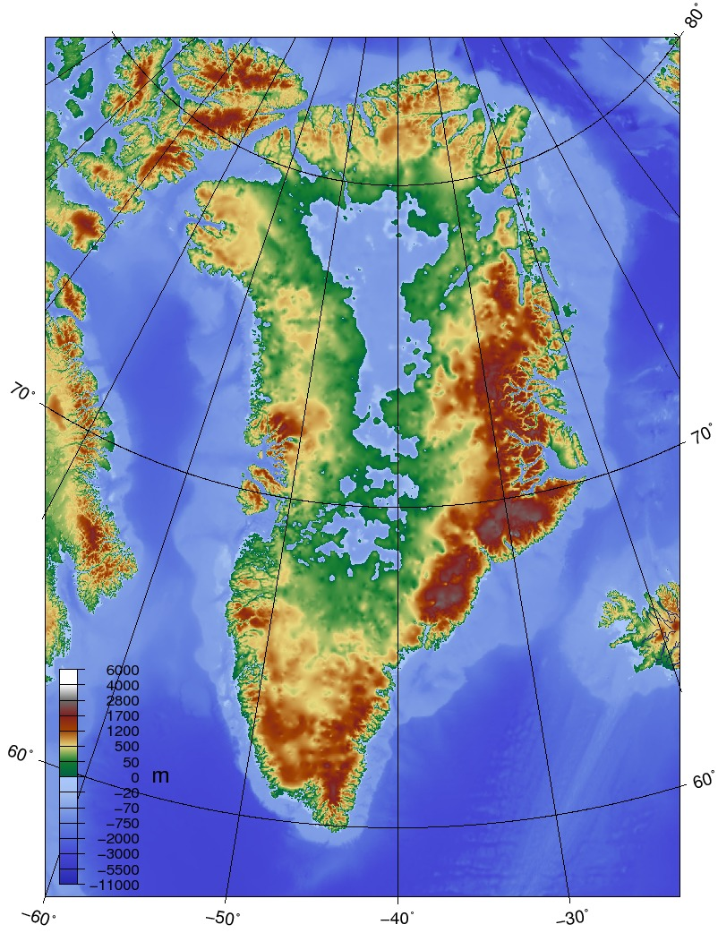
Greenland without ice
Ignores sea level rise, just removes ice.

Slide 72
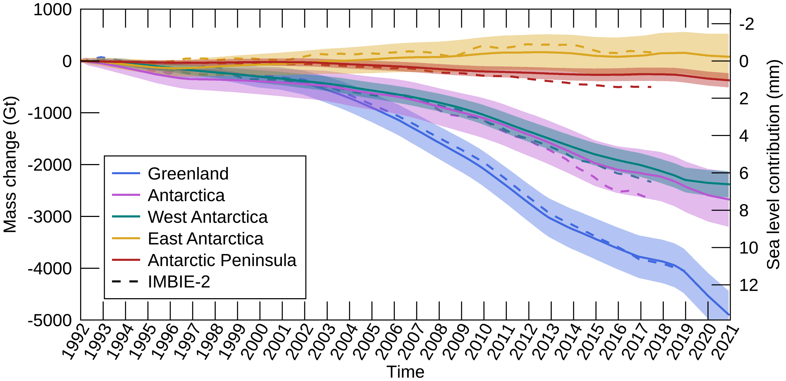

Slide 73
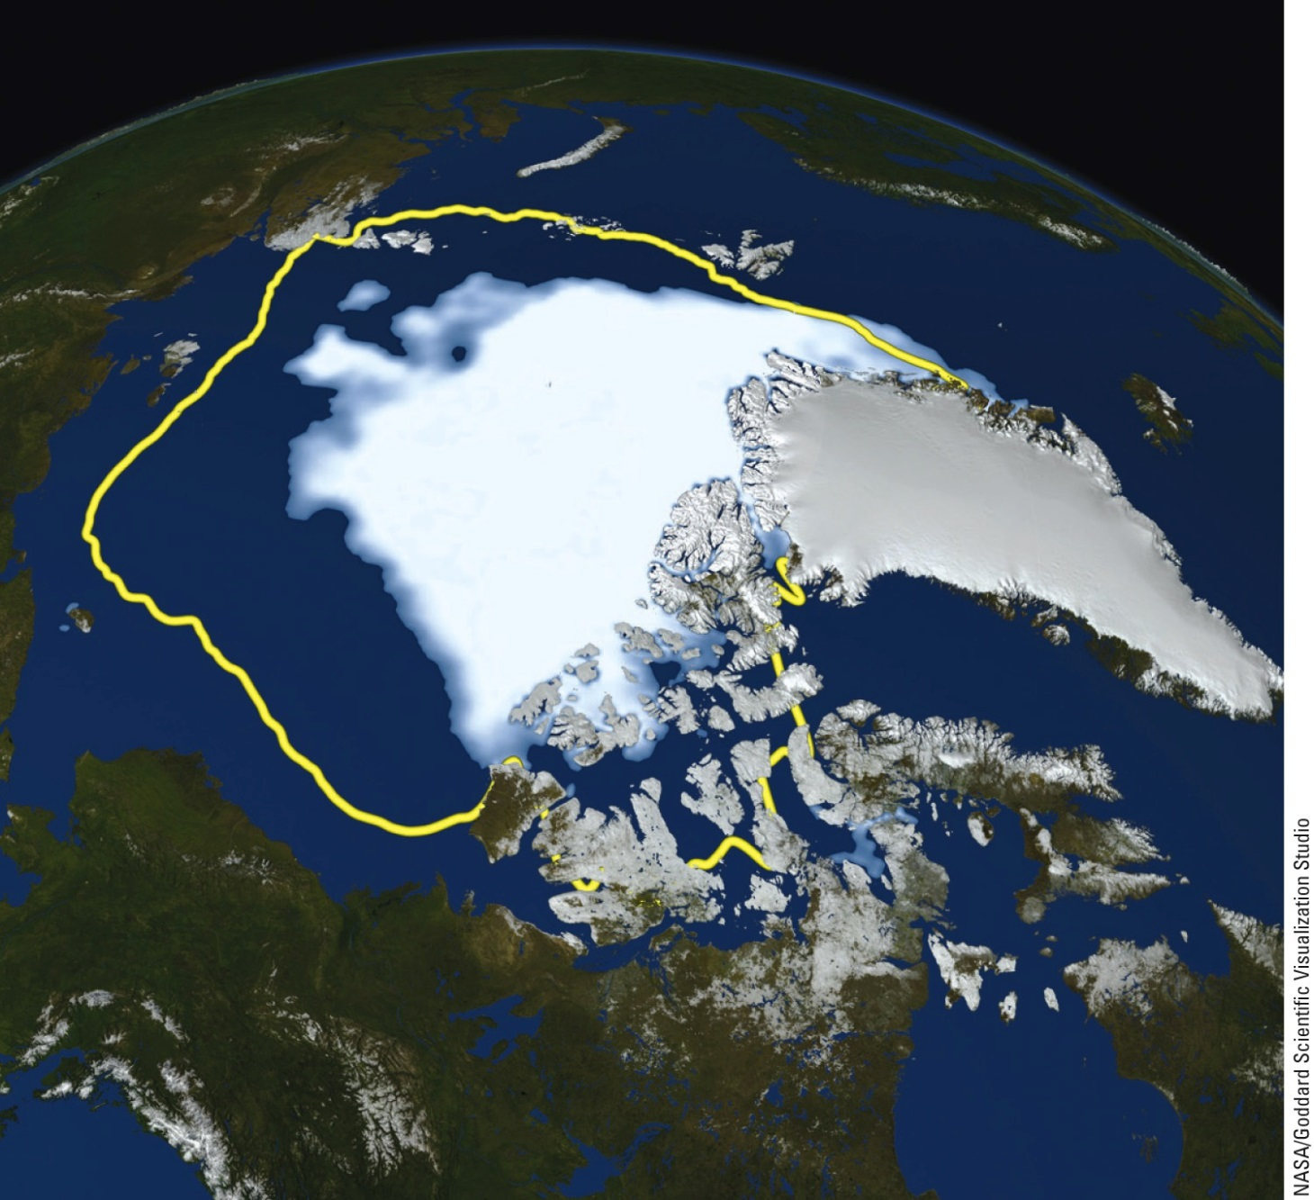
Average minimum ice cover, 1979–2010
Minimum ice cover, September 16, 2012
Notes:
Figure 19.11 The big melt: Rising average atmospheric and ocean temperatures have caused more and more arctic sea ice to melt during the summer months. The yellow line added to this satellite image (left) shows the average summer minimum area of ice during the period 1979–2010, in contrast to the white, ice-covered summer minimum in 2012. The graphs (right) show that the sea ice melt has been accelerating. Question: Which is declining faster, the summer sea ice area, or the summer sea ice volume?

Slide 74
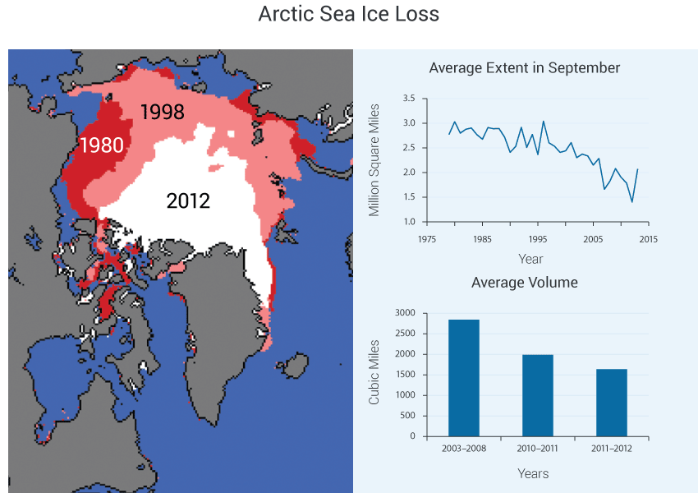

Slide 76
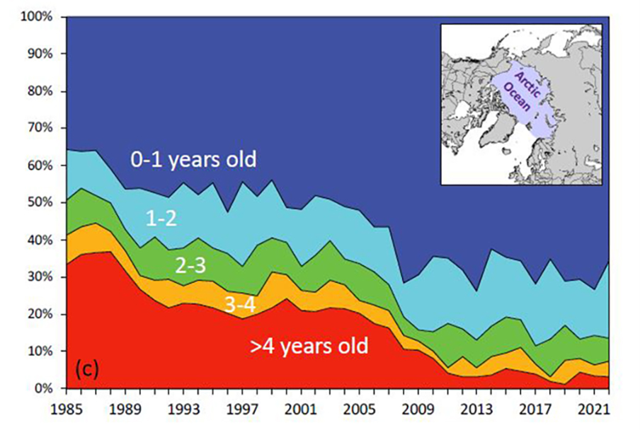

Slide 77
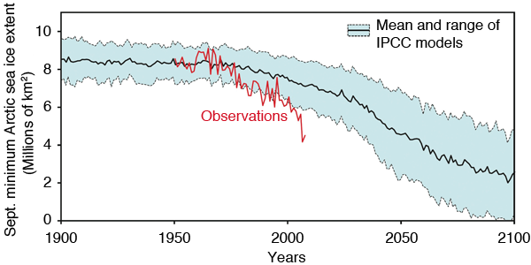
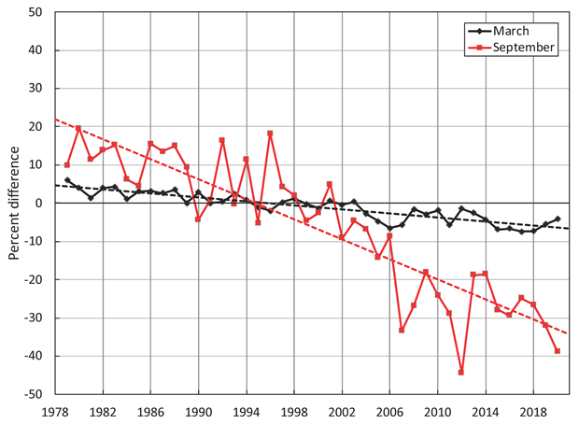
Notes:
Figure 19.11 The big melt: Rising average atmospheric and ocean temperatures have caused more and more arctic sea ice to melt during the summer months. The yellow line added to this satellite image (left) shows the average summer minimum area of ice during the period 1979–2010, in contrast to the white, ice-covered summer minimum in 2012. The graphs (right) show that the sea ice melt has been accelerating. Question: Which is declining faster, the summer sea ice area, or the summer sea ice volume?

Slide 78
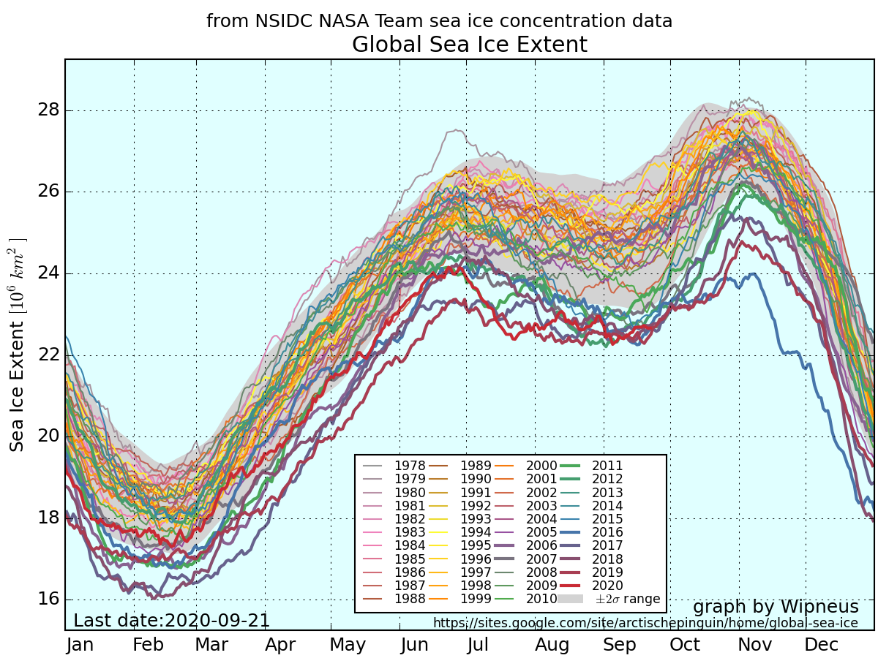

Slide 79
Sea Levels Are Rising
Projected sea level rise
0.5 to 1.5 meters by 2100 (which assumes no major melting of the ice caps)
Projected irreversible effect
Degradation and loss of 1/3 of coastal estuaries, wetlands, and coral reefs
Disruption of coastal fisheries
Flooding of:
Low-lying barrier islands and coastal areas
Agricultural lowlands and deltas

Slide 80
Sea Levels Are Rising (cont’d.)
Projected irreversible effect (cont’d.)
Contamination of freshwater aquifers
Submergence of low-lying islands in the Pacific and Indian Oceans and the Caribbean
Flooding of coastal cities

Slide 81
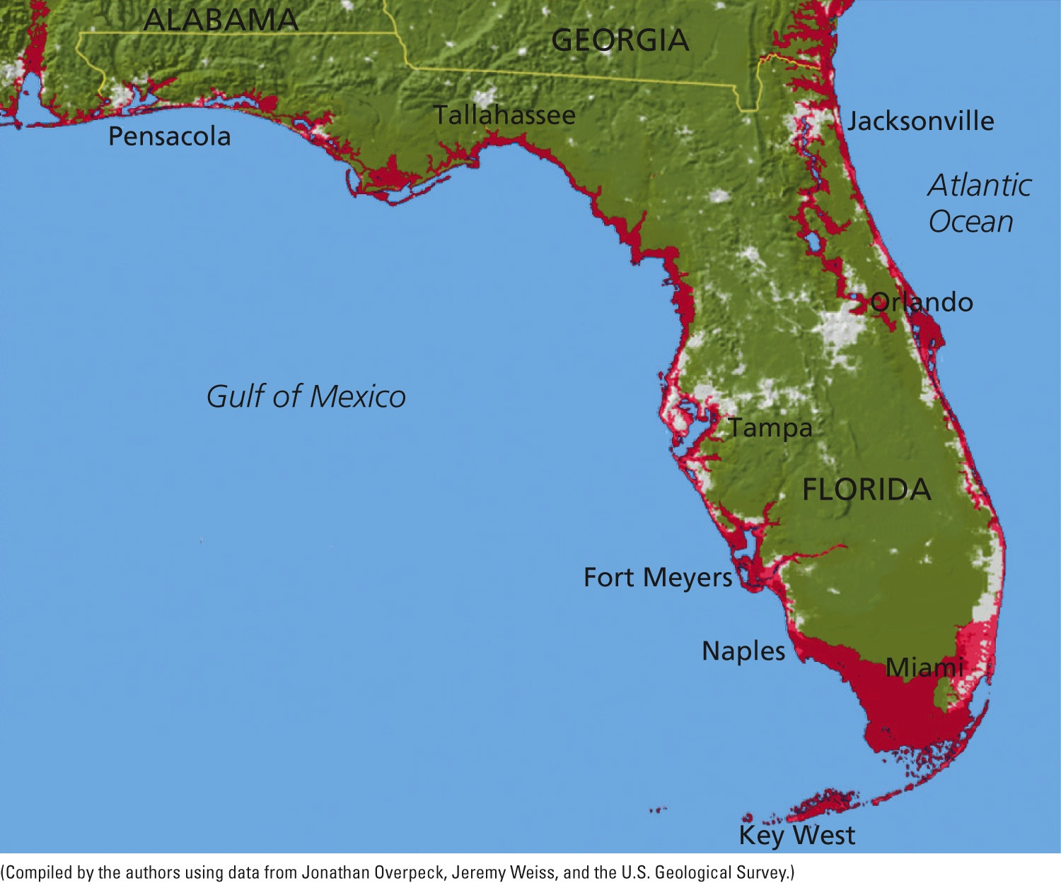
1m rise
Fig. 19-14, p. 520
Notes:
Figure 19-14: If the average sea level rises by 1 meter (3.3 feet), the areas shown here in red in the U.S. state of Florida will be flooded.

Slide 82
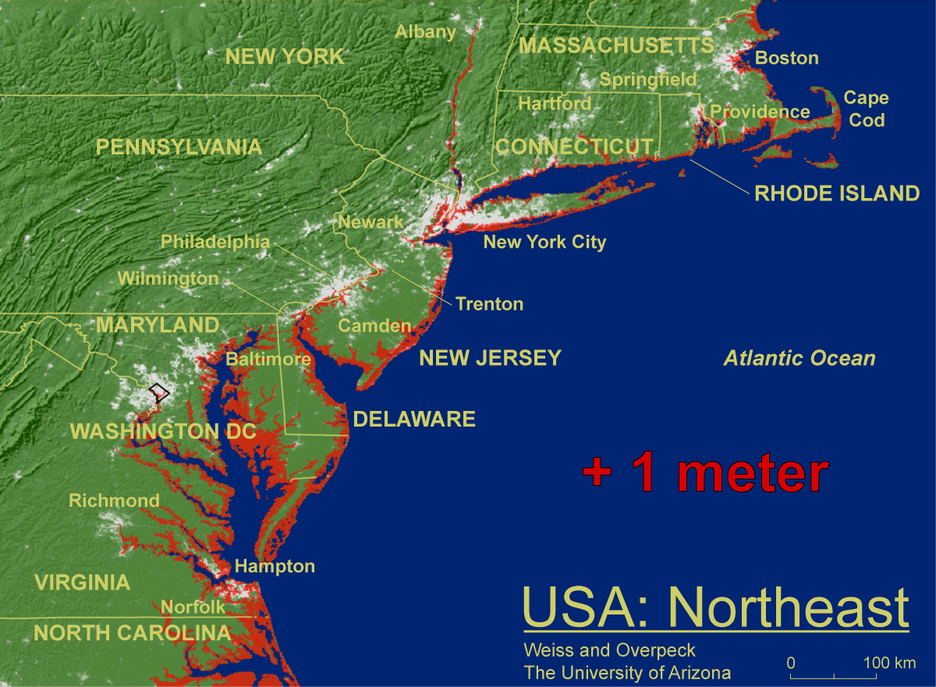

Slide 83
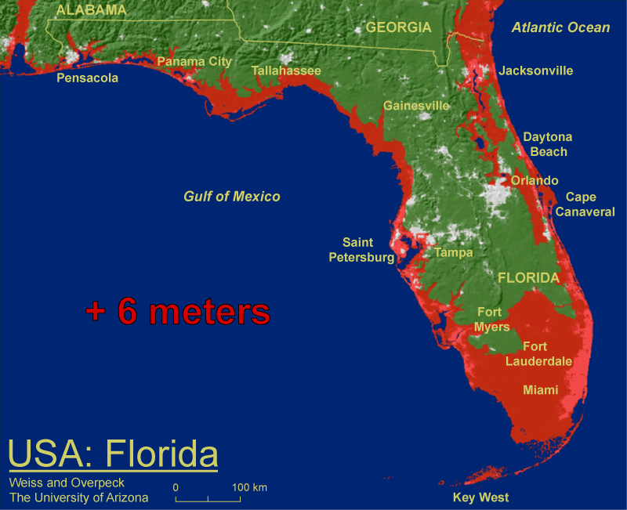

Slide 84
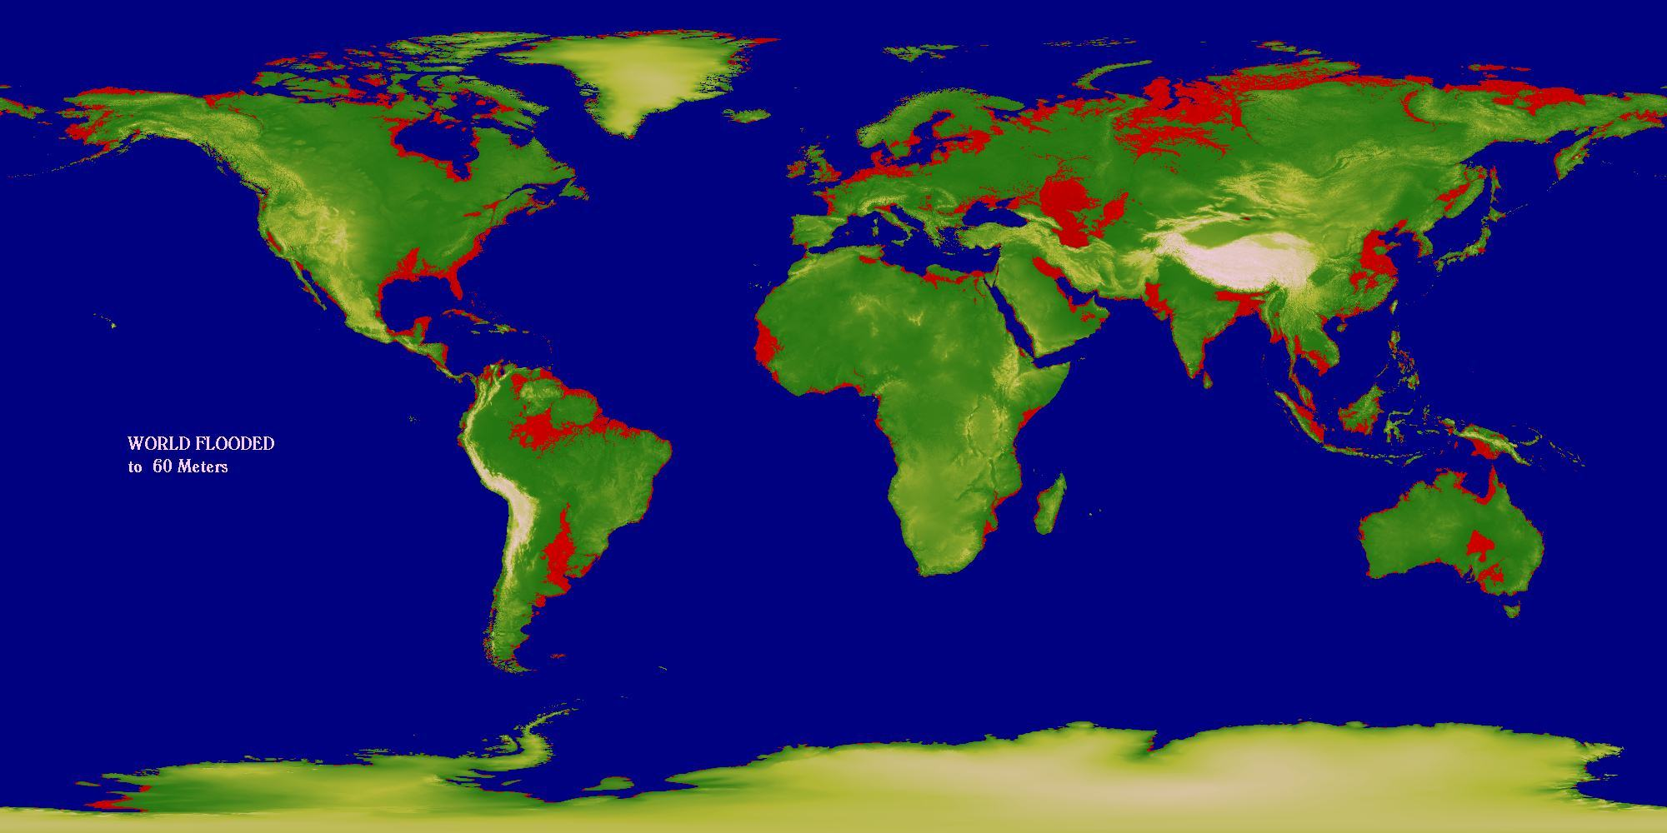

Slide 85
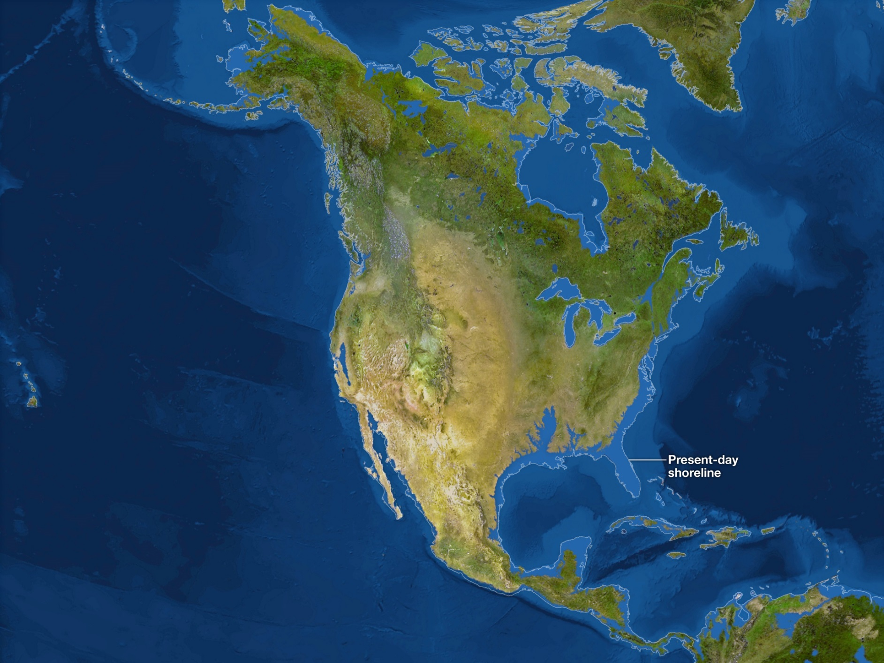
216 feet – all ice melted. 65m or so

Slide 86
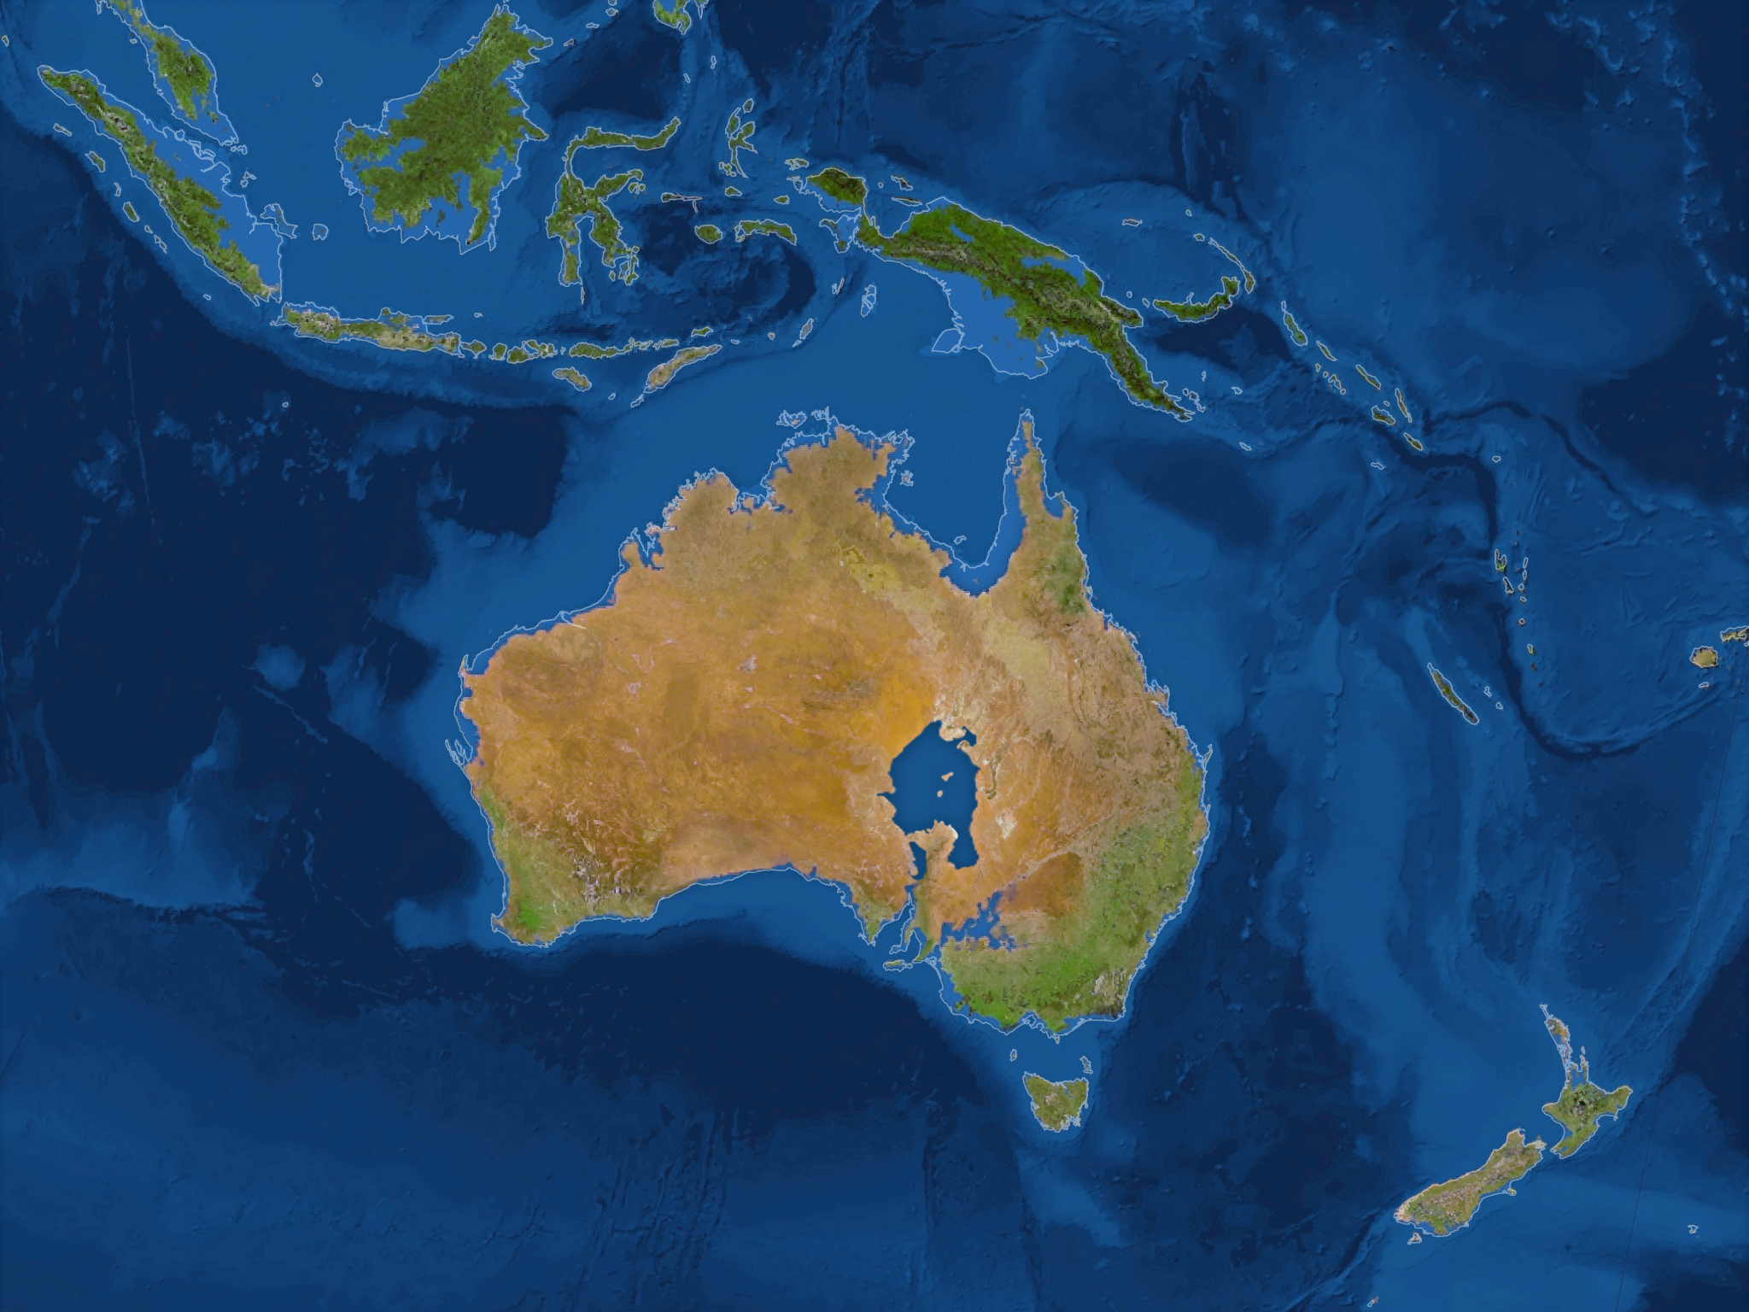

Slide 87
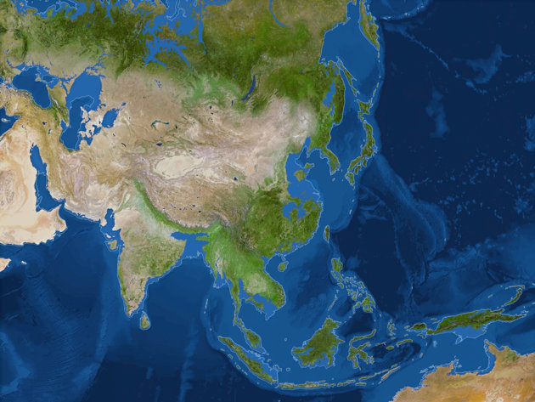

Slide 88
Rapid Atmospheric Warming Could Have Serious Consequences
Temperatures rising rapidly
Harmful effects will be unevenly distributed
Climate change tipping points
Thresholds beyond which natural systems will not recover
CO₂ concentration above 450ppm
Global average atmospheric temperature

Slide 89
Severe Drought Is Likely to Become More Common
Positive feedback loop
Water vapor warms the atmosphere, creating more evaporation
Increased wildfires
Declining surface water, lower water tables
Dry climate ecosystems will increase

Slide 90
Other Forms of Extreme Weather Will Be More Likely
Heat waves and droughts in some areas
Could kill large numbers of people
Prolonged rains and flooding in other areas
Will storms get worse?

Slide 92
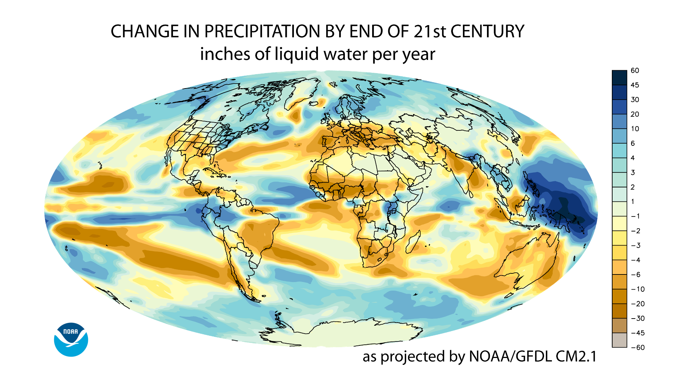

Slide 94
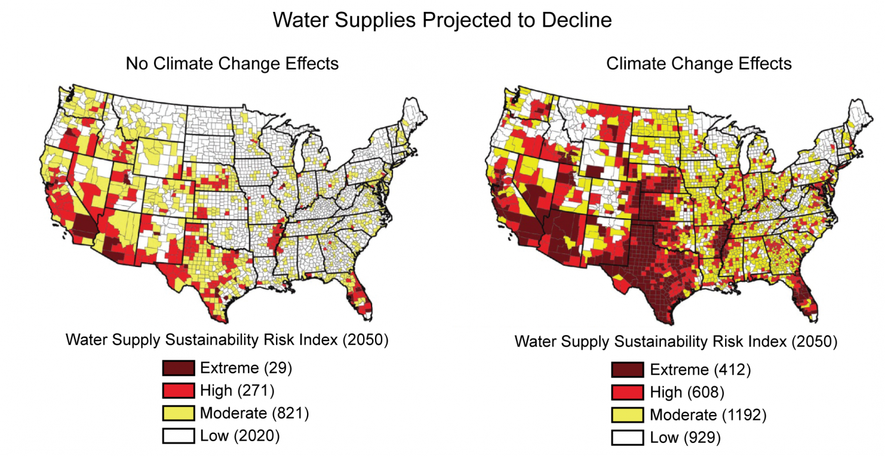

Slide 95
Climate Disruption Is a Threat to Biodiversity
Amazon rainforest
Up to 85% could be lost due to warming
Extinctions due to loss of habitat
Southern Ocean
Phytoplankton declined up to 90%
Shrinkage of sea ice
Increase damaging insects
Mountain pine beetle, etc.

Slide 96
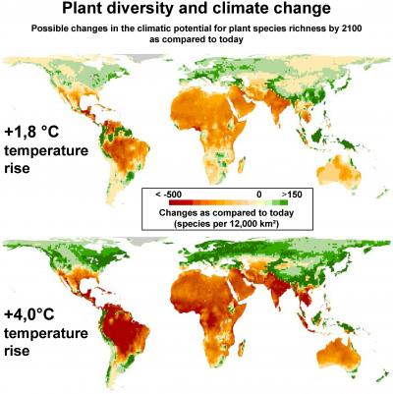

Slide 97
Food Production Could Face an Overall Decline
Regions of farming may (WILL!) shift
Decrease in tropical and subtropical areas
Increase in northern latitudes
Less productivity – soil not as fertile
Hundreds of millions of people could face starvation and malnutrition
Results of this?
US military has said global warming is their #1 threat. #1. Repeat, #1.

Slide 98
https://www.economist.com/graphic-detail/2022/11/10/climate-change-will-force-farmers-to-reshuffle-what-is-grown-where

Slide 99
Climate Disruption Threatens Human Health and Economies
Warmer world would likely favor things that make us sick
Projected disruption will likely force many to move in search of better conditions

Slide 100
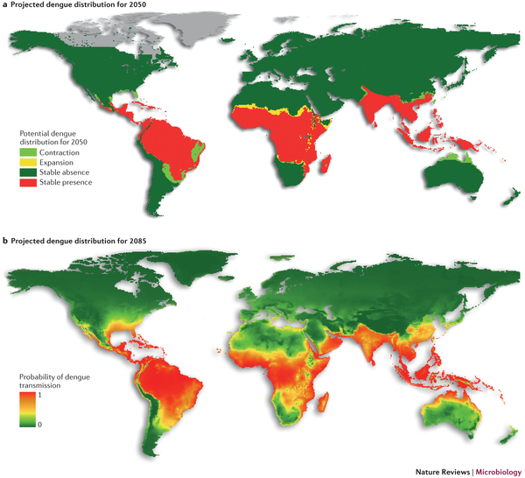

Slide 102
What Can We Do to Slow Projected Climate Disruption?
We can reduce greenhouse gas emissions and the threat of climate disruption while saving money and improving human health if we cut energy waste and rely more on cleaner renewable energy resources

Slide 103
Dealing with Climate Disruption Is Difficult
Global problem
Requires unprecedented and prolonged international cooperation
Long-lasting political issue
People respond better to short-term problems
Projected harmful and beneficial impacts of climate change are not spread evenly
It will be expensive, especially for direct costs. Most benefits for dealing with it are secondary

Slide 104
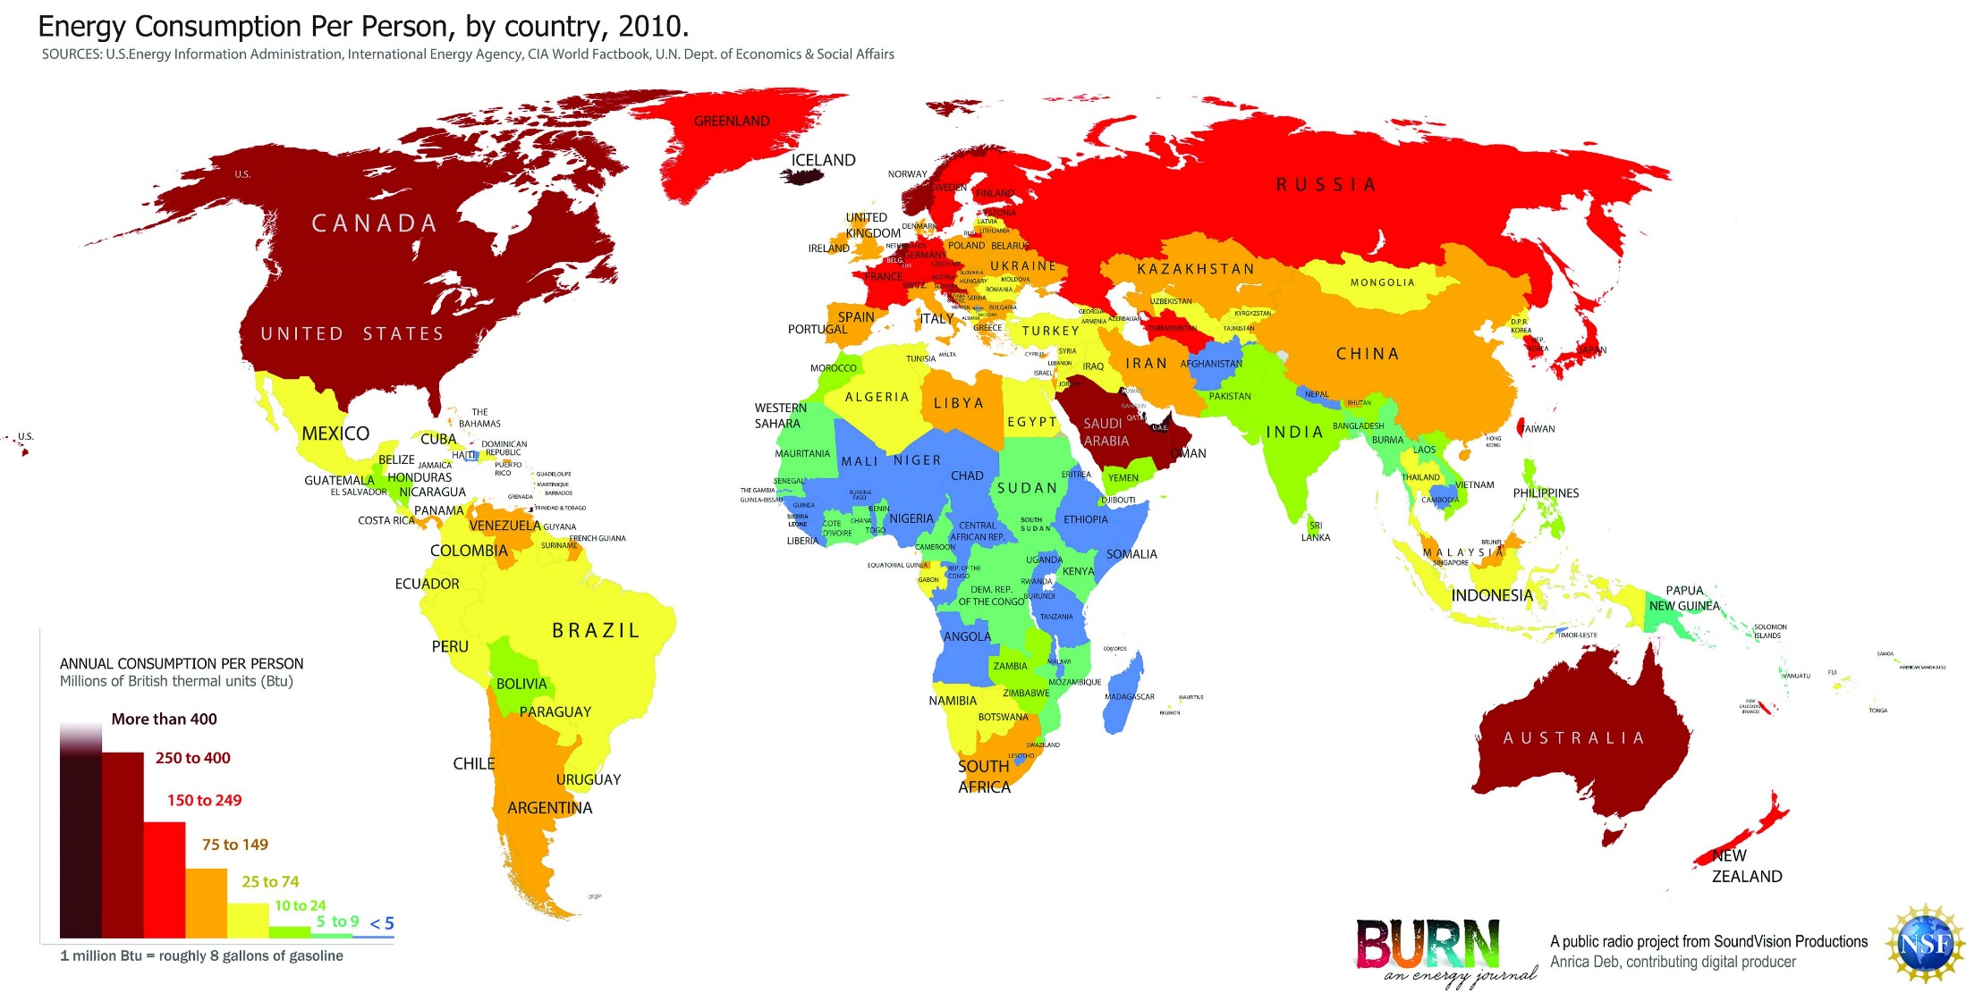

Slide 105
We Could Control and Prevent Greenhouse Gas Emissions
Solutions:
Improve energy efficiency to reduce fossil fuel use
Increased use of low-carbon renewable energy resources
Stop cutting down tropical forests. Really, any forests.
Shift to more sustainable and climate-friendly agriculture
Also reduce other greenhouse gases

Slide 106
We Could Try to Clean Up Greenhouse Gas Emissions
Solutions
Massive global tree planting (https://teamtrees.org/ )
Restore wetlands that have been drained for farming
Plant fast-growing perennials on degraded land
Preserve and restore natural forests
Capture/store carbon from coal-burning plants

Slide 107
Some Promote Geoengineering Schemes to Ward Off Climate Change
Geoengineering as last resort, if other methods and policies fail
Injection of sulfate particles into the stratosphere
Seed oceans with iron
Suck CO2 directly out of the air and sequester it deep in the crust
https://www.theguardian.com/environment/2021/sep/09/worlds-biggest-plant-to-turn-carbon-dioxide-into-rock-opens-in-iceland-orca
Problems:
Political and ethical

Slide 108
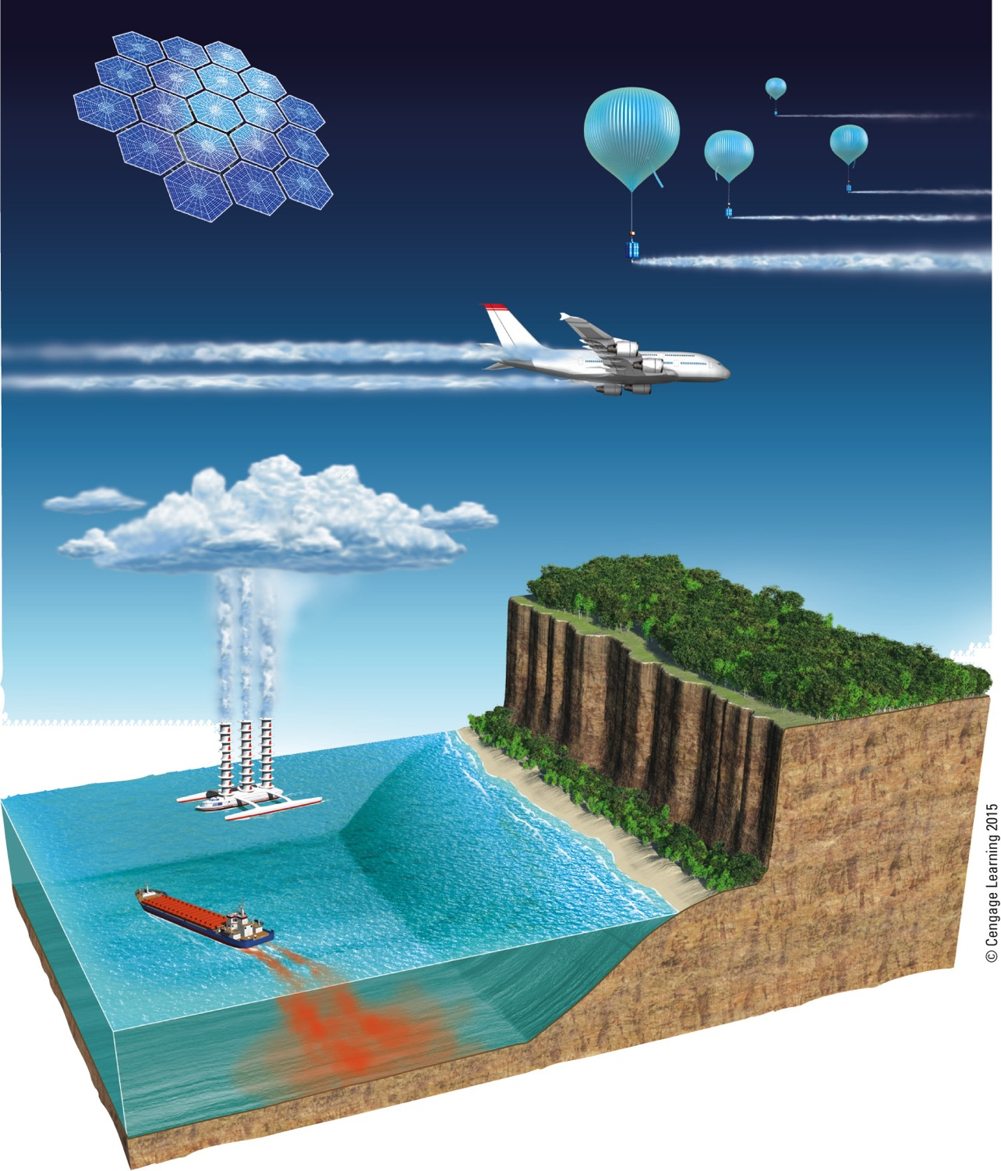
Orbiting Satellite Space Shield
Stratospheric Reflective Aerosol Dispersal Using High-altitude Balloons
Stratospheric Reflective Aerosol Dispersal Using Jet Aircraft
Genetically Modified
Trees Absorb More Carbon
Cloud Brightening with Seawater
Iron Fertilization Promotes Carbon-Absorbing Marine Organisms
Fig. 19-23, p. 529
Notes:
Figure 19-23: Geoengineering schemes include ways to reflect more sunlight, and some carbon sequestration approaches (Figure 19-D) can also be thought of as geoengineering. Questions: Of the approaches shown here, which three do you think are the most workable? Why?

Slide 109
Greenhouse Gases Can Be Regulated as Pollutants
CO₂ is classified as a pollutant
Concentration in the atmosphere
2009 – the EPA classified several greenhouse gases as a danger to public health
Fossil fuel companies are against

Slide 110
We Can Put a Price on Carbon Emissions
Carbon or energy taxes
Cap on total human-generated CO₂ and CH₄
Cap-and-trade

Slide 111
Trade-Offs
Carbon and Energy Taxes
Advantages
Disadvantages
Simple to administer
Tax laws can get complex
Clear price on carbon
Vulnerable to loopholes
Covers all emitters
Doesn’t guarantee lower emissions
Predictable revenues
Politically unpopular
Fig. 19-24, p. 532
Notes:
Figure 19-24: Using carbon and energy taxes or fees to help reduce greenhouse gas emissions has advantages and disadvantages. Question: Which two advantages and which two disadvantages do you think are the most important and why?

Slide 112
Trade-Offs
Cap and Trade Policies
Advantages
Disadvantages
Clear legal limit on emissions
Revenues not predictable
Rewards cuts in emissions
Vulnerable to cheating
Rich polluters can keep polluting
Record of success
Low expense for consumers
Puts variable price on carbon
Fig. 19-25, p. 533
Notes:
Figure 19-25: Using a cap-and-trade policy to help reduce greenhouse gas emissions has advantages and disadvantages. Question: Which two advantages and which two disadvantages do you think are the most important and why?

Slide 113
Government Subsidies Can Be Used to Address Climate Disruption
Subsidies
To encourage energy-efficient technologies, etc.
Phase out subsidies on fossil fuels
Government funding of research and development
Switch to clean industries

Slide 114
Governments Can Cooperate Internationally
The Kyoto Protocol
1997 – treaty to slow climate change
Not signed by the U.S.
Technology transfer
Helping poor countries
Protection of large forests
Paris Agreement: http://unfccc.int/paris_agreement/items/9485.php
Obama was in. Trump backed us out. Biden brought us back.
Net result here, just about zero.

Slide 115
Some Countries, States, and Localities Are Leading the Way
Costa Rica – goal to be carbon neutral by 2030. Ditto Sweden: http://www.iflscience.com/environment/sweden-combats-climate-change-aiming-be-fossil-fuel-free-nation . And Hawaii
China, the US, and India must change energy habits.
U.S. cities and states taking initiatives to reduce carbon emissions
California
Portland

Slide 116
Some Companies Are Reducing Their Carbon Footprints
Major global companies are reducing greenhouse gas emissions
Alcoa, DuPont, IBM, Toyota, GE, Wal-Mart
Profit opportunity – and only if there is a clear profit opportunity. Much are simply doing it to reduce energy costs.

Slide 117
Colleges and Universities Are Going Green
Reducing greenhouse gas emissions
Arizona State University
Solar panels
College of the Atlantic
Carbon neutral since 2007
EARTH University, Costa Rica
Promotes sustainable development in tropical countries
CWU?
LEED buildings
Solar on the new tech building
???

Slide 118
Every Individual Choice Makes a Difference
Carbon footprint: Carbon generated directly or indirectly by a person or group. Major decisions include
Diet
transportation
Nonfood purchases
voting

Slide 119
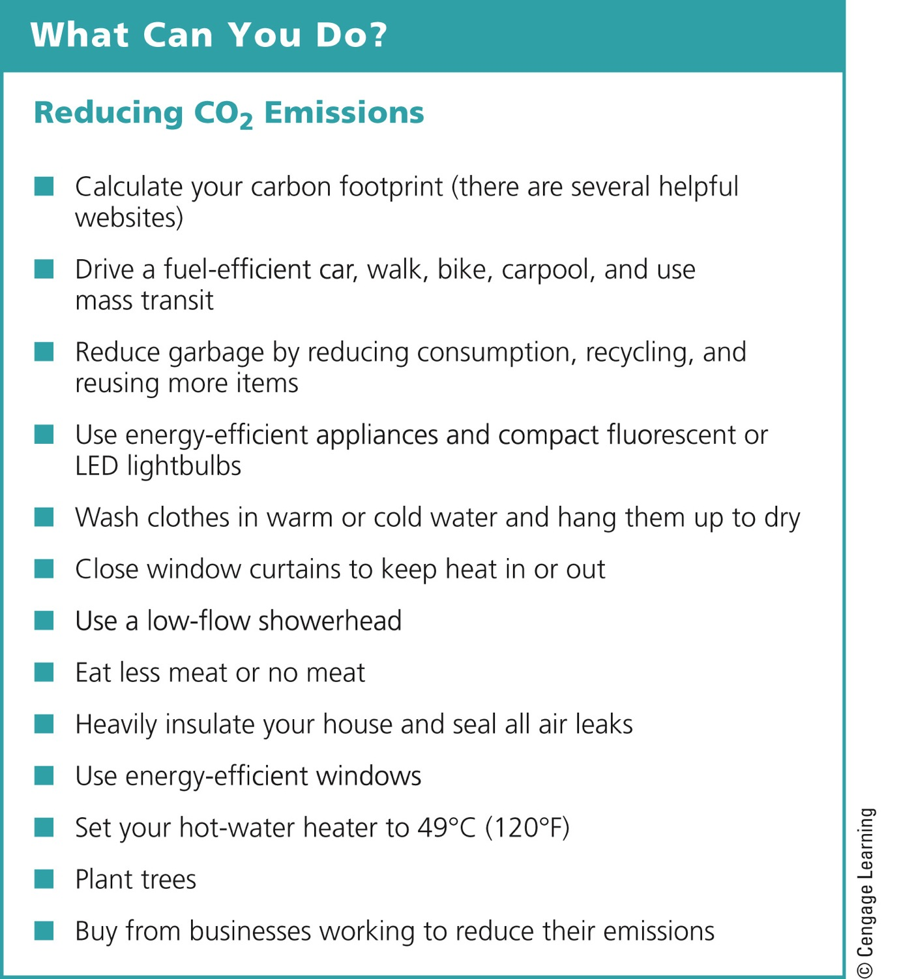
Notes:
Figure 19-28: Individuals matter: You can reduce your annual emissions of CO₂. Question: Which of these steps, if any, do you take now or plan to take in the future?

Slide 120
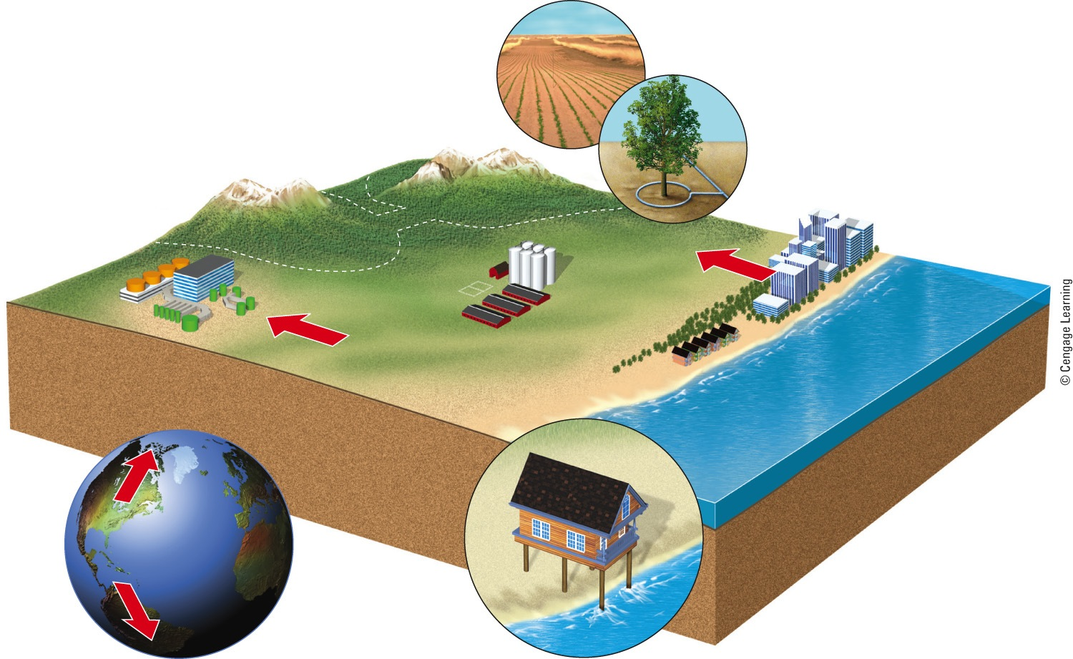
We Can Prepare for Climate Disruption
Develop crops that need less water
Waste less water
Connect wildlife reserves with corridors
Move people away from low-lying coastal areas
Move hazardous material storage tanks away from coast
Stockpile 1- to 5-year supply of key foods
Prohibit new construction on low-lying coastal areas or build houses on stilts
Expand existing wildlife reserves toward poles

Slide 121
A No-Regrets Strategy
What if climate models are wrong and there is no serious threat of climate disruption?
No-regrets strategy
Any actions against climate disruption will lead to important benefits

Slide 122
1/23/19 news
https://www.abc.net.au/news/2019-01-23/mass-brumby-death-discovered-in-remote-central-australia/10739178
https://www.newsweek.com/sarah-sanders-dismisses-ocasio-cortez-climate-warning-well-leave-it-much-much-1301197

Slide 123
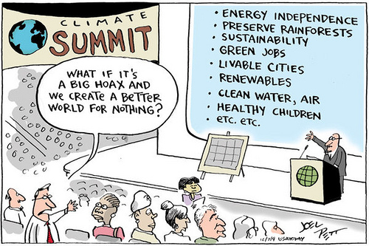

Slide 126
https://www.youtube.com/watch?v=o4oMsfa_30Q 44 minute lecture about climate change by one of the dudes that, literally, wrote the book on climate change (the UN report). Fascinating look at ice sheets and a warming climate
http://coralreefwatch.noaa.gov/satellite/bleachingoutlook_cfs/outlook_cfs.php
https://www.technologyreview.com/s/612780/lets-keep-the-green-new-deal-grounded-in-science/
https://www.bloomberg.com/news/articles/2019-01-23/pentagon-fears-confirmed-climate-change-leads-to-war-refugees and then follow the breadcrumbs to the actual literature.
https://arstechnica.com/tech-policy/2019/04/yet-another-state-washington-this-time-passed-100-clean-energy-legislation/
https://www.nytimes.com/2019/04/15/climate/climate-migration-duluth.html

Slide 127
Recap
http://climate.nasa.gov/evidence/ Awesome overview!
Vote
Vote
Vote
Vote
Vote
Vote
Vote
Vote

