Slide 1
Acid rain

Slide 2
Primarily
Sulfur oxides (and nitrogen oxides) combine with water to form sulfuric and nitric acids in the atmosphere
Know the formula (put on whiteboard)

Slide 3
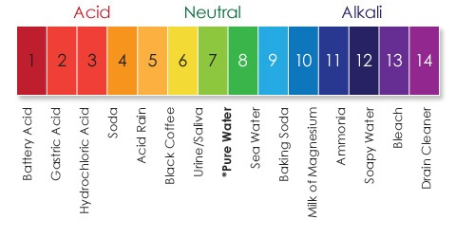

Slide 4
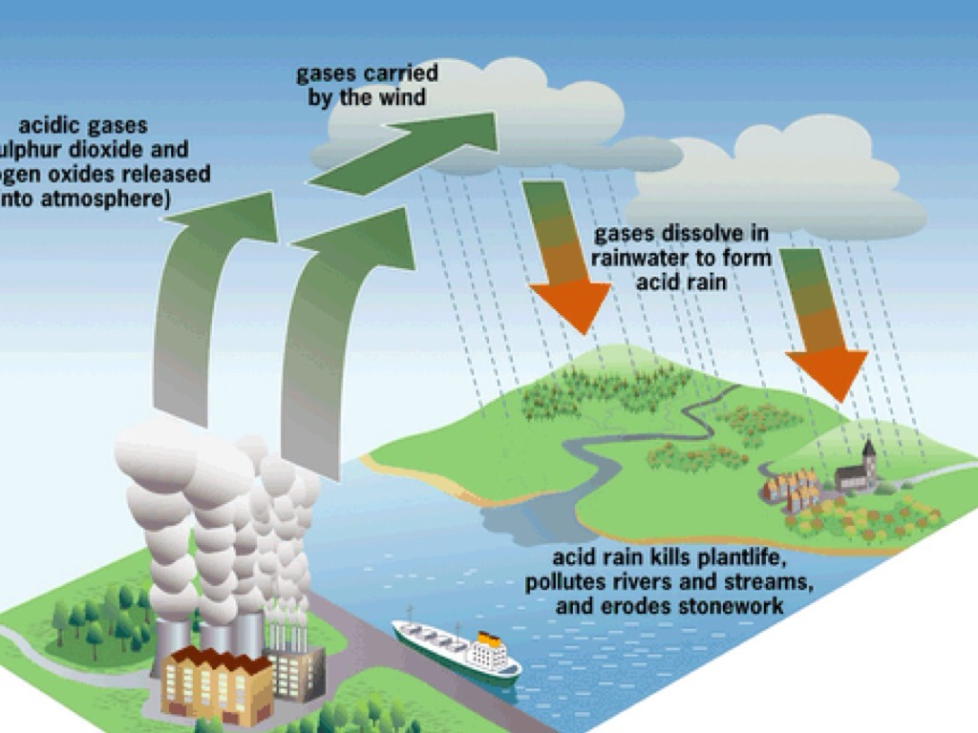

Slide 5
Why the heck is sulfur up there?
Smelting sulfide minerals
Burning coal
Burning diesel (note, newer low S diesel)
Burning pretty much any hydrocarbon to some extent

Slide 6
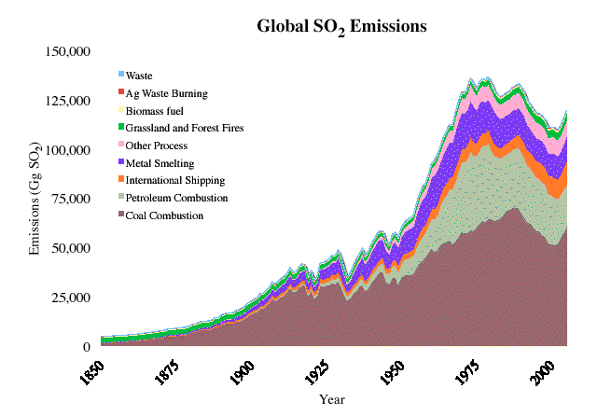

Slide 7
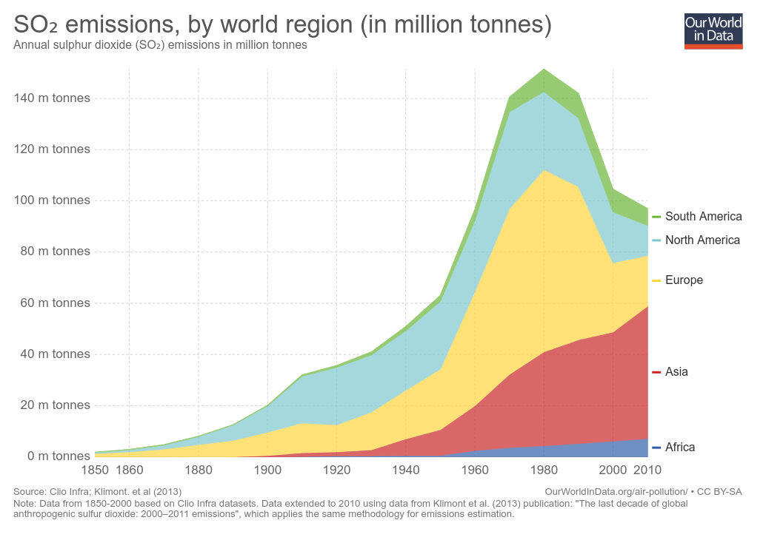

Slide 8
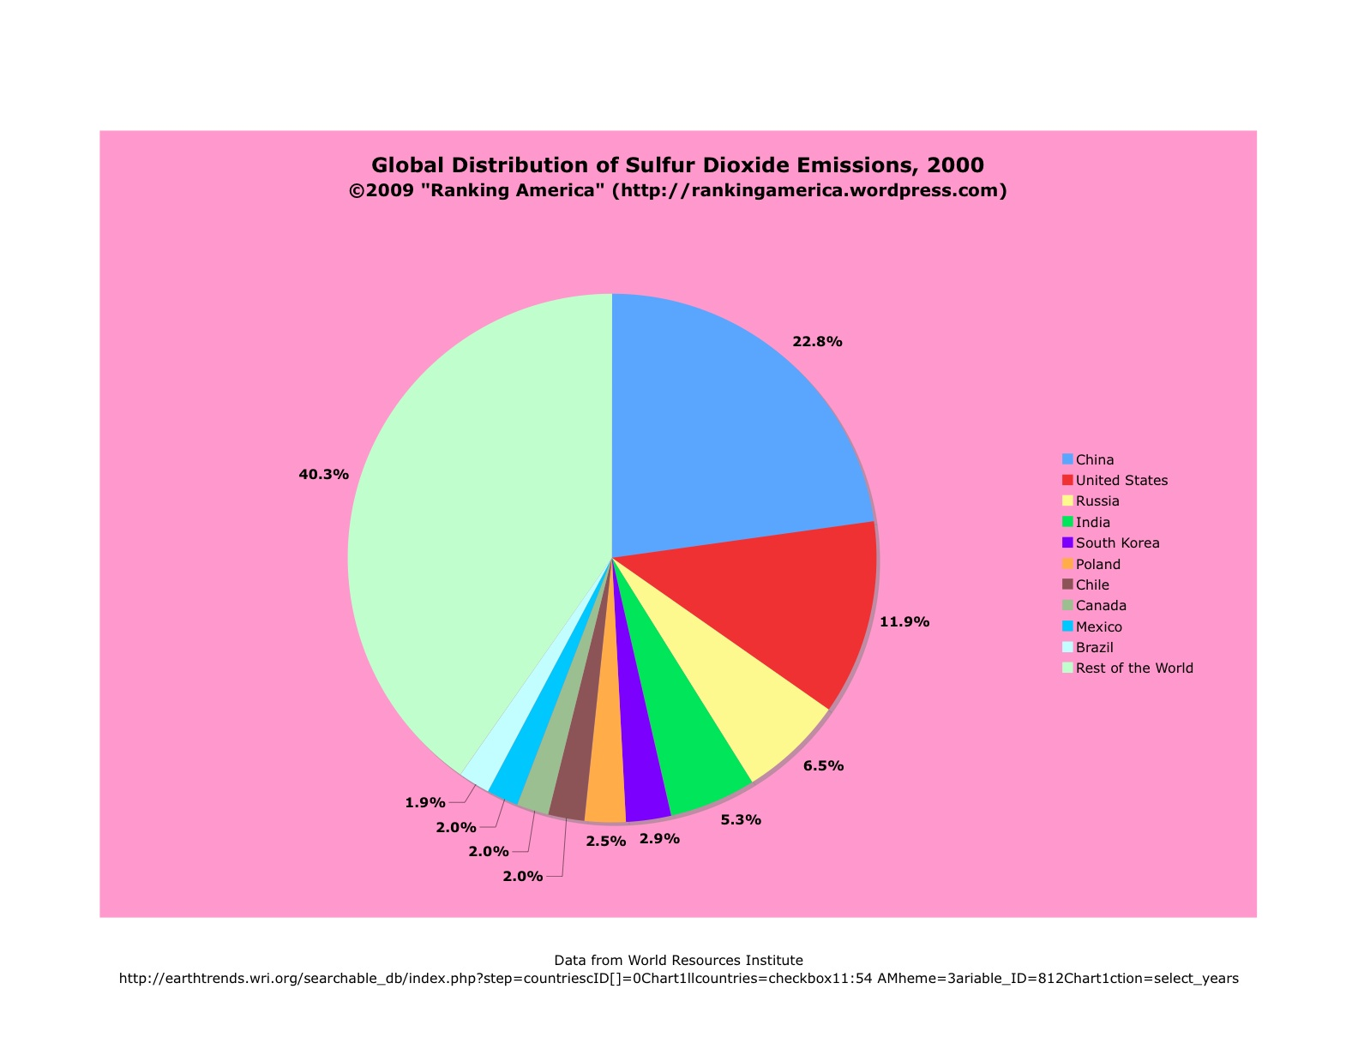

Slide 9
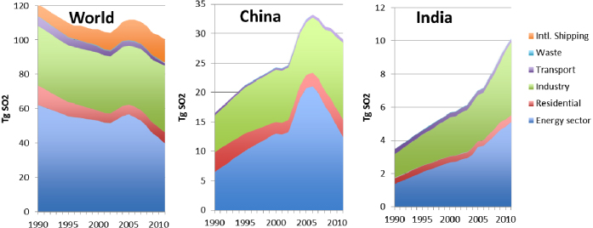
SO2 emissions

Slide 10
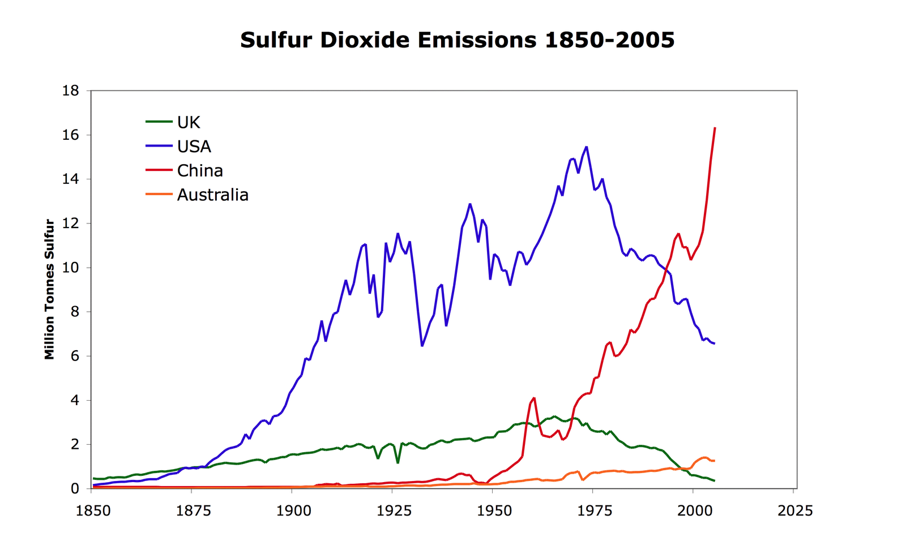

Slide 11
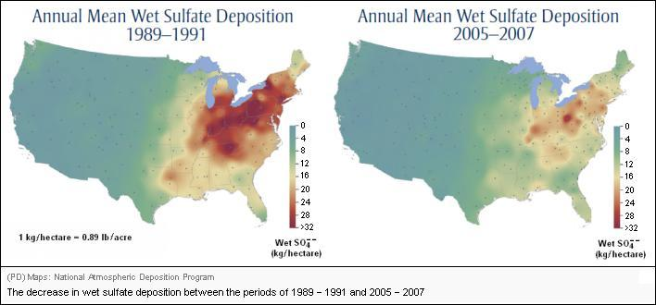

Slide 12
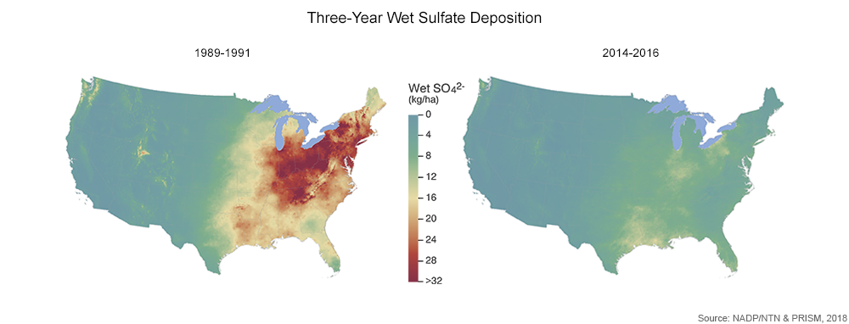

Slide 13
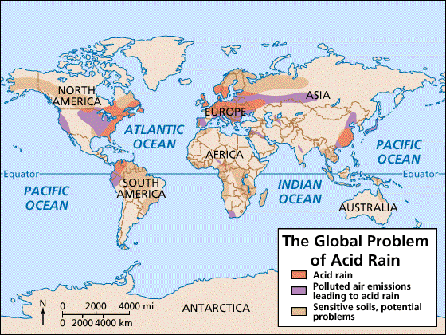

Slide 14
So what? Who cares about a little acid?
https://www.epa.gov/acidrain Good overview.
Acidifies streams, lakes, soils.
  Stress to kill plants and animals – to the point that some lakes in the NE were declared “dead”
  Dissolves heavy metals (very bad for you…)
    Flint, MI. Flint river water is acidic – dissolving lead and other materials in old pipes. In this case, salt and other de-icers are the source of the acid.
  https://theberkey.com/blogs/water-filter/flint-michigan-water-crisis-its-timeline-and-latest-update
  https://www.cnn.com/2016/03/04/us/flint-water-crisis-fast-facts/index.html
  https://en.wikipedia.org/wiki/Flint_water_crisis#2019 good timeline.
    Note, Flint issue not caused by acid rain, but rather acidic river water.
  Dissolve rocks, particularly carbonates (limestone and marble). And concrete!

Slide 15

Stressed vs unstressed trees

Slide 16
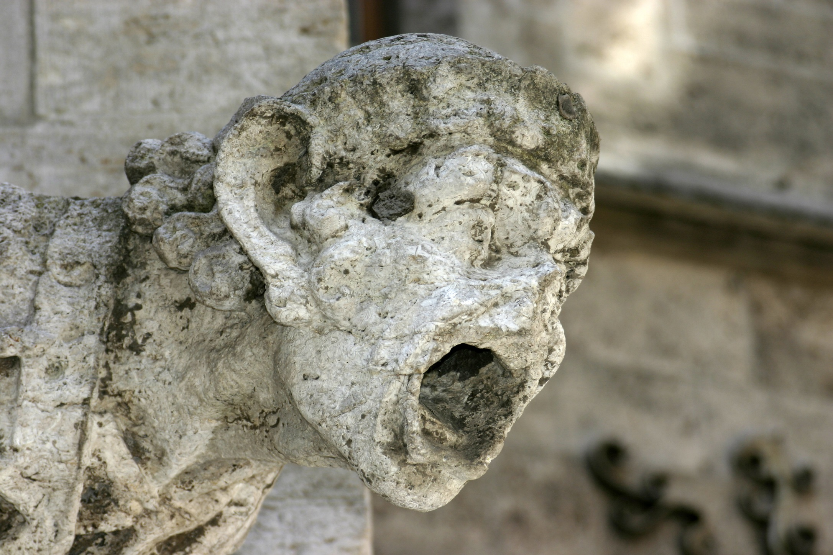

Slide 17

1908-1969

Slide 18


Slide 19
What to do?
Not burn hydrocarbons. Duh. Especially coal, fuel oils, and (older) diesel. https://en.wikipedia.org/wiki/Fuel_oil
Install scrubbers – smelters/power plants
Clean fuel (oil/gas) before distribution.
  Shipping industry uses the dirtiest stuff.

Slide 20
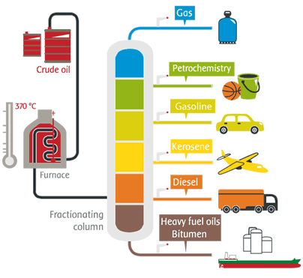

Slide 21
Solutions are easy and known why don’t we do them?
Economics. Discuss.

