Slide 1
Mud: It’s Australian for Birds Or… Citizen science on the mudflats of Western Australia
Bob Hickey
Department of Geography, CWU
For the science in a pint Series,
cornerstone pie
March 6, 2018

Slide 2
What is Citizen Science?
Scientific research conducted in whole or in part by amateur scientists
Public participation in scientific research
Anyone can do it!

Slide 3
Why do it? Isn’t it harder with less trained people?
Manpower (and/or womenpower)!
Sometimes, you just need more people to do the work.
Larger+complex = more different people with more different skills required
Education and involvement.
The more people that are involved, the more that folks learn.
The more, the greater the secondary impacts (rock in pond analogy)
It’s fun to be involved in these larger projects.

Slide 4
The project
Mapping and evaluating the habitat of migratory wading birds in NW Australia.

Slide 5
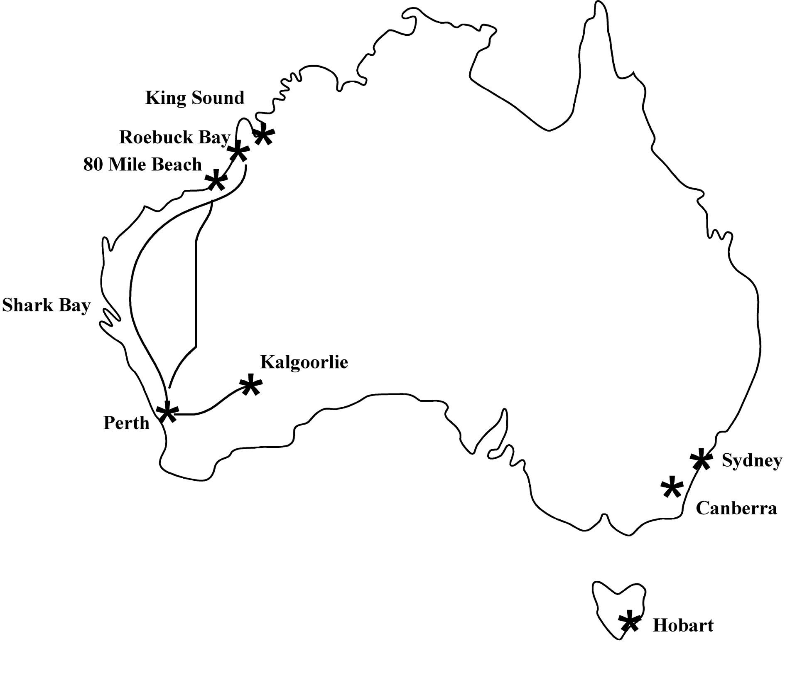

Slide 6
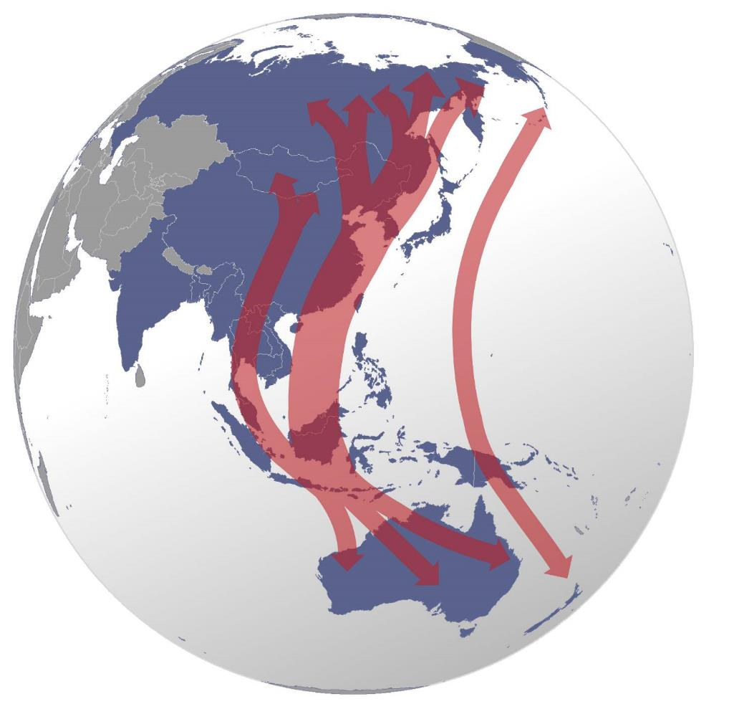
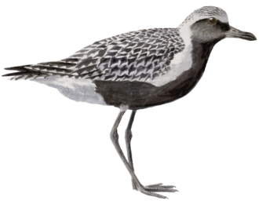
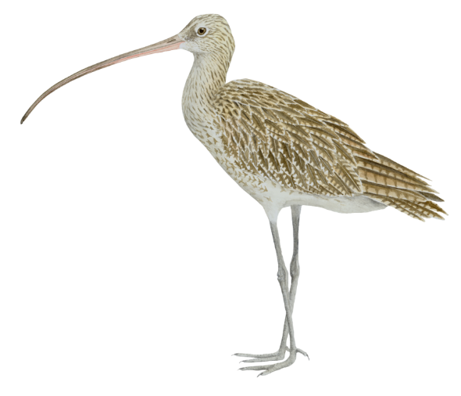
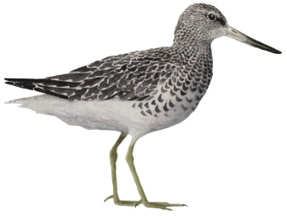
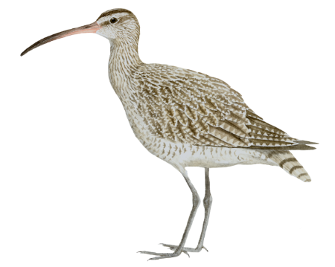
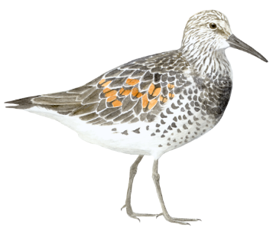
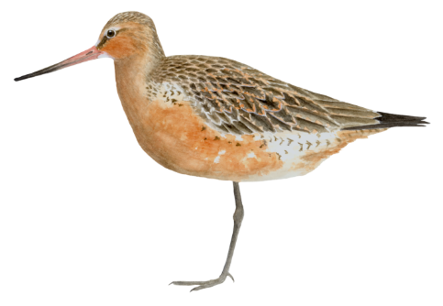
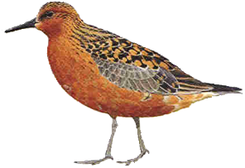
the East-Asian Australasian Flyway
Grey Plover
Eastern Curlew
Nordmann’s
Greenshank
Whimbrel
Great Knot
Red Knot
Bar-tailed
Godwit

Slide 7
It was only in the ‘80s that the area was “discovered” as a bird paradise. The research started in the early ‘90s as folks began to pay attention to all these birds and what they eat.

Slide 8
Which, of course, begged the questions:
Why are they here?
Where did they come from?
What are they eating?
What’s unique about these areas?
What are the greatest hazards to the birds?
What do we need to do to protect them?

Slide 9
Which began 20+ years of work on:
Birds
Benthos
Hydrology
Sedimentology
8 major expeditions involving 50-120 people each
1997, 1998, 1999, 2000, 2002, 2006, 2013, and 2016
Plus occasional bird surveys by team members all over this area.
And monthly benthic invertebrate sampling

Slide 10
Our objectives
Science!
Education!
Protection!
I can honestly say that we’ve met all three, though we do need to publish a lot more.

Slide 11
Roebuck Bay
Extensive Mudflats:
Tidal range > 10 metres, the second largest in the world.
Exposes approx. 188 km² at low tide, 45% of the bay.
Tons of Birds
Important staging area for migratory wading birds.
>170,000 birds of over 120 species
World’s seventh most populous site for migratory wading birds.

Slide 12
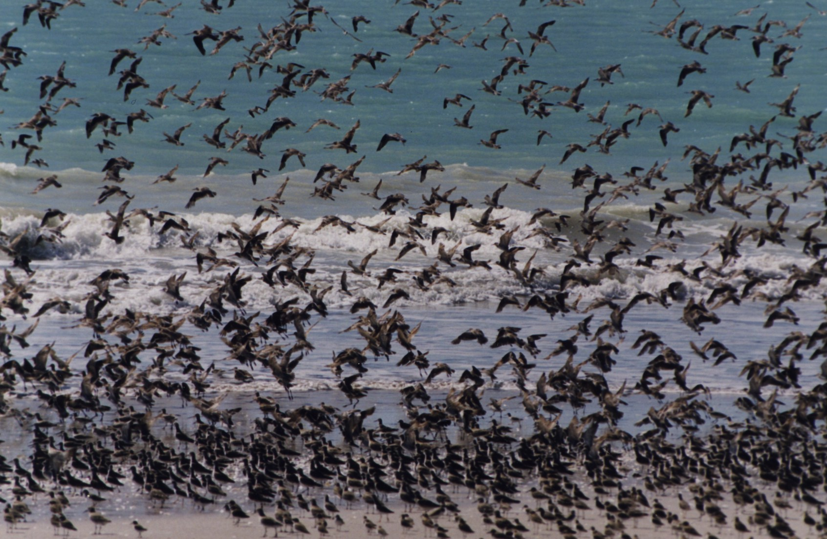
No kidding about the birds – hundreds of thousands…..
Bar-tailed Godwit
Black-tailed Godwit
Great Knot
Grey-tailed Tattler
Terek Sandpiper
Red Knot
Greater Sand Plover
Grey Plover
Red-necked Stint
Broad-billed Sandpiper
Lesser Sand Plover
Curlew Sandpiper
Red-capped Plover

Slide 13
Great Knot
Grey-tailed Tattler
Oriental Plover
Red Knot
Curlew Sandpiper
Red-necked Stint
Photo: Ginny Chan

Slide 14
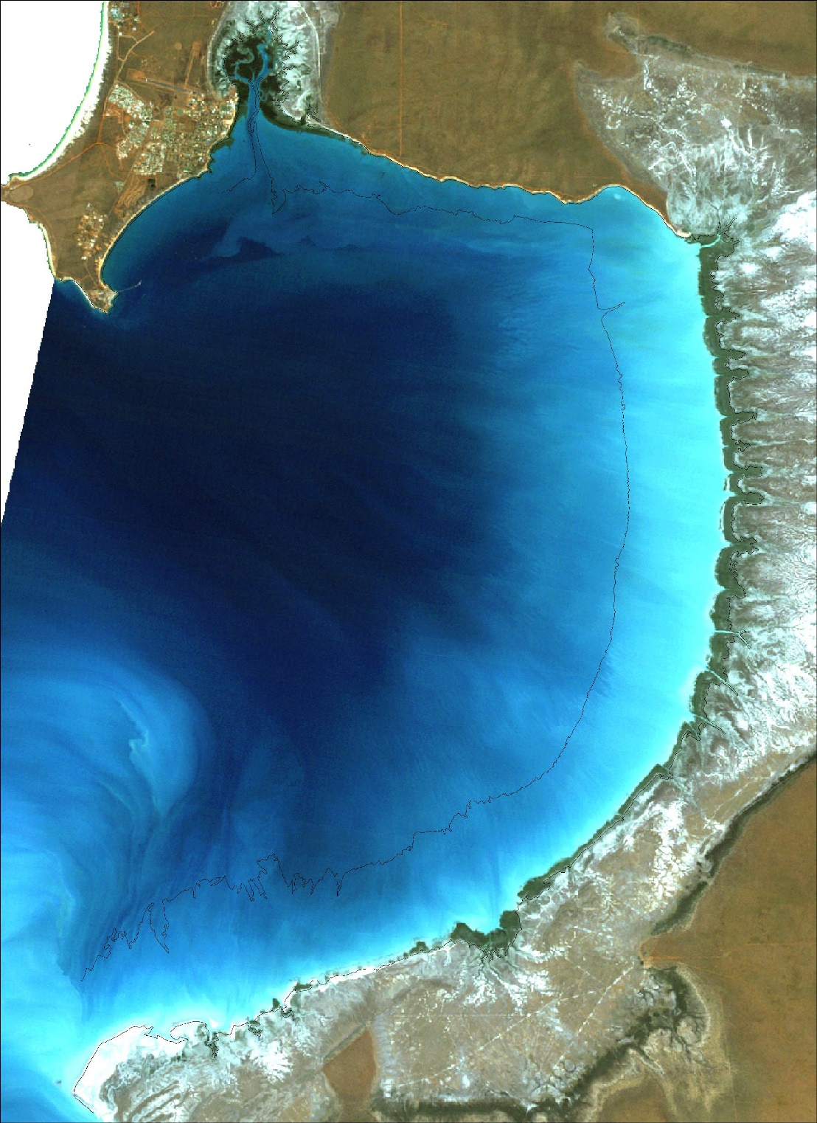
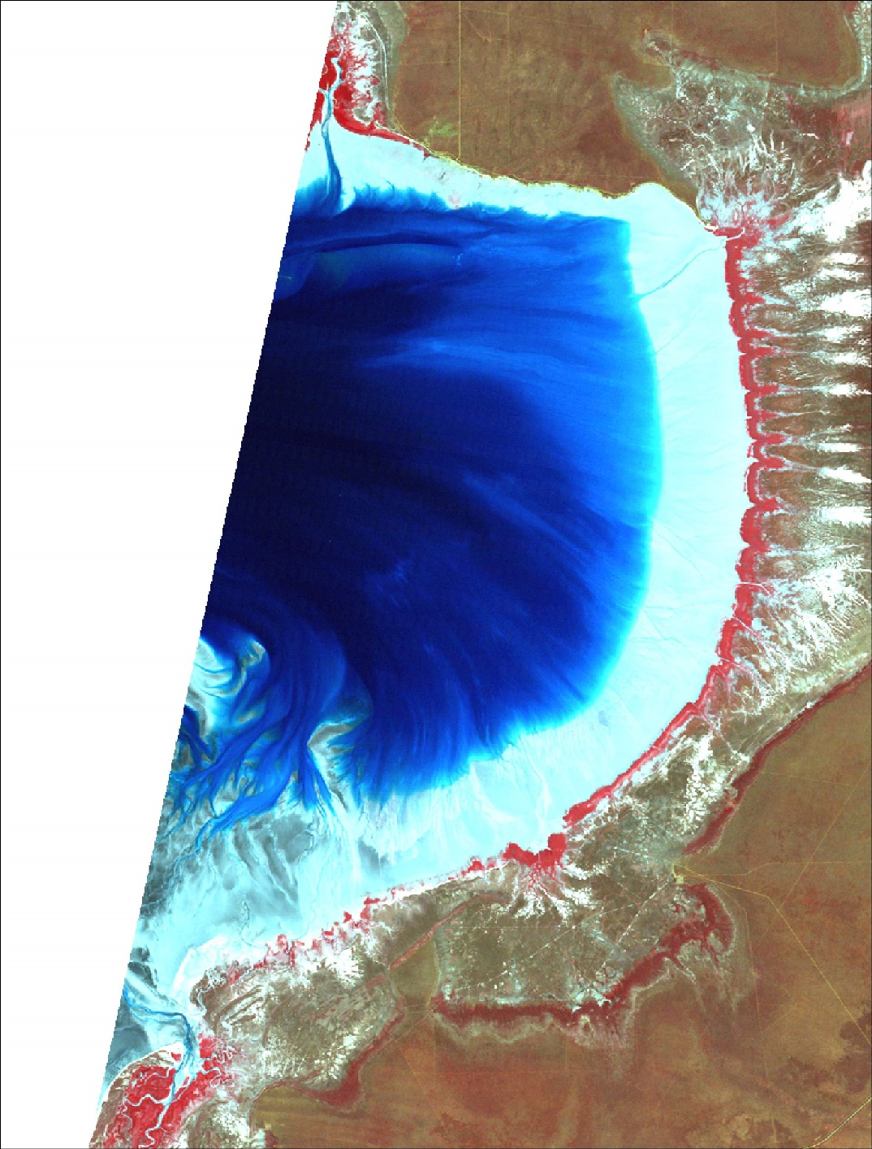
1994 and 1995 high/low tide Landsat TM imagery

Slide 15
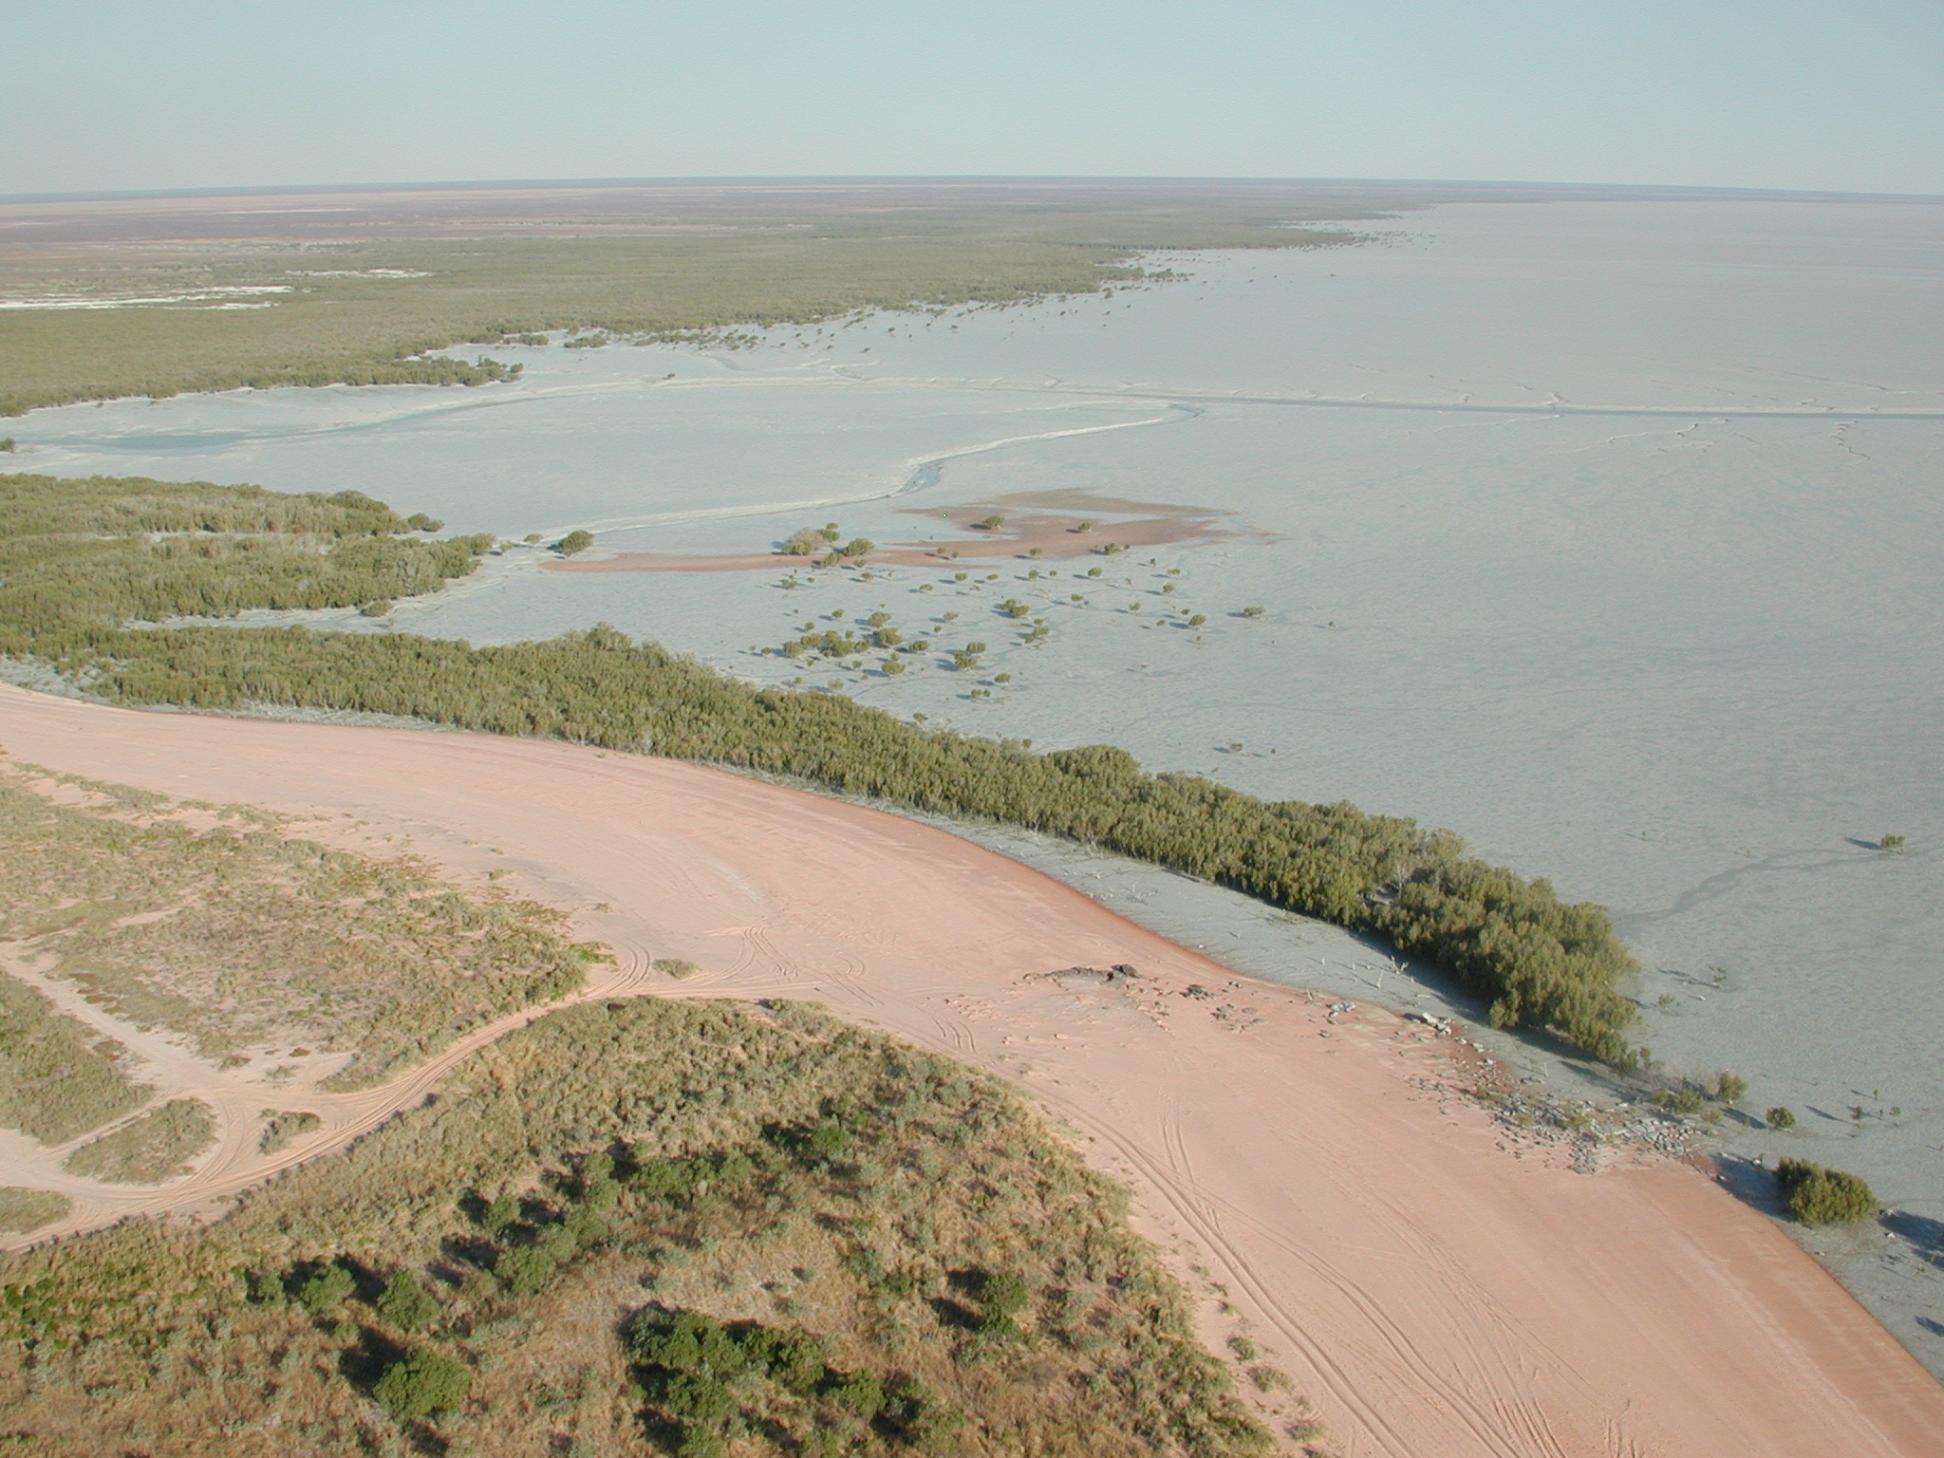

Slide 16
Photo: Bob Hickey

Slide 17
Who was involved? And Why?
Scientists and their students (Australia, Netherlands, US, China)
Most volunteering their time
Retirees
Small world….
Government Agencies (and now, a consulting firm) – both from Perth and Broome
Scientists
Technicians
Volunteers
Paying participants (like Earthwatch, only through WA government)
Broome Bird Observatory (BBO)
Rangers
Random visitors

Slide 18
Specialists (mostly recruited ahead of expeditions)
Hoovercraft owners/drivers
Cooks
Medics
Mechanics
Photographers
Videographers
Broome area public
Via the BBO
Earlier volunteers – many repeat offenders, some have brought friends
Newspaper ads
Aboriginal tribes/rangers
Cattle station
Local Government
Community outreach (talks, conferences, involvement in events)

Slide 19
Massive, huge bonus was….
Lots and lots of repeat people.
Kept things moving smoothly with little down time
Consistent data etc over the last 20 years.
And an important note – the skills and capabilities of these folks varied greatly, from experts to, well, not. But everyone who was willing to help out contributed.

Slide 20
How did we get these numbers consistently and over time?
Well, I’ll leave that for the end….

Slide 21
So.. What do we do? (science and volunteer tasks)

Slide 22
Preliminary tasks
Hustle funding, equipment, and people.
Heavily reliant on volunteers and in-kind donations (ie, the use of hovercraft)
Prepare for sampling
Plan the expedition
Generate a sampling grid and maps for every field team.
Volunteer training
Coordinate with videographers, town events, mini-conferences, etc.

Slide 23
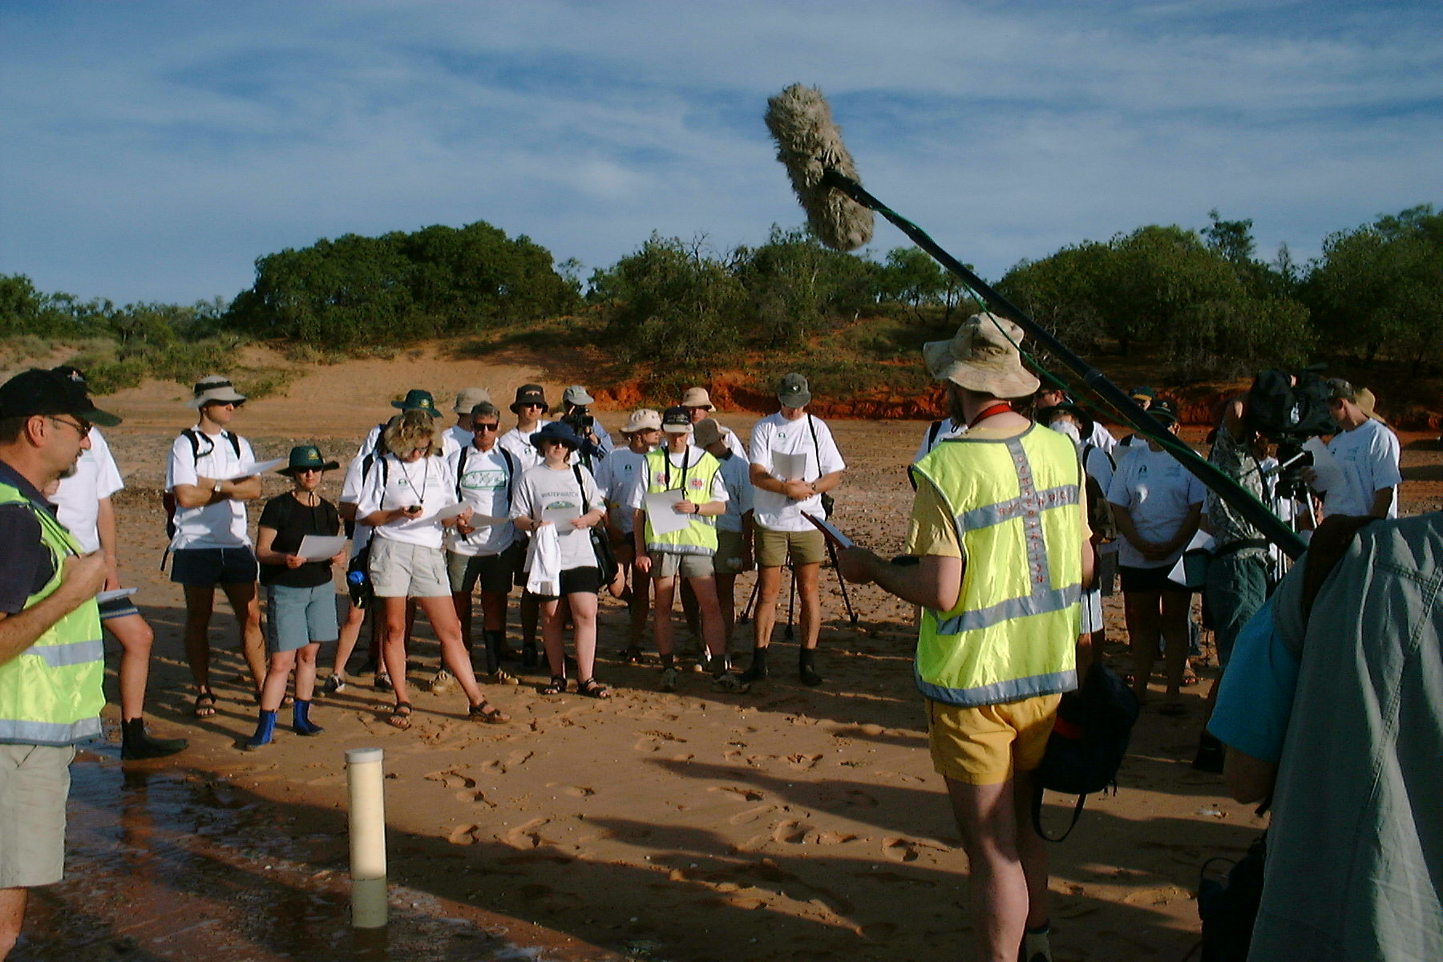
Training session
Photo: Bob Hickey

Slide 24
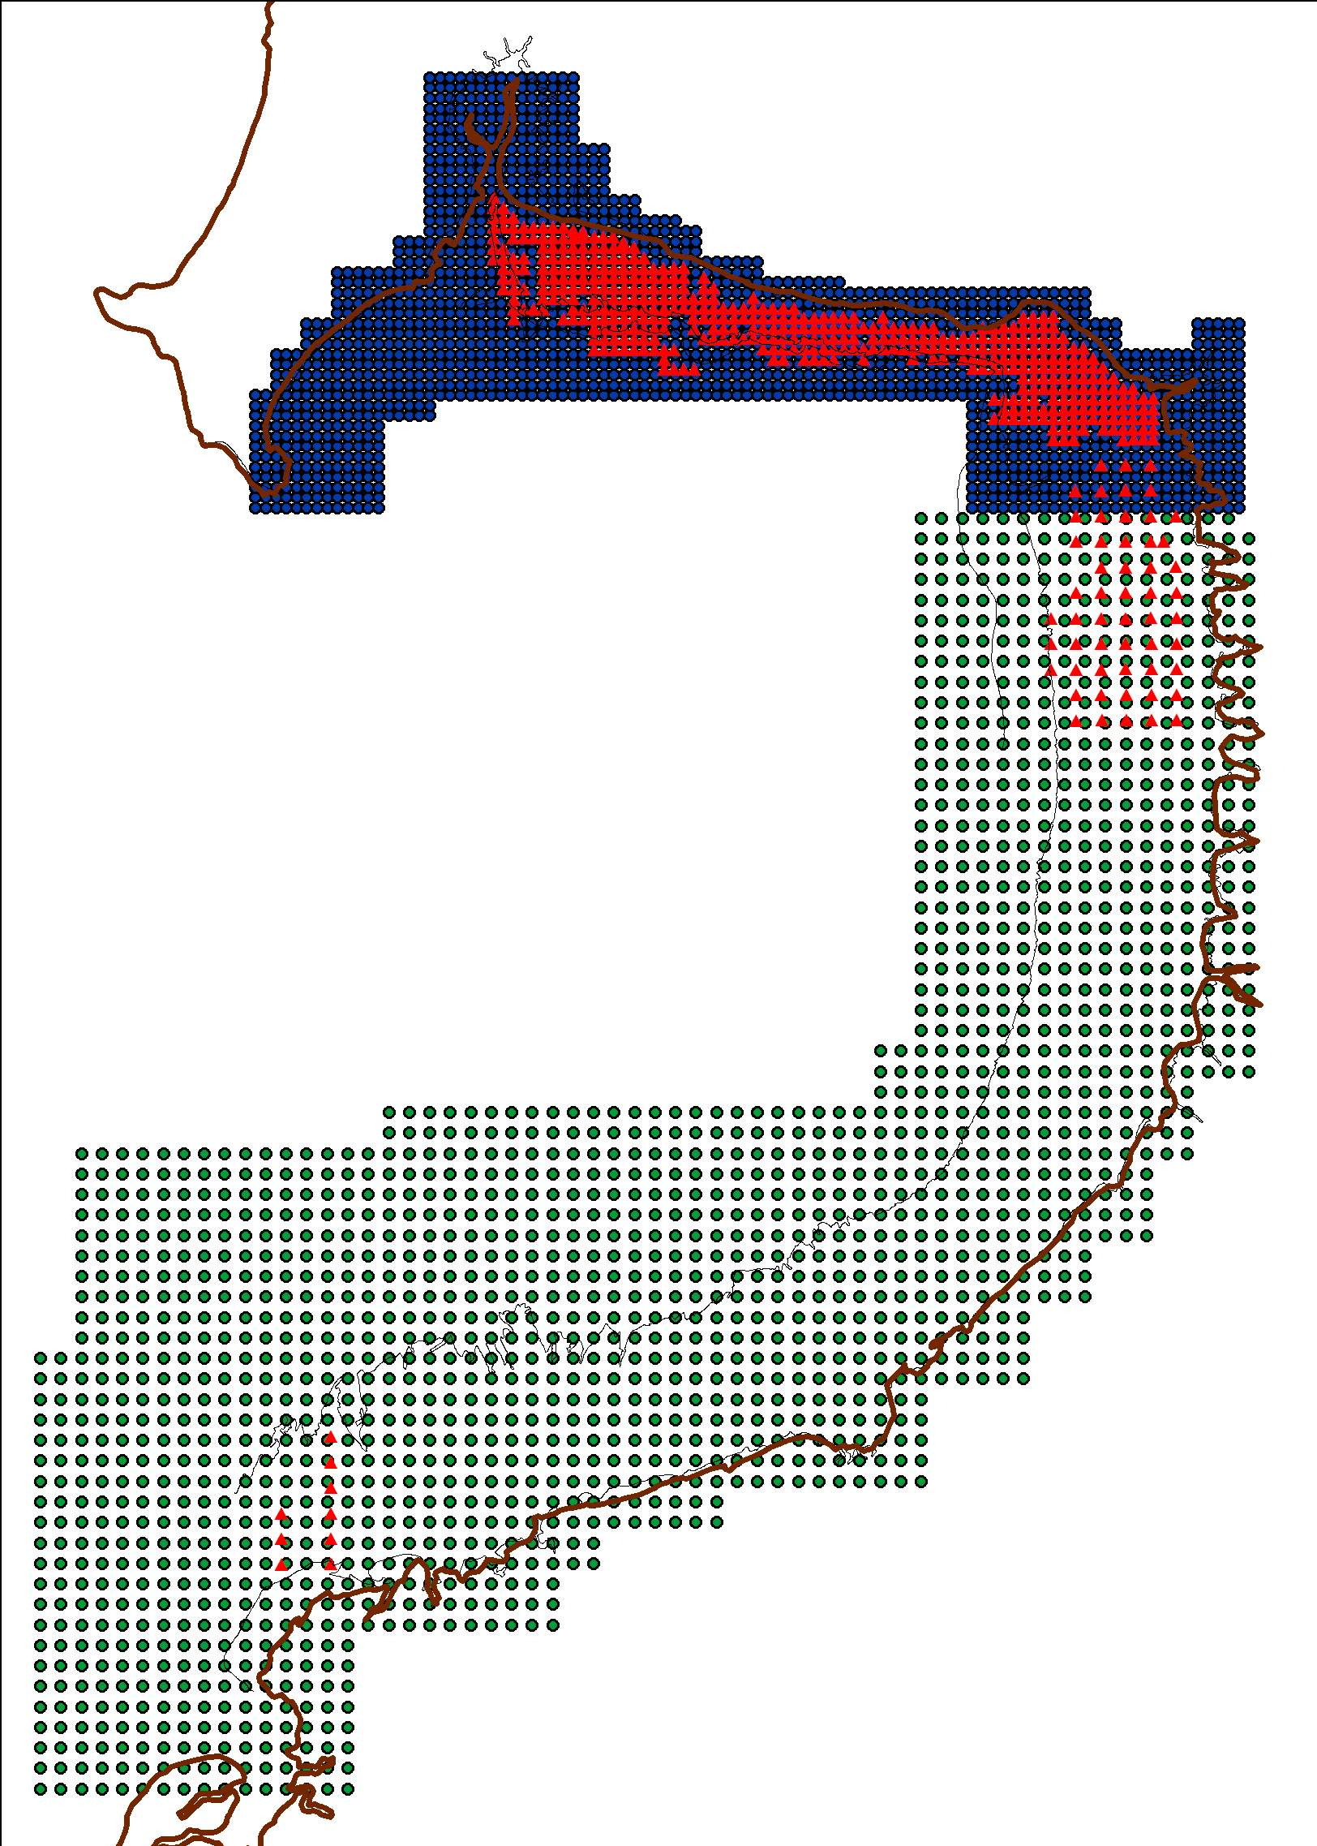
Three datasets:
200m North (blue)
400m South (green)
1997 data (red)
(unique row/column ID and UTM Northing/Easting generated for each point)

Slide 25
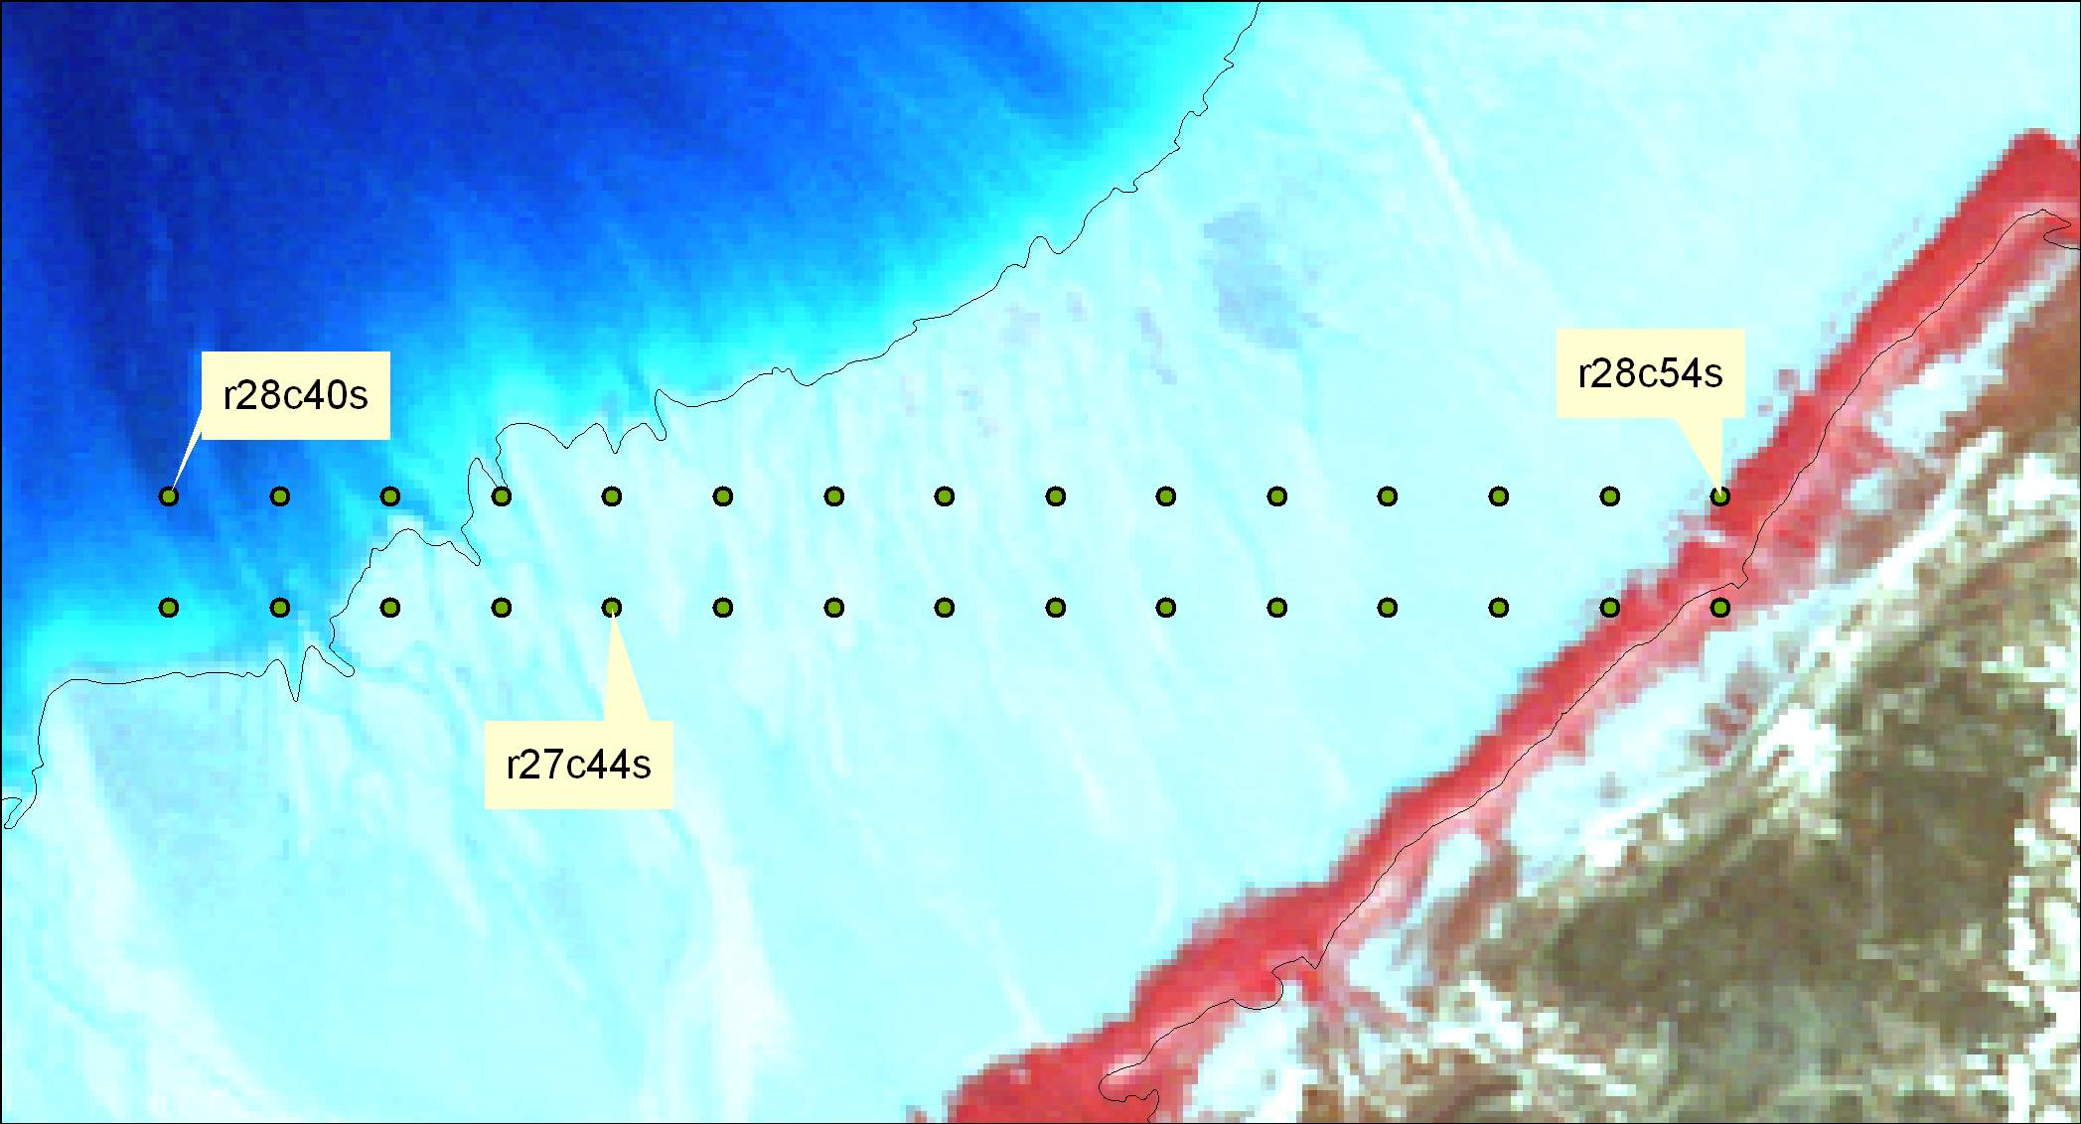
Sampling map
Note: each map also came with a set of labels and GPS coordinates.
I’ve made hundreds of these over the years….

Slide 26
Custom field maps

Slide 27
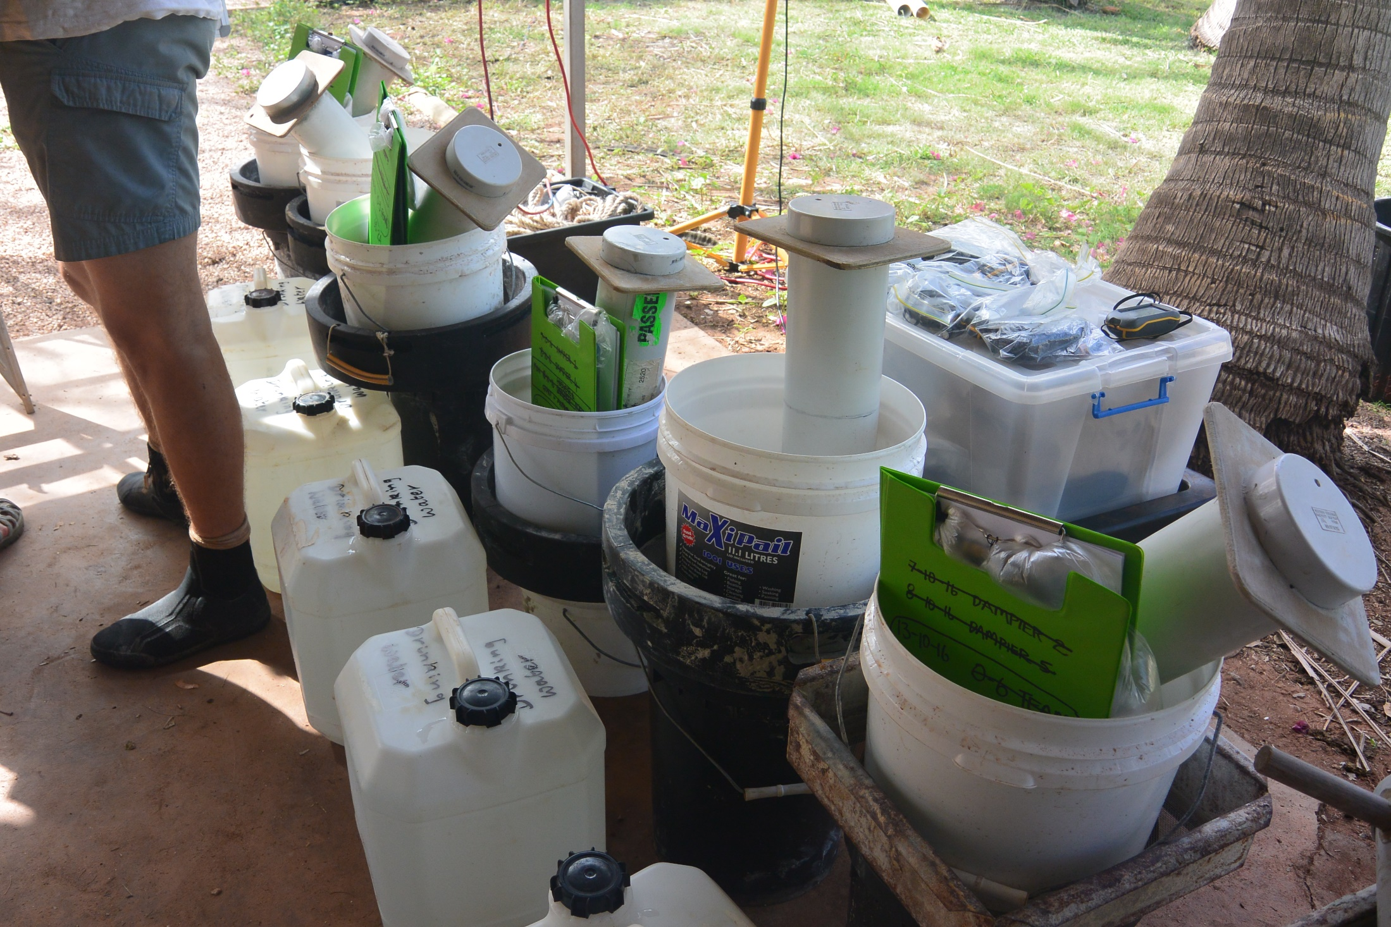
Photo: Ginny Chan

Slide 28
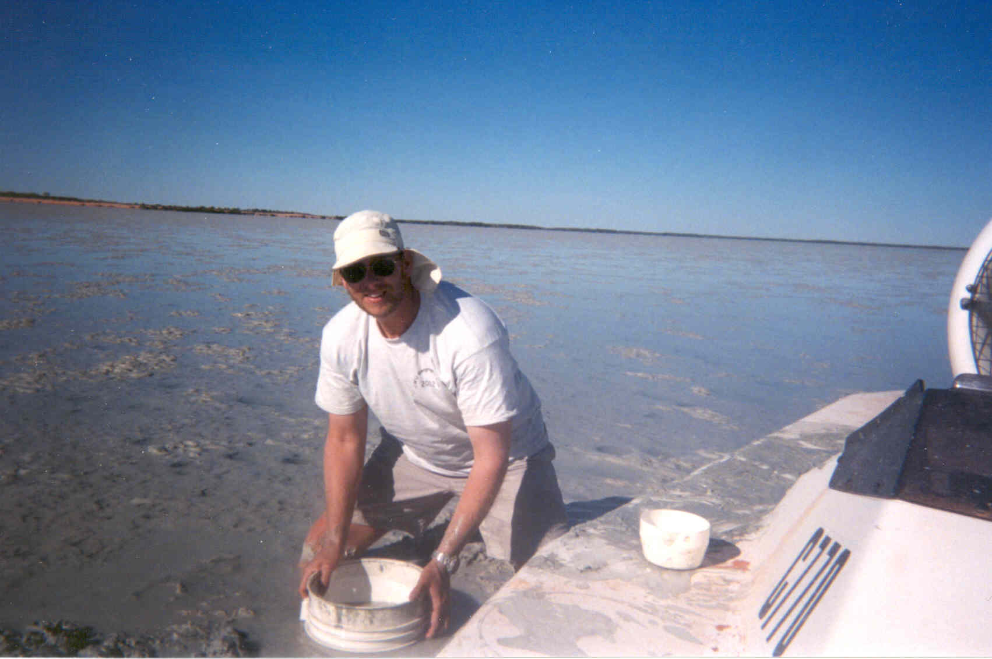
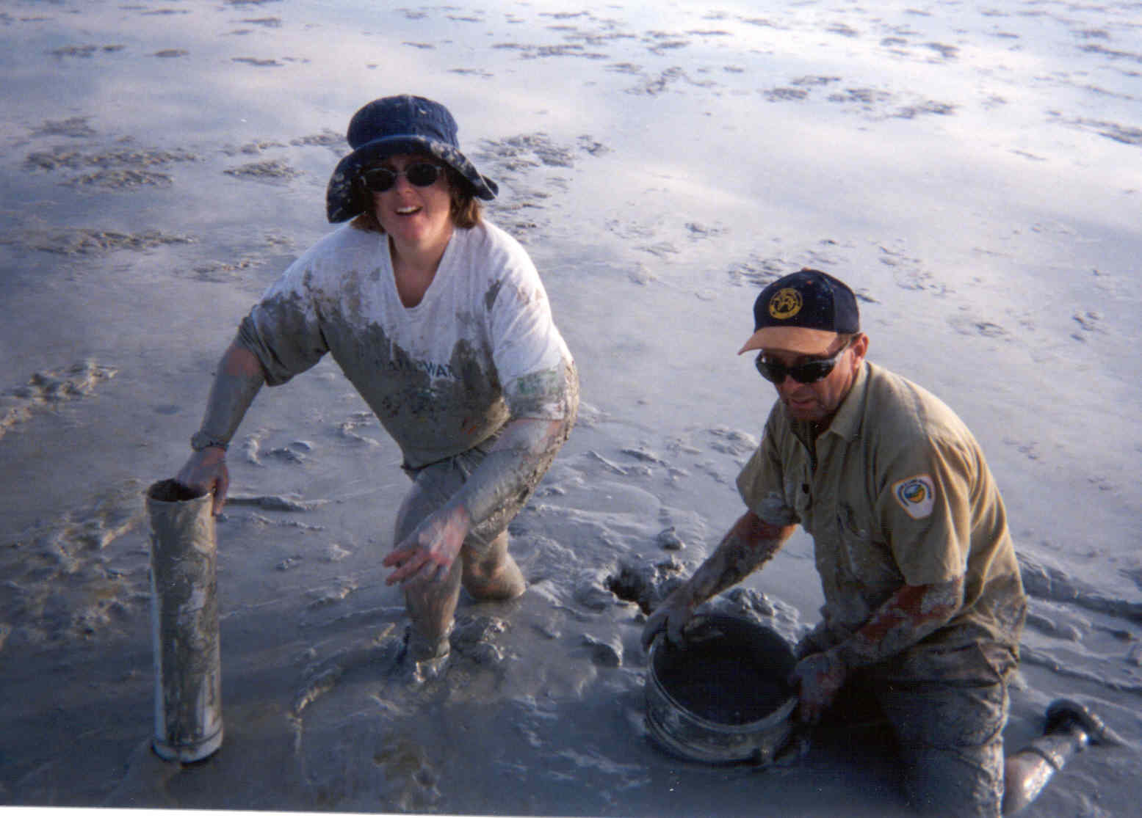
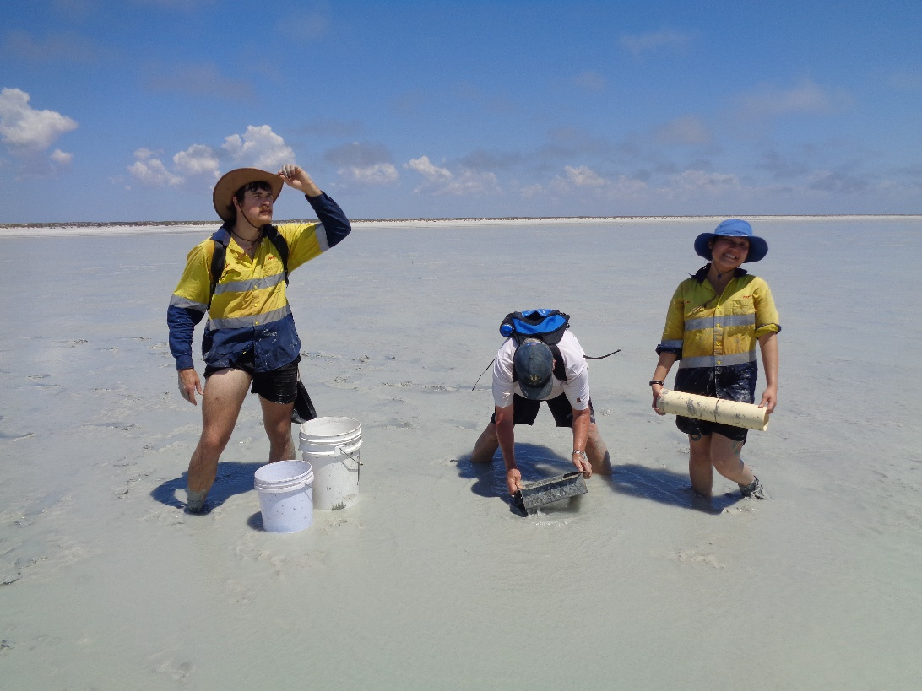
Sampling
Photo: Marc Lavaleye

Slide 29
Photo: Bob Hickey

Slide 30
Photo: Angela Rossen

Slide 31
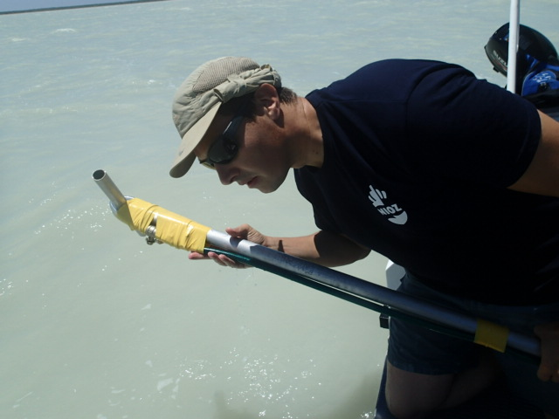
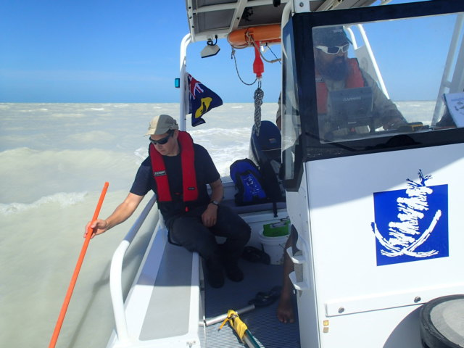
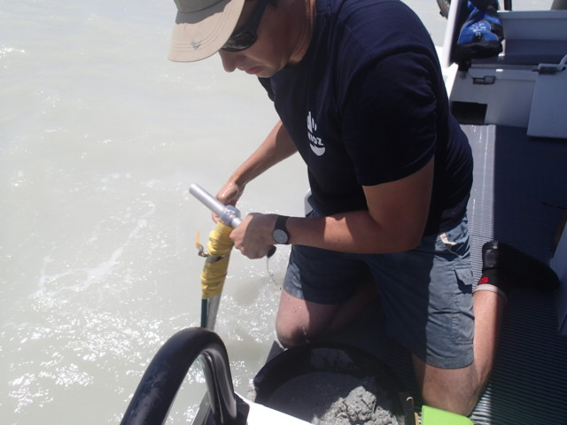
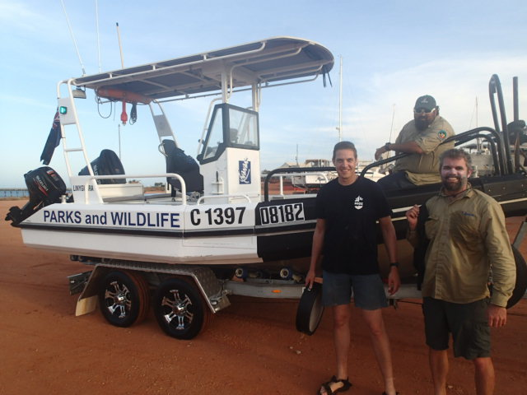

Slide 32
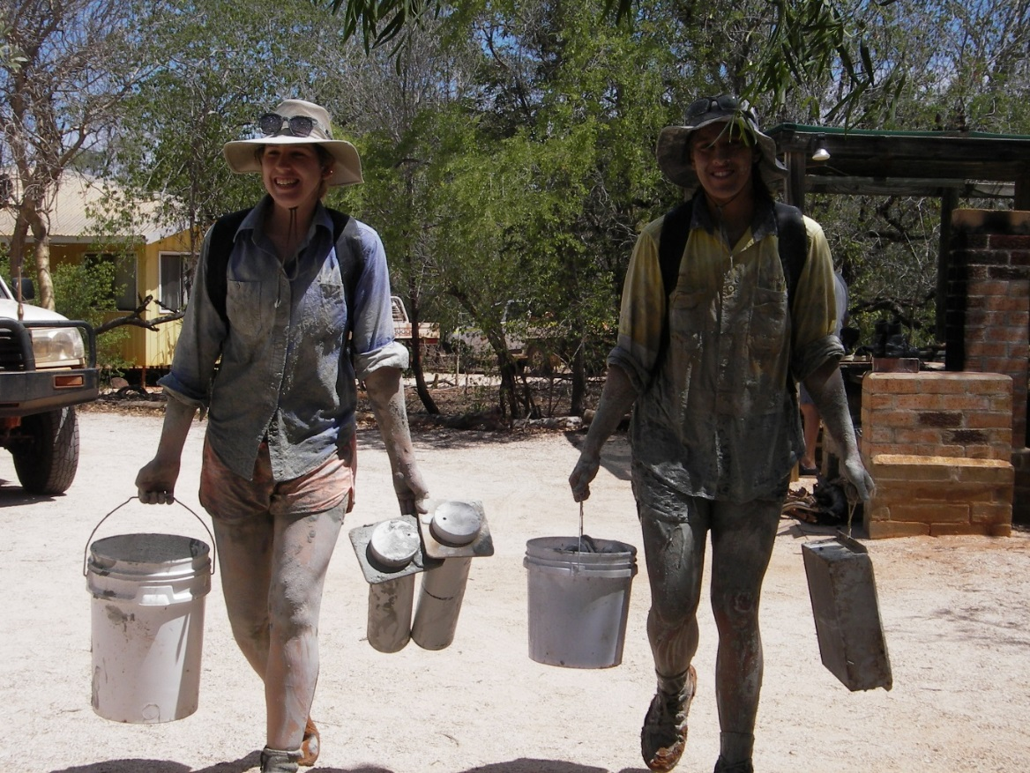
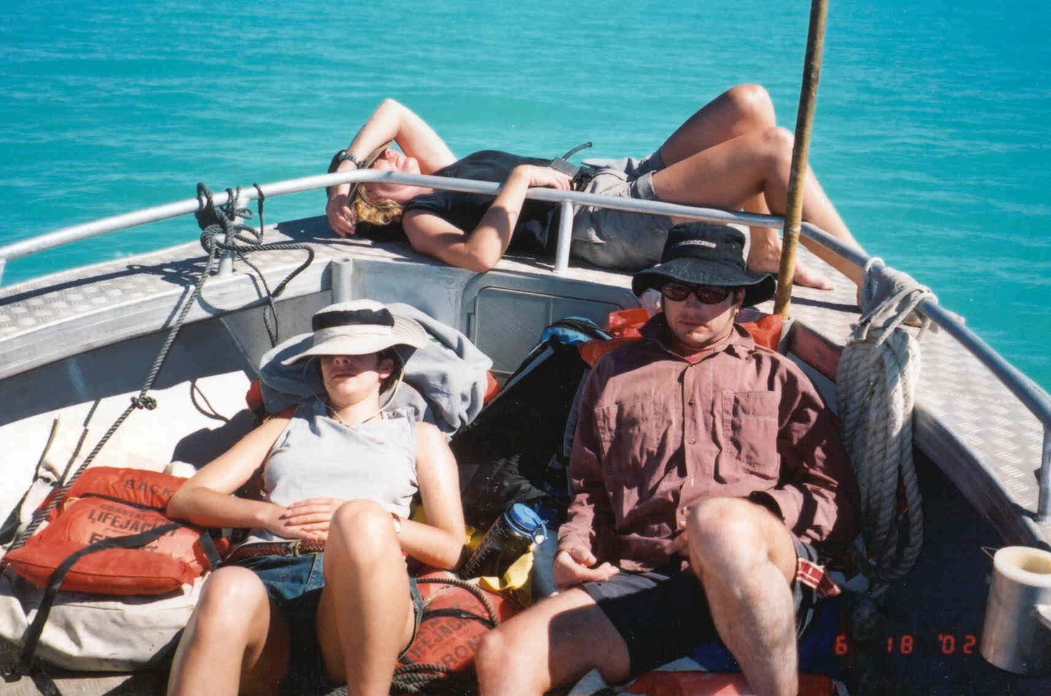
The end of the day
Photo: Yvonne Winchcombe
Photo: Bob Hickey

Slide 33
What did we see out there?

Slide 34
Photo: Bob Hickey

Slide 35
Photo: Fintan Angel

Slide 36
Photo: Ginny Chan

Slide 37
Photo: Loran Kleine Schaars

Slide 38
Photo: Loran Kleine Schaars

Slide 39
Jan

Slide 40
Photo: Ginny Chan

Slide 41
Eelke

Slide 42
Photo: Yvonne Winchcombe

Slide 45
Photo: Angela Rossen

Slide 46
Photo: Chris Glasby

Slide 47
Photo: Chris Glasby

Slide 48
Back to the BBO for:
Sorting
ID
Database entry (both field data and species ID data)
Mapping
Preliminary analysis
Preliminary report.

Slide 49
Theunis

Slide 50
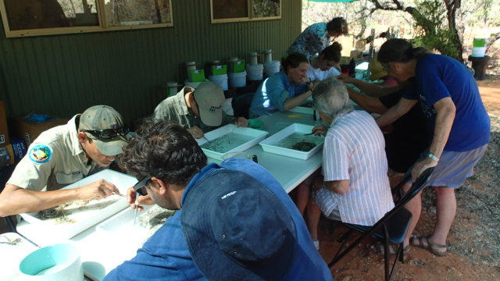
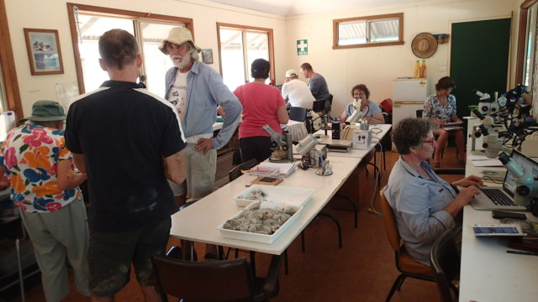
Photos: Theunis Piersma

Slide 51
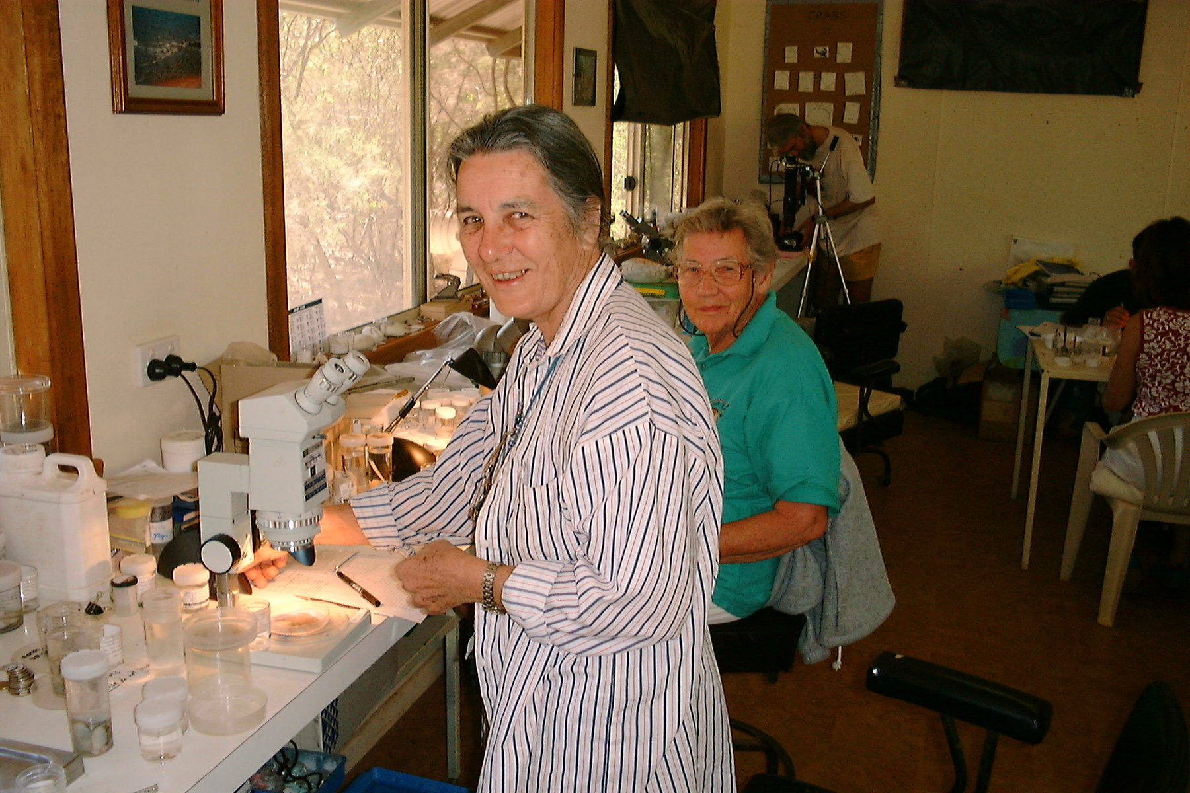
2002

Slide 52
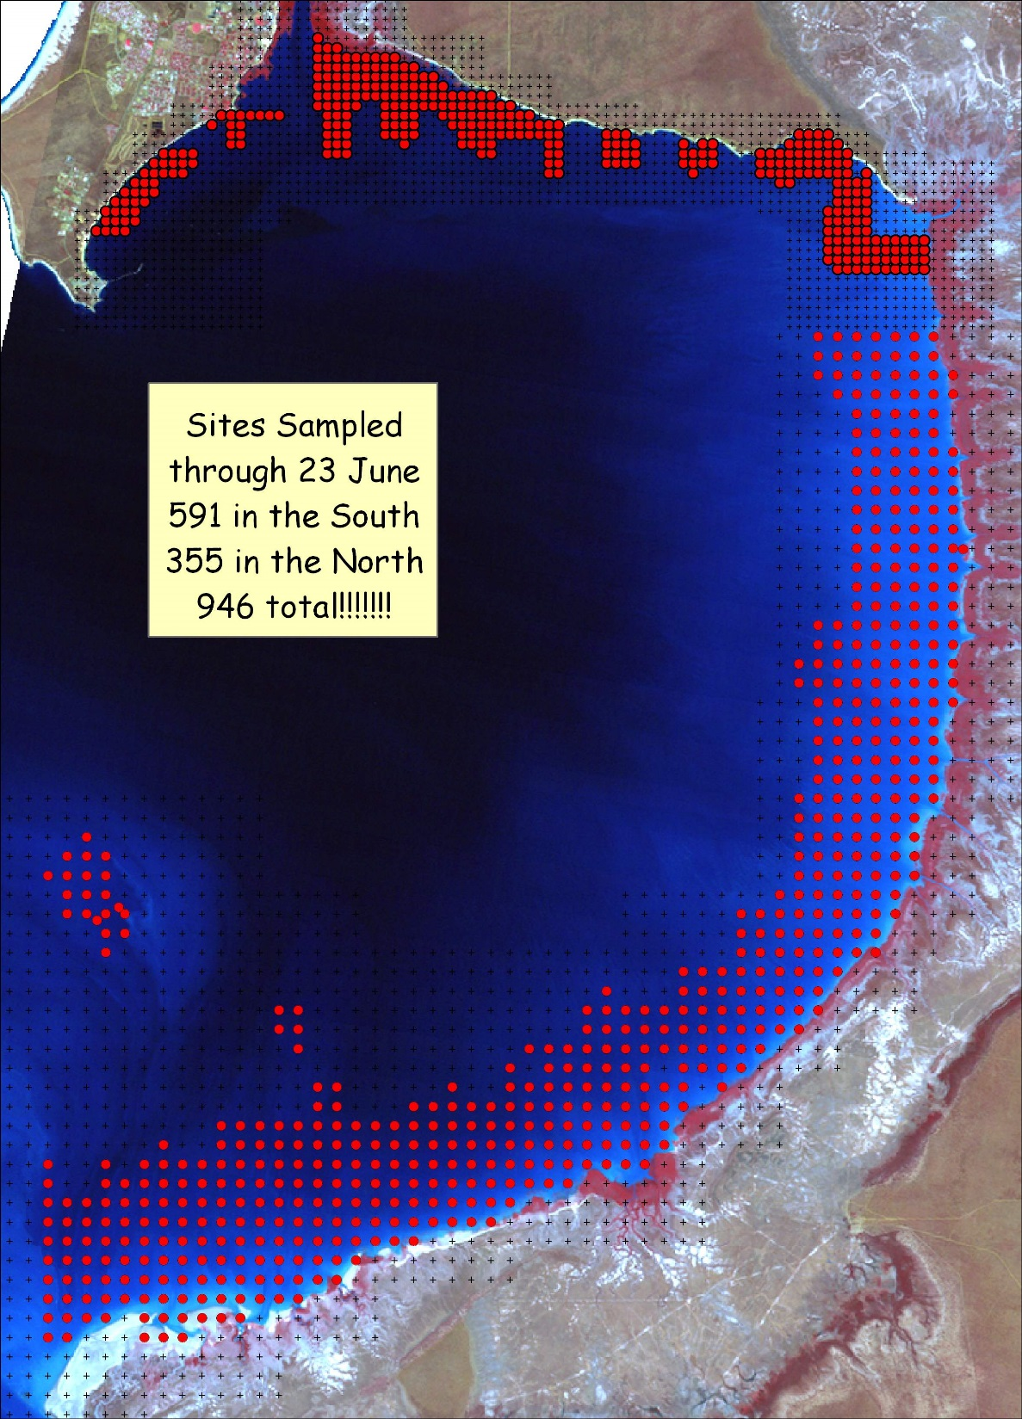
Daily progress maps

Slide 53
But…. How do we know what the birds are actually eating?

Slide 54
Red Knot dropping
Photo: Amanda Lilleyman

Slide 55
Now for some results…..
In 2016:
534 sample sites at Roebuck Bay and 816 at Eighty Mile Beach over a 3 week period in October.
ID’d and measured ~32,500 individual invertebrates.
New species
Added to an already extensive database.

Slide 56
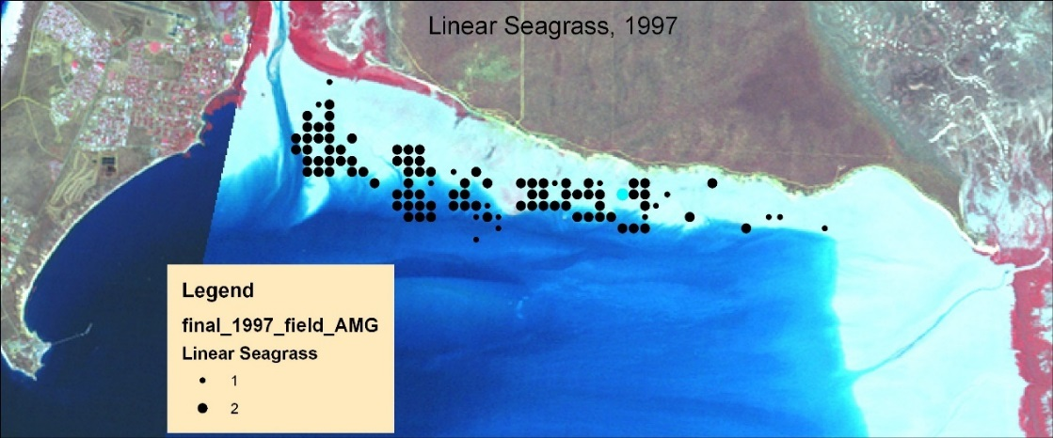
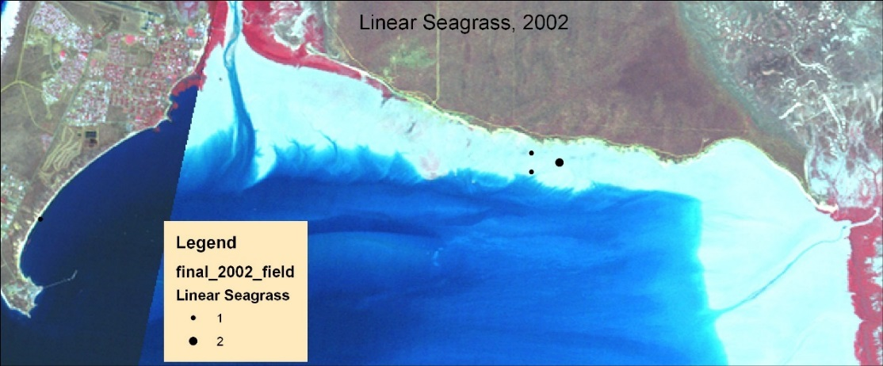
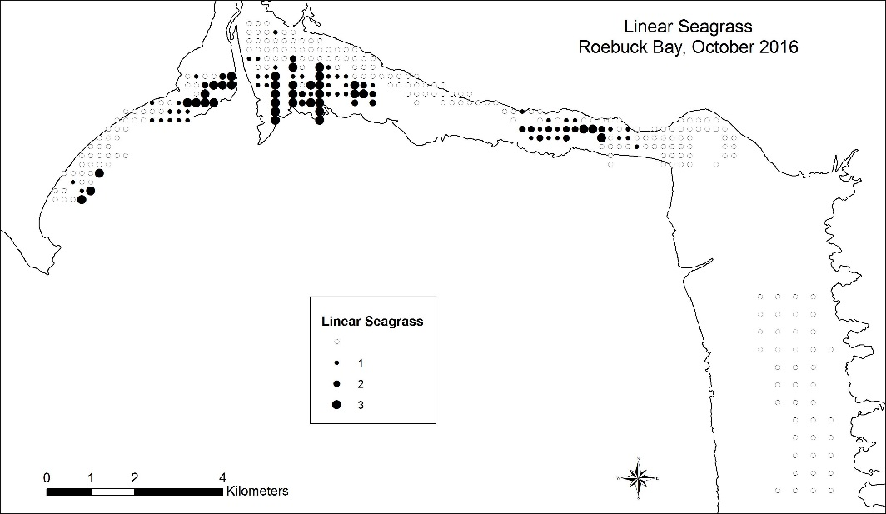
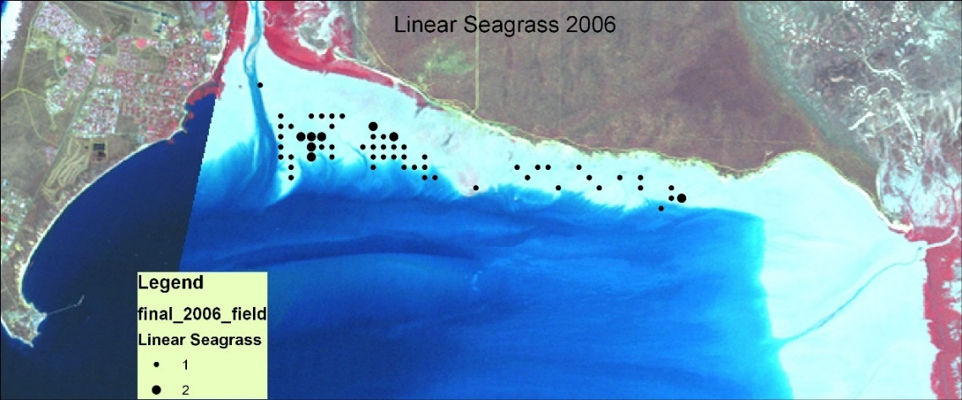
Dugong
Hurricanes

Slide 57
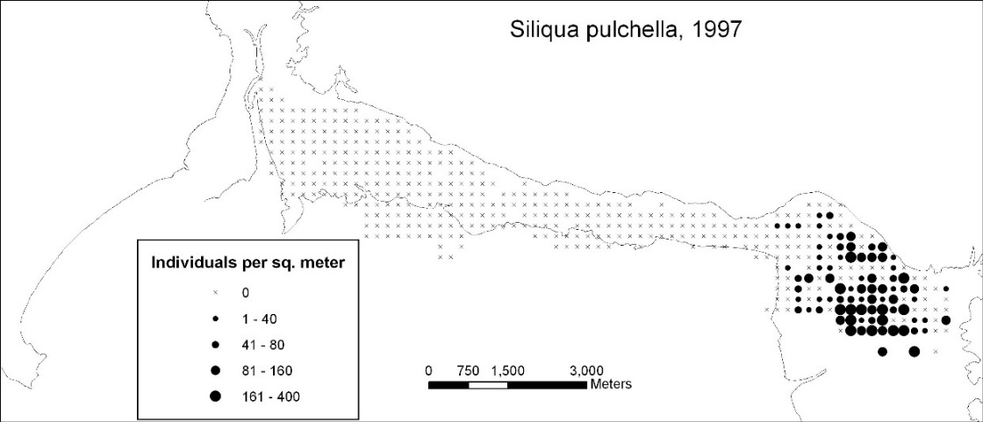
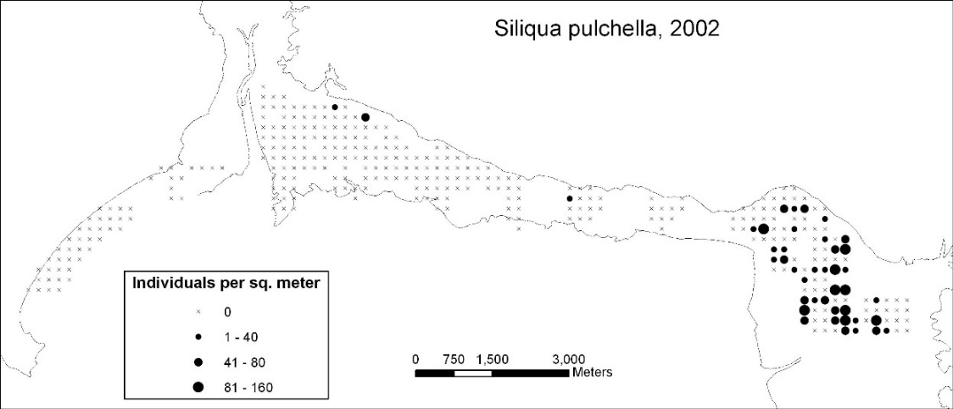
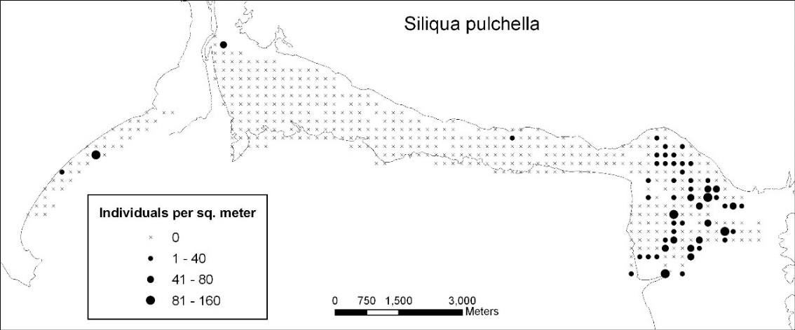
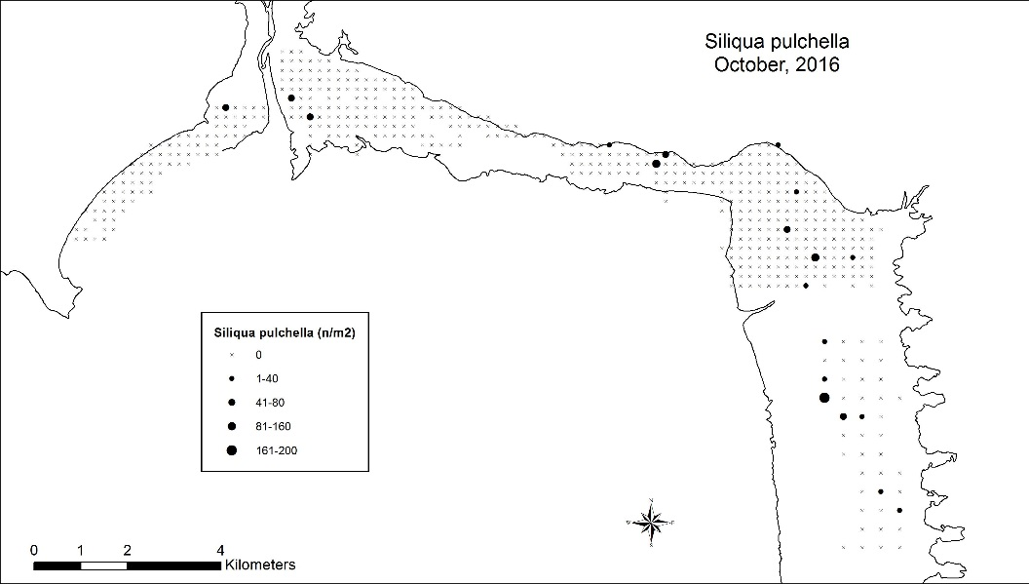
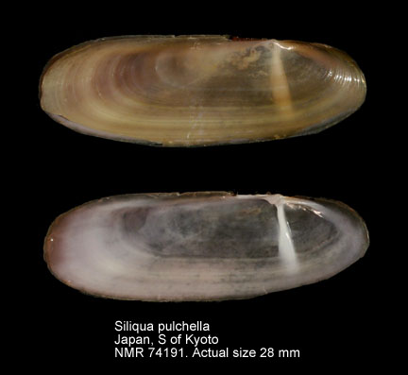
Site faithfulness in bivalves.
Appears to be related to sediment size.
Sampling method issues?

Slide 58
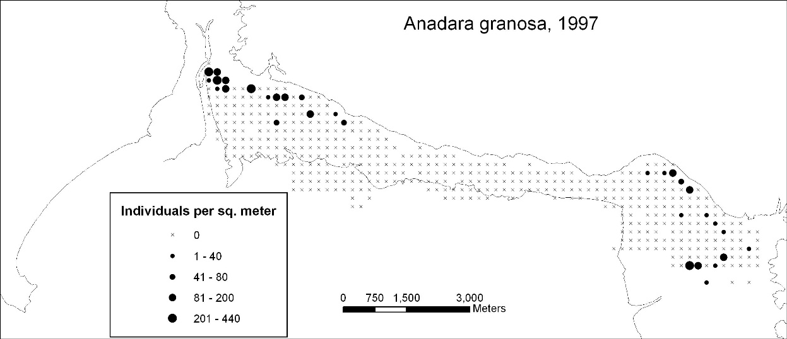
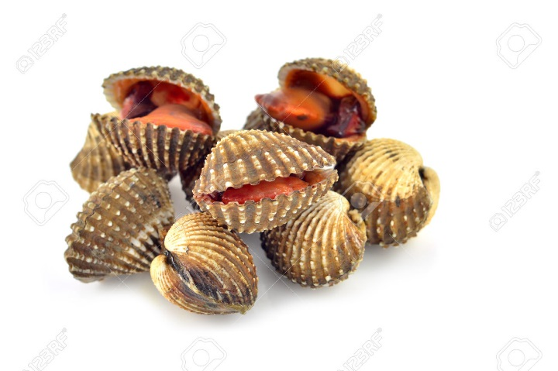
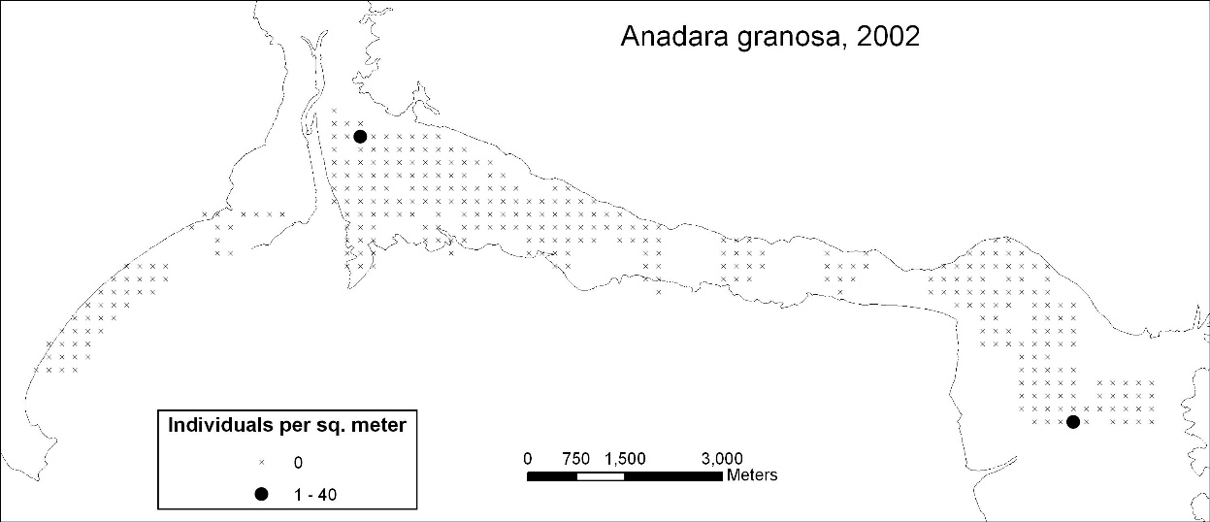
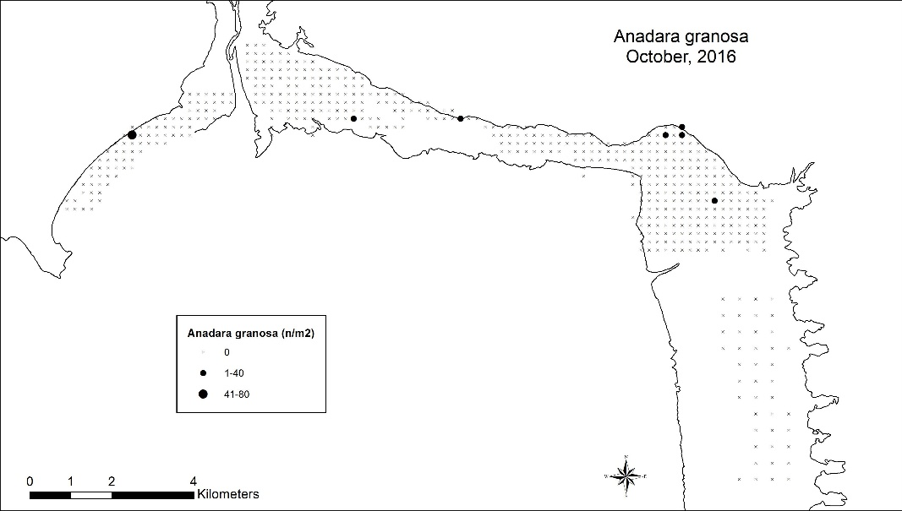
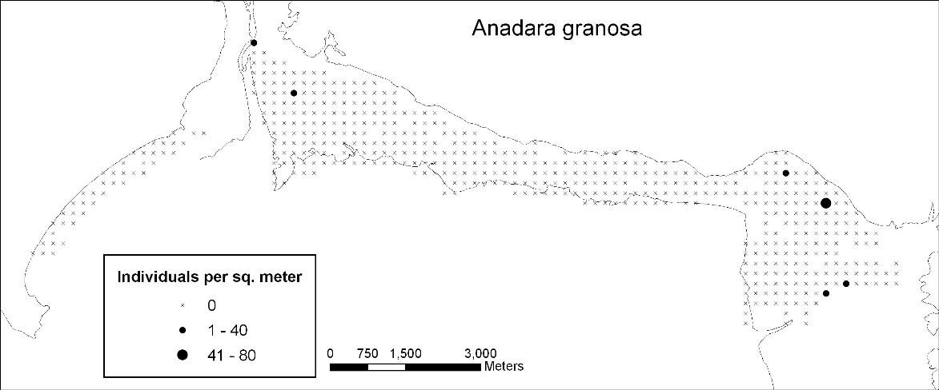
The decline of the bloody cockle.
Traditional food – huge piles of shells found throughout area

Slide 59
We also looked at the birds themselves

Slide 60
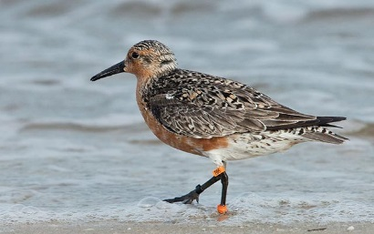

Slide 61
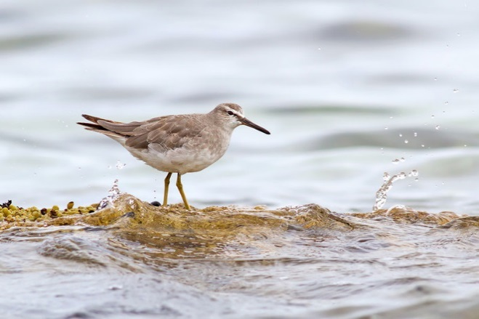

Slide 62
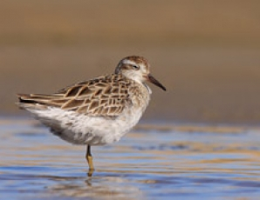

Slide 63
“the richest known intertidal mudflat in the world”
Grant Pearson

Slide 64
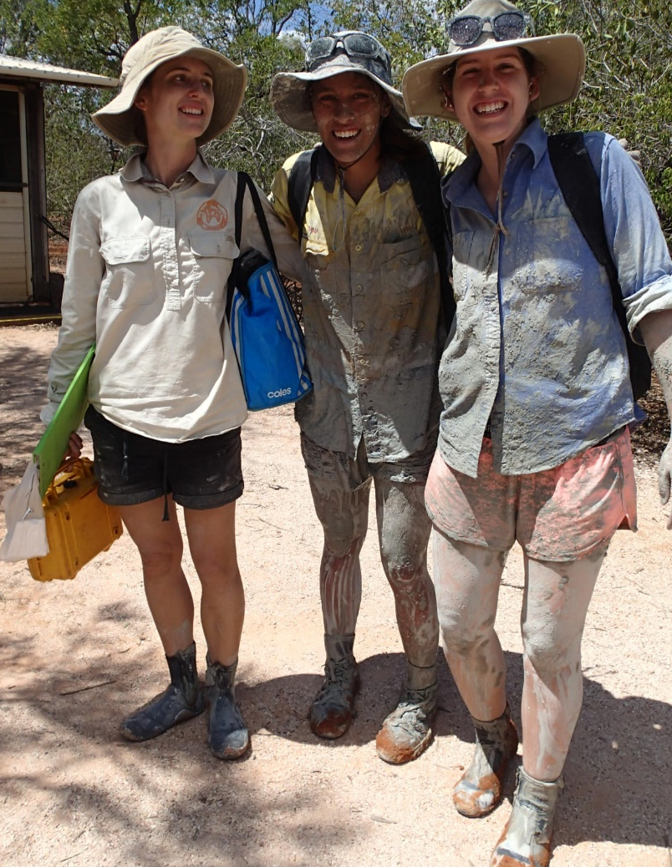
“the biggest known marine benthic invertebrate survey in the world”
Grant Pearson

Slide 65
That’s the science and the volunteers….
What about the specialists?

Slide 66
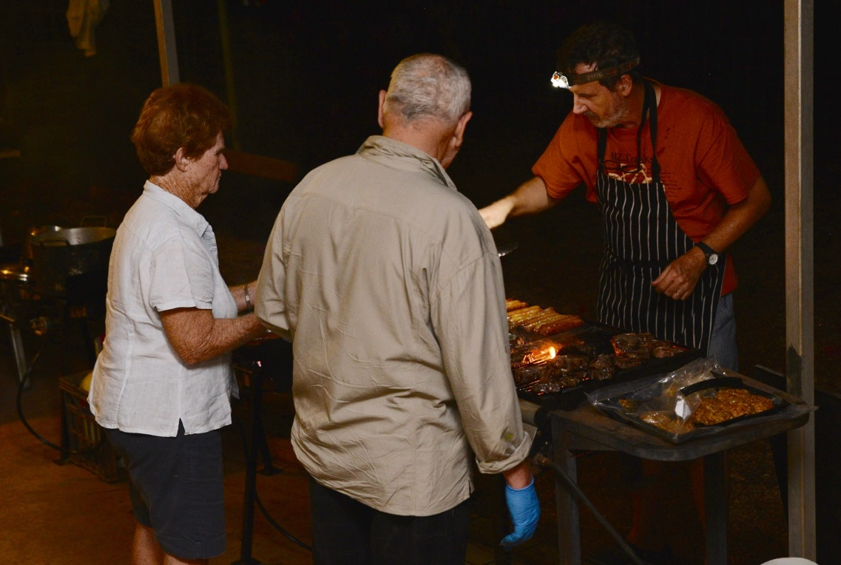
Great cooks

Slide 67
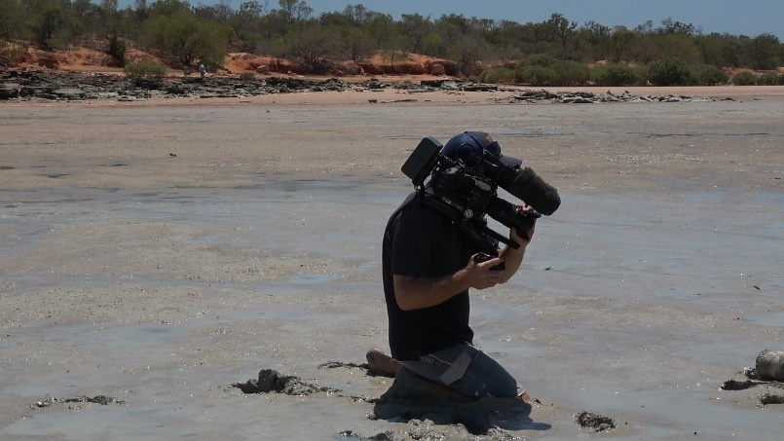
Videos
Postcards WA – on national TV
Smaller, more local vids in competitions, etc.

Slide 69
A good mechanic

Slide 70
And never forget a medic
Photo by Lucie

Slide 71
All this is nice, but….
Why did it work?
Why did so many people come back and volunteer their time?
Were the outcomes met?

Slide 72
Well….
We mostly had the right people with the right skills
Excellent leadership that brought people together despite some challenging situations.
Including people to the extent possible, given their skills, time, and interest.
Made education of everyone a priority - kept everyone informed with almost daily briefings and plenty of Q&A.
Everyone worked – especially the senior people.
It was fun.
Everyone could see the importance of what we were doing

Slide 73
The keystone of all this:
A lot of research, a lot of community outreach.
And one dude who never stopped believing.

Slide 74
Regular updates and meetings

Slide 75
New blood.. And old.

Slide 76
Community Events

Slide 81
Or town. Or, really, anywhere
Photo: Ginny Chan

Slide 82
Between expedition continuity via….
Locals!
Bird banding and various bird expeditions.
Monroeb sampling
BBO

Slide 83
Expedition leaders that share the dirty work.

Slide 84
Keeping your sense of humor
Photo: Ginny Chan

Slide 85
Having fun.
Photo: Hebo Peng

Slide 86
What about the outcomes?
Science
Published a buncha papers, gotten grants, etc…
Which excites almost no one except the senior scientists in the group
But… it provides the background for:
Education
More people than ever know something about and are interested in the Bay
Protection
Resulted in … that’s right… drum roll…..

Slide 87
In 2016, both Roebuck Bay and Eighty Mile Beach, Western Australia were designated Marine Parks.
And I have a little, tiny piece of that. Which is so amazingly cool…..

Slide 88
Photo: Hebo Peng

Slide 89
What’s next?
Become a part of the mandated park monitoring?
World Heritage Sites (they’re already Ramsar Sites)?
Refocus on the rest of the flyway?

Slide 90
Acknowledgements:
Travel funding from the Graduate School, OISP, CALM/DPaW, and others.
My students over the years: Rod, Ed, Michelle, Suzanne, Ora, and Brad (and Brad’s dad, McGuiver).
The team, especially Grant – who keeps pulling us together and keeping us going.
Theunis Piersma for sharing some of the early slides.
Danny Rogers for bird ID.
Everyone whose photo I used.

Slide 92
Photo: Hebo Peng

