Slide 1
Metals

Slide 2
They are elemental and cannot degrade
Can form compounds – can be more or less toxic than the elemental metal.
  Tetraethyl lead
  Iron oxide
Toxicity often PH dependent. For most, more acidic conditions = more toxic metals.
  Side discussion – AS, CD, PB, ZN at the anaconda smelter site.

Slide 3
Emitted during
Burning fossil fuels!
Mining/smelting/refining metals. Each stage releases some metal. Remember inefficiency?
Manufacture of objects containing metals
Recycling products that contain metals.

Slide 4
Mining, real quick.
Multiple issues.
  First is the ore, which is extracted, crushed, etc….
  Waste rock – still has metals in them, just not economic quantities. Radically increased surface area, so water can get to it, react, and carry said metals downstream.
  The mine itself
    Open pit – toxic pit. Goto Berkeley pit in Butte.
    Underground – this time, directly impacting groundwater – again, increased surface area, porosity, and permeability.

Slide 5
Burning hydrocarbons
This is starting to get repetitive, isn’t it?
Especially coal!
Natural gas (and heavily cleaned gas/diesel) are the best.
Install scrubbers on powerplants.
But, the ash always has high metal concentrations (and high surface area). What do do?
  Typically, bury in lined landfills. But the high volume is still a problem.

Slide 6
Impacts
Soil (especially acidic ones)
  Some places, the soils are not fit to grow crops.
    Areas in eastern Europe/soviet union have deserted villages because of this.
    10% of rice paddies in Japan are unusable due to metal contamination.
Lake/ocean sediments
  Think Lake Couer d’Alene
Water – especially the oceans.

Slide 7
Toxicity?
Obviously depends on the metal, form, and concentrations. But…
Some of these are pretty nasty. We’ll go on to talk about lead, arsenic, and mercury.
Funny… a diet high in fruits, veggies, and grains tends to not only lead to less metal input, but a body better able to deal with what it gets.

Slide 8
OK. Let’s talk about lead for a bit.
Neurotoxin. And persistent. But can affect pretty much every organ. Worse for kids, etc.
Stored in the bones.
Lower IQs and more frequent mental issues as lead exposure goes up.
Even the romans knew that lead was toxic!
  Why then the ubiquitous use up to very recently?

Slide 9
Widely used in pipes, solders, paint, gasoline (as tetraethyl lead, added as an anti-knock agent).
Lots emitted from coal burning.
Often a waste metal when mining. And we all know what, historically, happened to waste materials.
Ubiquitous in the environment.

Slide 10
Much is injected into the atmosphere
Can travel very long distances – found globally. Literally.
When it falls on land, it sorbs to clays in the soil and remains fairly in-place. Beware erosion (including wind)
More toxic as things get acidic (mouth, stomach?)

Slide 11
Lead risk in the US – age of houses+poverty
https://www.vox.com/a/lead-exposure-risk-map

Slide 12
https://www.cmu.edu/news/stories/archives/2019/august/lead-exposure.html

Slide 13
What’s been done?
Obvious ones re putting less into the atmosphere. Less burning coal, better dealing with waste.
No more lead in gasoline (replaced with benzene, a carcinogen. But not as bad as lead)
No more leaded paints (still dealing with this legacy, though. Banned in ’78 for residential structures)
Banning lead shot? Not yet in the US. Why not?
Replacing pipes. Remember Flint?

Slide 14
Mercury!
Another neurotoxin. As always, especially bad for the fetus and infants.
Are both inorganic and organic compounds. The organic one is common and extremely toxic (methyl mercury)

Slide 15
Mad as a hatter!
https://www.healthline.com/health/mad-hatter-disease
During the 18th to 20th centuries, hat makers used mercury to stiffen felt for hats. They used a type of mercury called mercuric nitrate and worked in poorly ventilated rooms.
Over time, the hatters inhaled mercury vapors. Many developed symptoms of chronic mercury poisoning, including psychosis, excitability, and tremors. These symptoms became so common in hatters that the phrase “mad as a hatter” was born.
In the United States, mercury was used in hat making until 1941.
Alice in wonderland.
Mercury used

Slide 16
Found as
Elemental, liquid mercury
Inorganic forms. Including mercurochrome (anyone remember that?). Which is now banned in the US, but not everywhere. Useful topical antiseptic.
Organometallic form – methylmercury (CH4Hg). VERY toxic. Produced my microorganisms in water and soil.

Slide 17
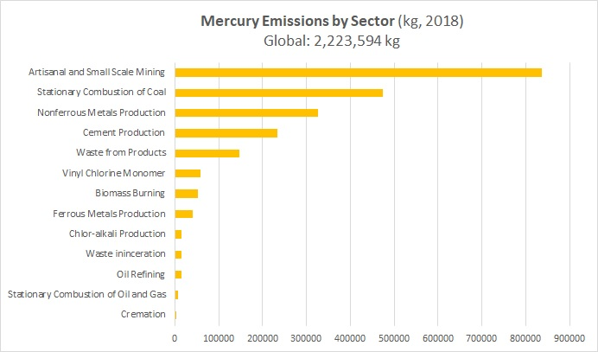
In US, coal is #1

Slide 18
Gold mining: Mercury is mixed with gold-containing materials, forming a mercury-gold amalgam which is then heated, vaporizing the mercury to obtain the gold.
But, the real problem in most places is Methyl mercury - formed by bacteria, especially in water bodies. Which then biomagnifies up the food chain.
Top predators have LOTS. Think tuna, killer whales, sharks, swordfish, etc. Also, many freshwater fish. Often results in bans on eating fish from certain bodies of water.

Slide 19
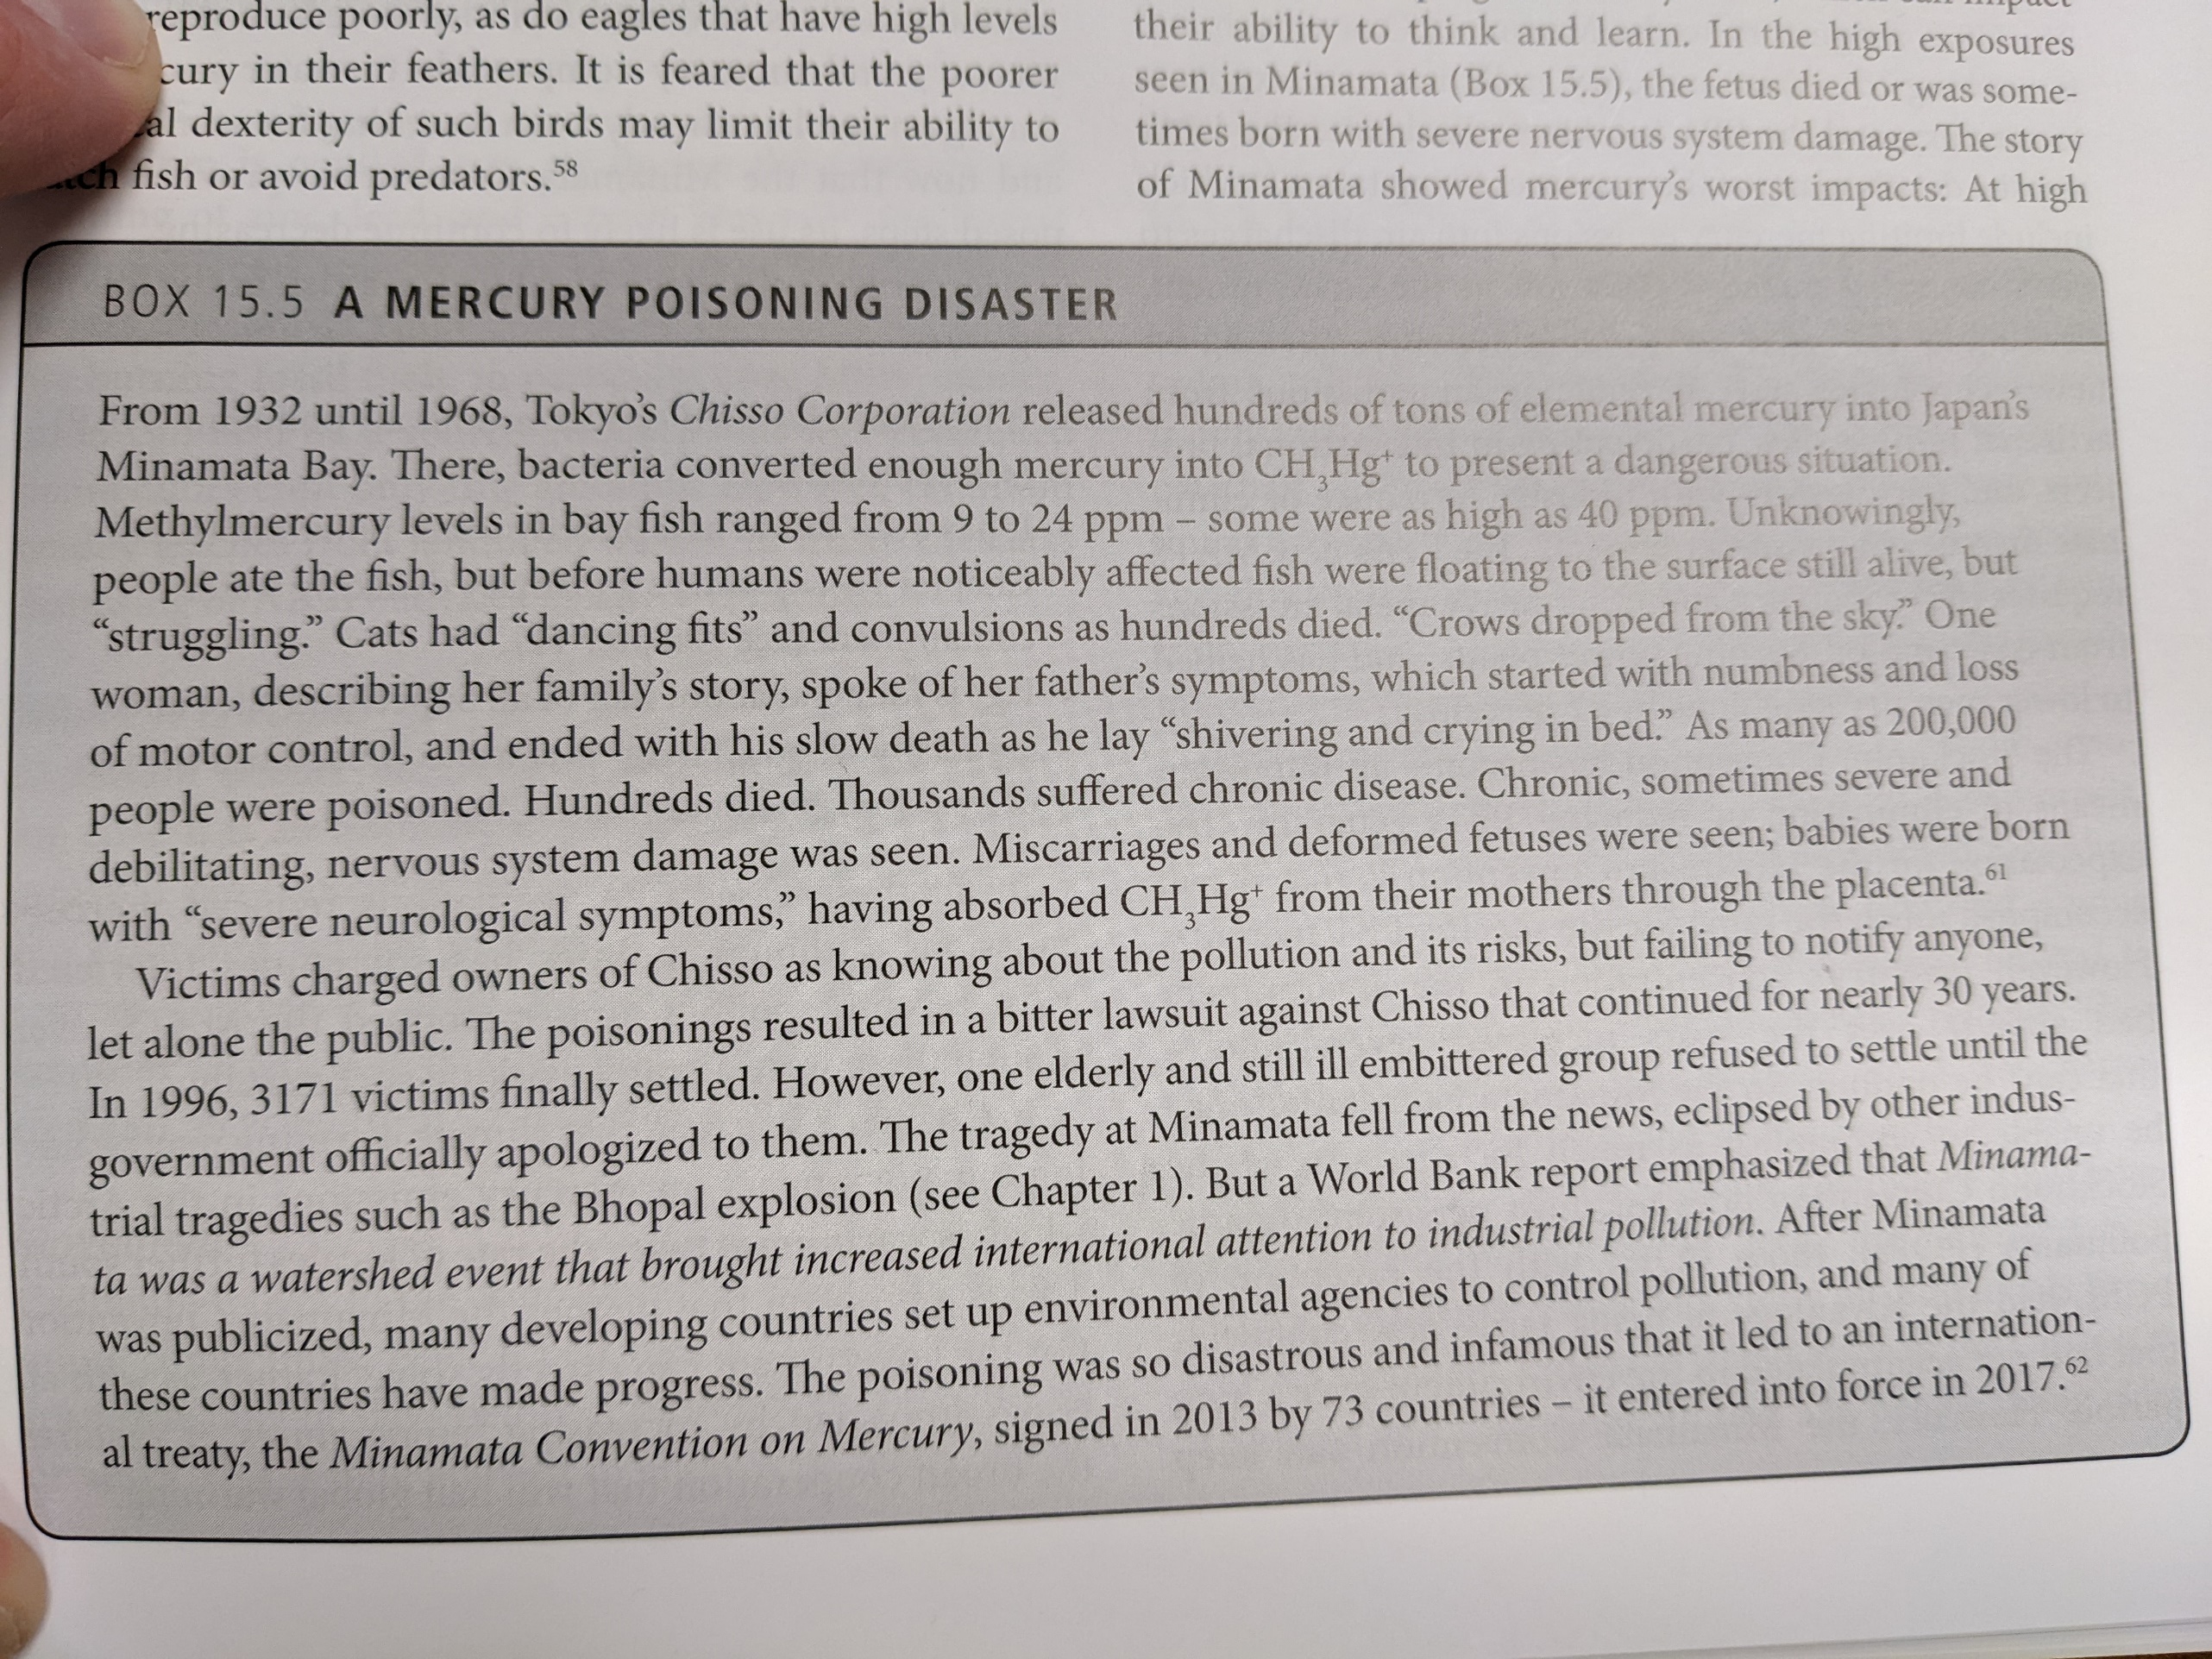

Slide 20
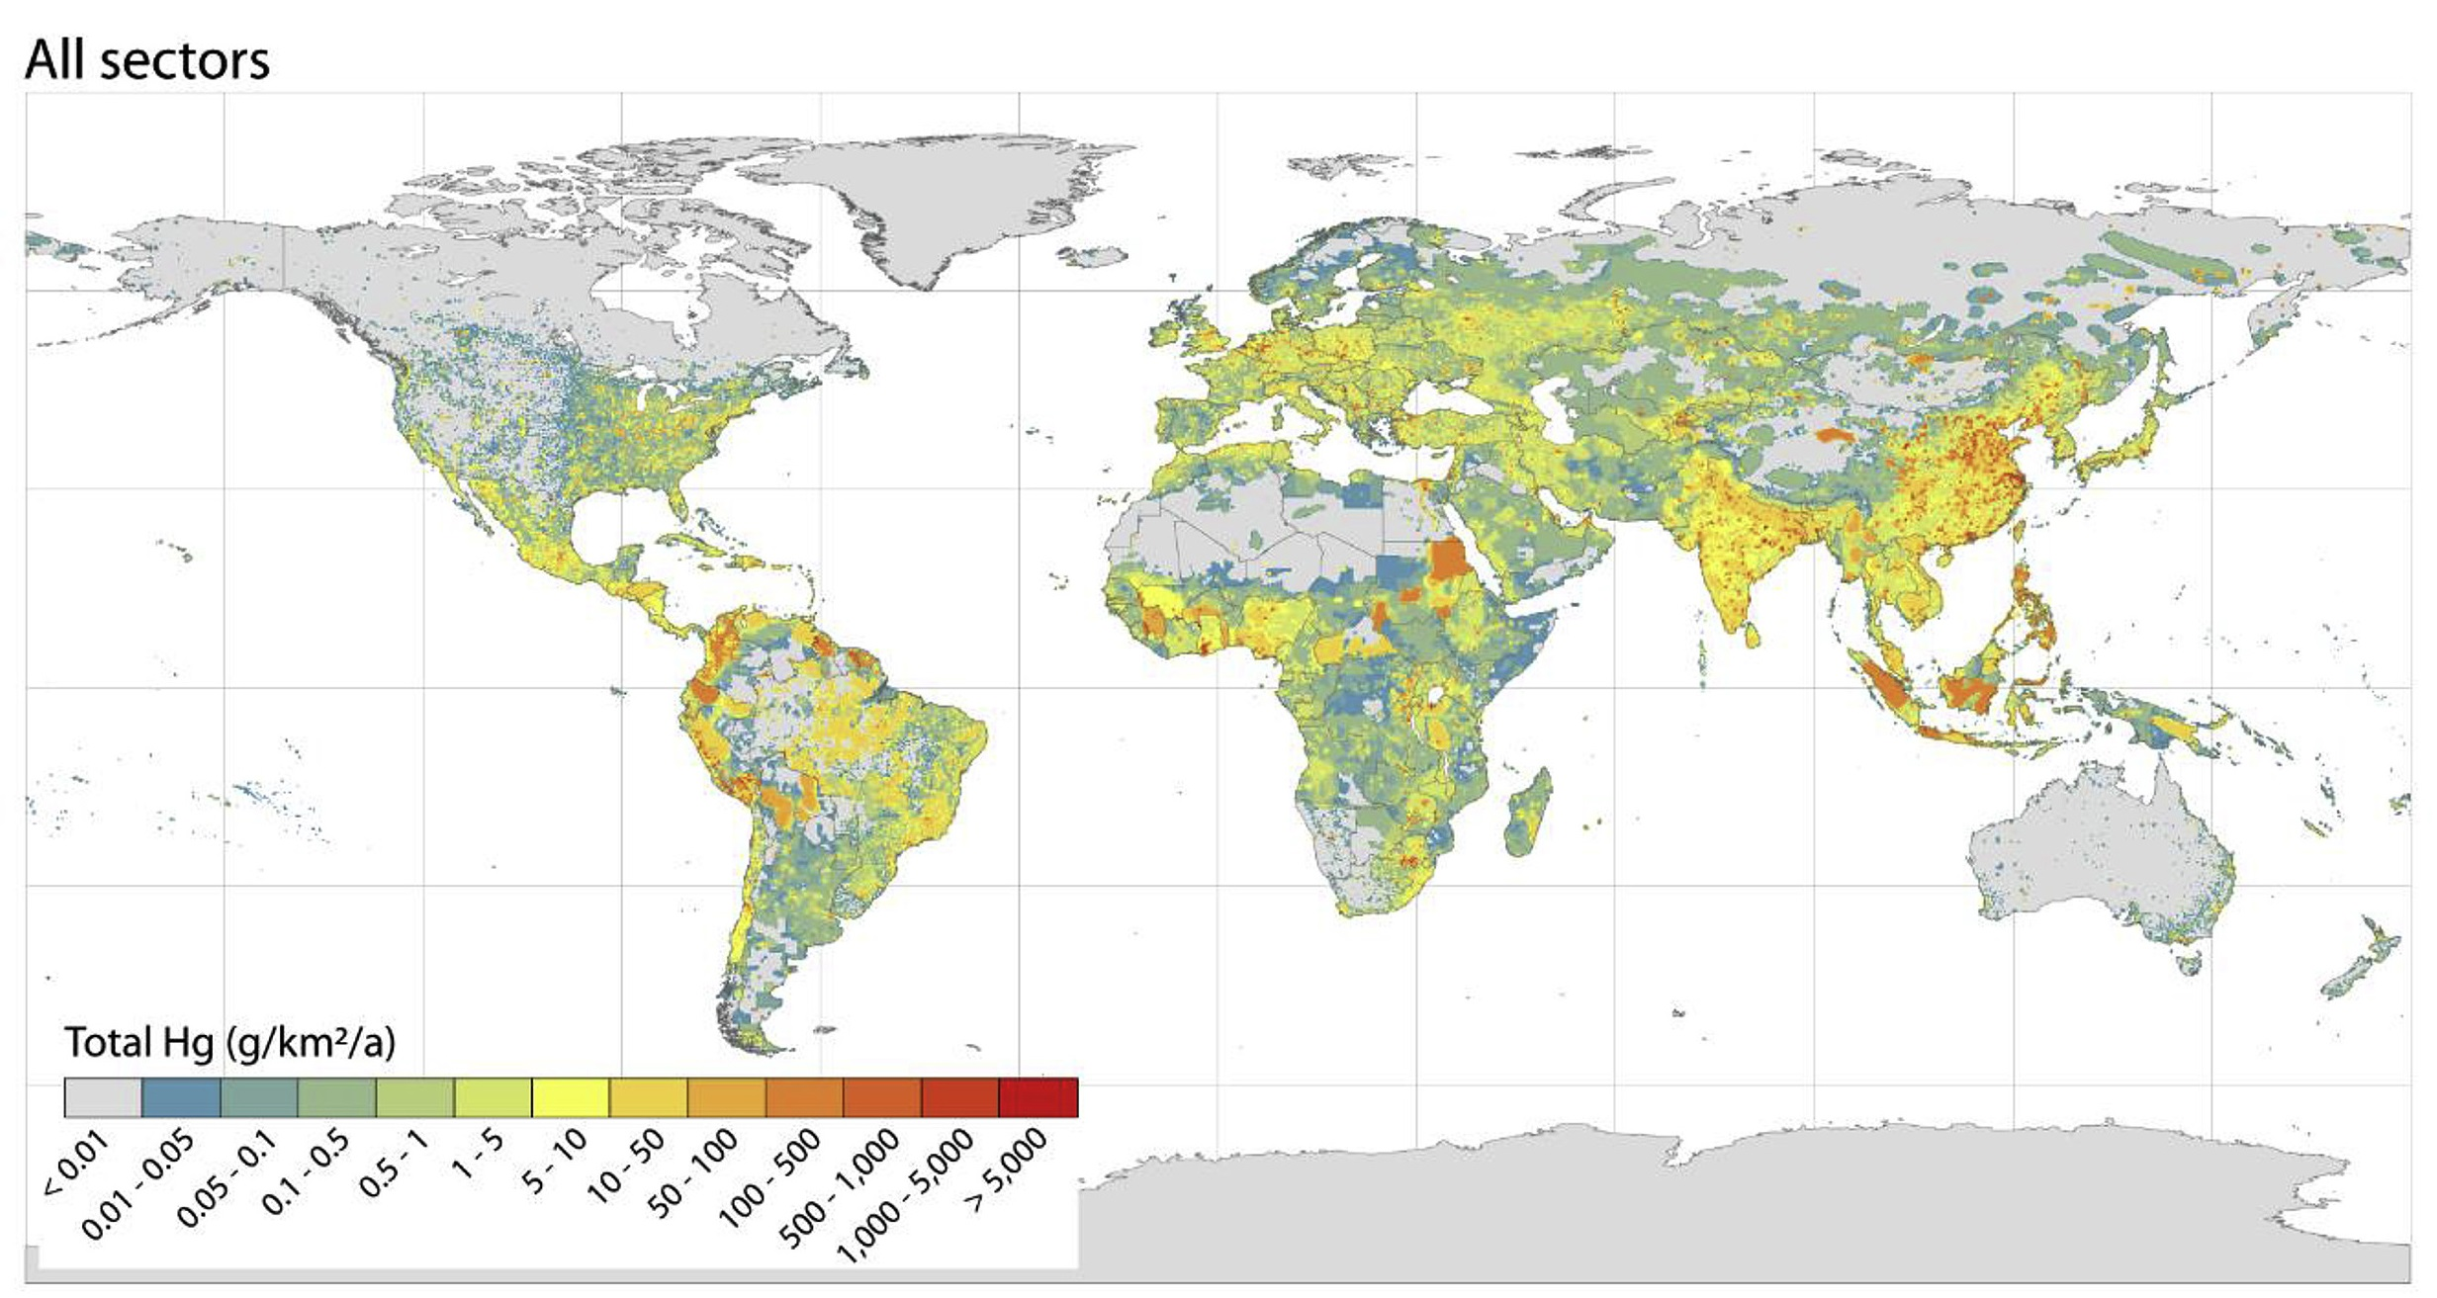

Slide 21
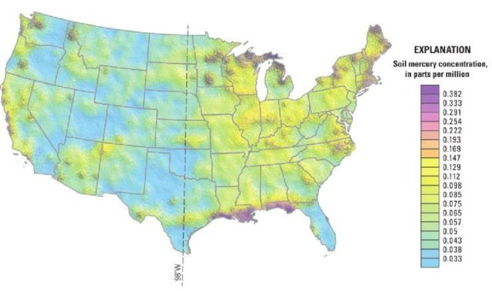

Slide 22
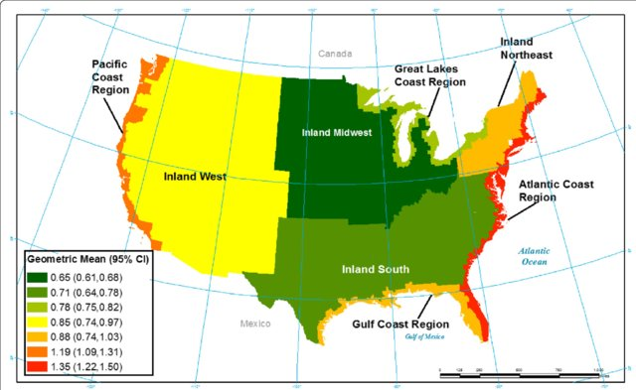

Slide 23
https://www.yourdoctorsorders.com/2014/04/fish-and-mercury-causes-symptoms-fish-you-can-eat/

Slide 24
2013 Minamata Convention on Mercury
Controls on emission of mercury.
  No longer use mercury amalgams to fill cavities in teeth.
Went into effect in 2017. 123 countries have signed.
  Reduce/eliminate use in mining
  Control emissions from coal plants, waste incineration, and cement production.
  Phase out use in electronics, cosmetics, pesticides, etc.
  Phase out in manufacturing processes.
  Safer storage and disposal.

Slide 25
Arsenic
A metalloid – not quite a metal. But not quite a non-metal.
Usually found as a compound.
Typical byproduct of mining/purification of silver. Also, burning coal…
Heavily used to treat wood products (chromated copper arsenate) – prevents decay. Ouch.
Gets into drinking water. Also food (from soils)
Higher concentrations in seafood, though it does not seem to be as bioavailable.

Slide 26
toxicity
As always, dose dependent. Nausea.. Up to heart problems.
Chronic exposure can cause skin lesions/issues. Later on, skin cancers, high blood pressure, diabetes,.

Slide 27
Ironic…
Much of the use of arsenic that is poisoning water supplies was put there deliberately to deal with pathogens (Bangladesh is the poster child for this issue). Worked great in the short term…..

Slide 28
https://www.usgs.gov/mission-areas/water-resources/science/arsenic-and-drinking-water

