Slide 1

Drone Imaging for Science and Public Service
Douglas (Doug) Stow
Department of Geography and
Center for Earth Systems Analysis Research (CESAR)
San Diego State University
The View From Above: Exploring the Future of Drones
(slightly edited for geog 430 by Bob Hickey)

Slide 2
Presentation Overview
Drone imaging as a type of remote sensing
Science and public applications of drone imaging
SDSU research on drone imaging applications

Slide 3
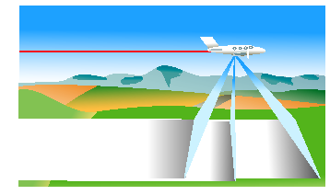
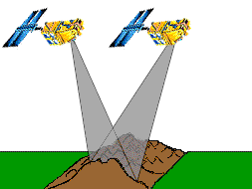
Remote Sensing of Environment
Remote sensing of environment = collection of data
about the earth’s surface and atmospheric features or
phenomena, without being in direct contact with such
features or phenomena.

Slide 4
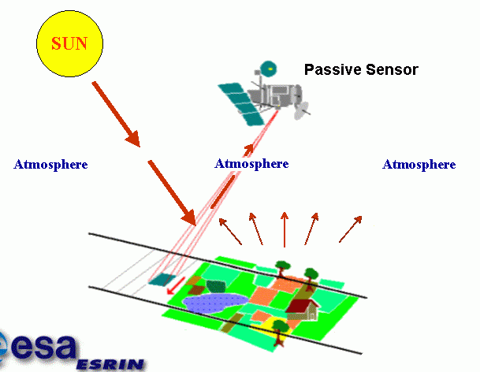
Electromagnetic Radiation (EMR) as Information Link

Slide 5
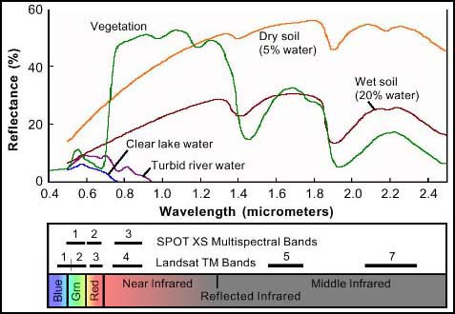
Spectral Reflectance Signatures

Slide 6
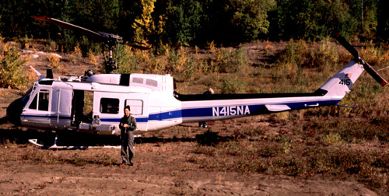
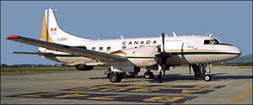
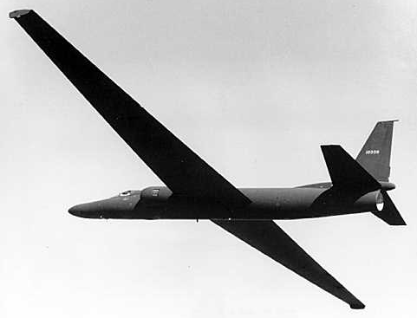
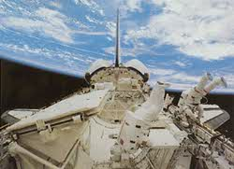
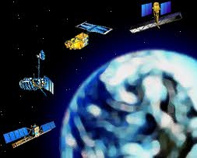
Platforms

Slide 7
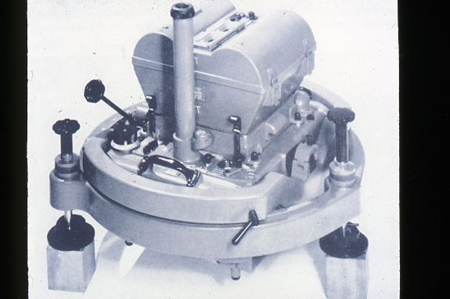
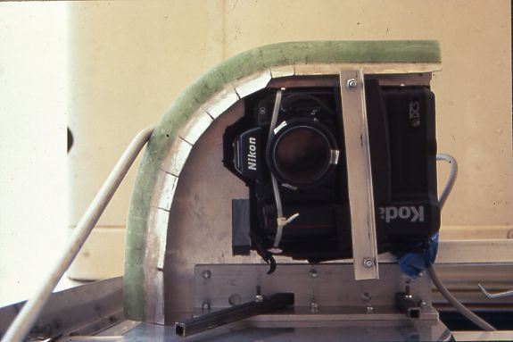
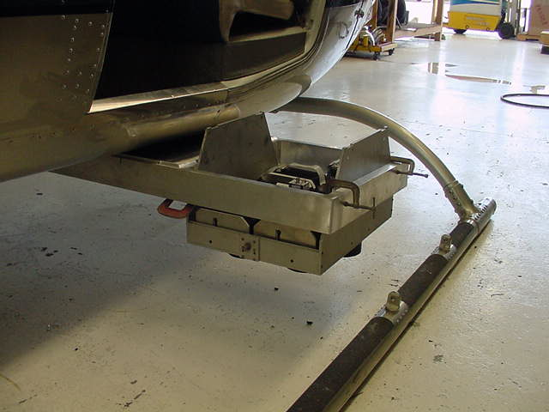
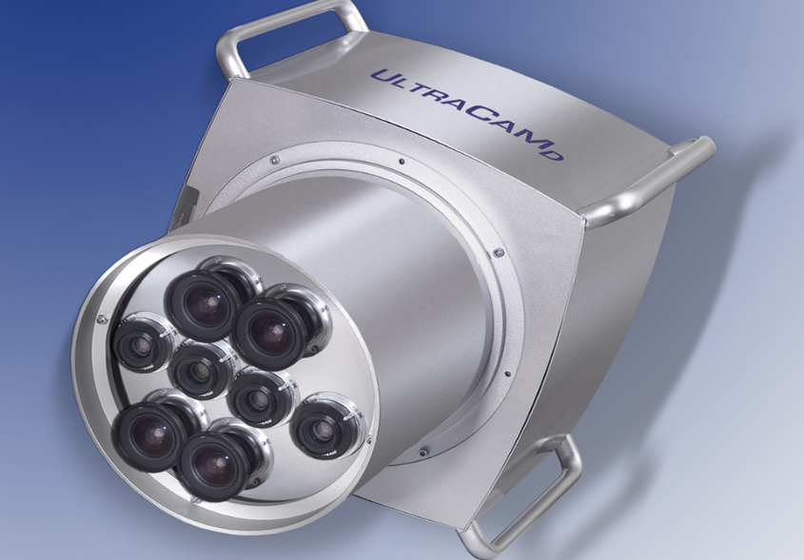
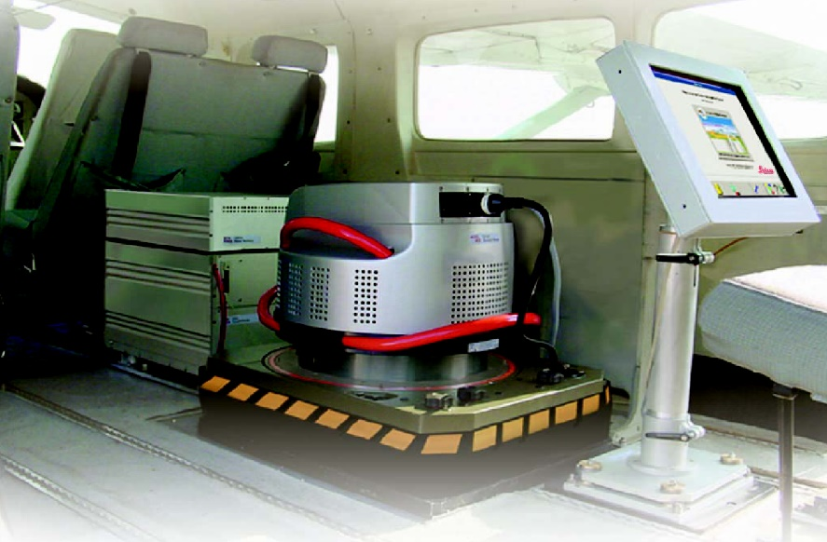
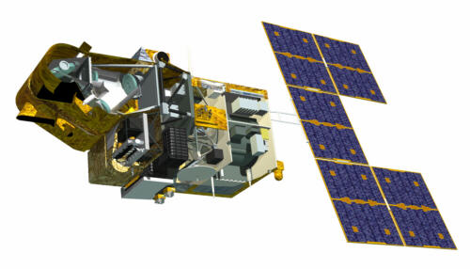
Optical Imaging Sensors

Slide 8
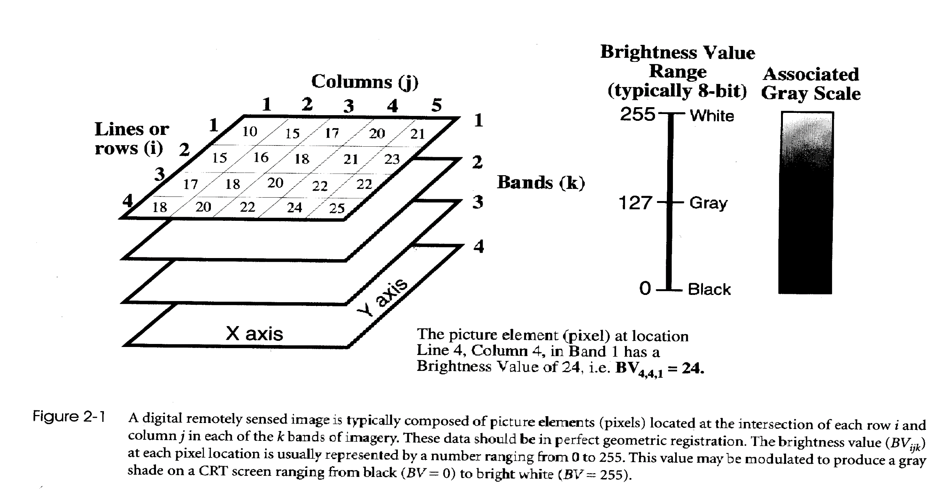
Multi-spectral Digital Image

Slide 9
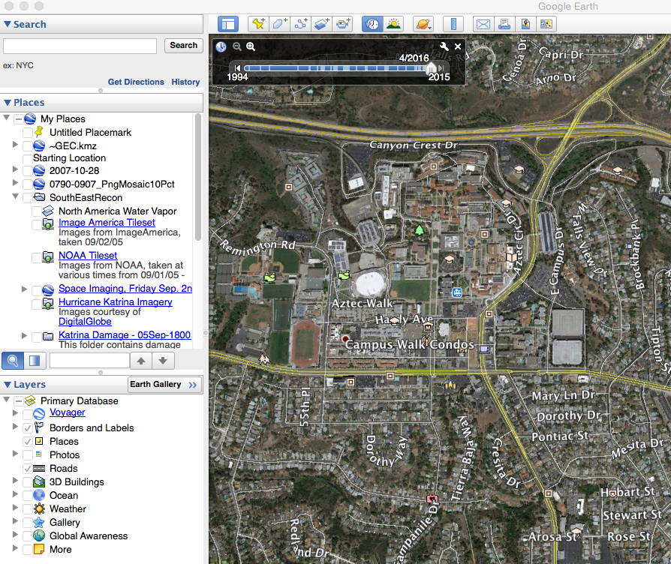

Slide 10
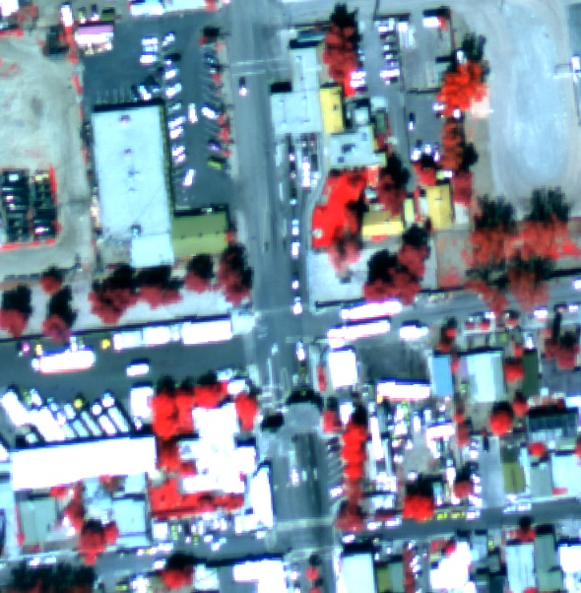
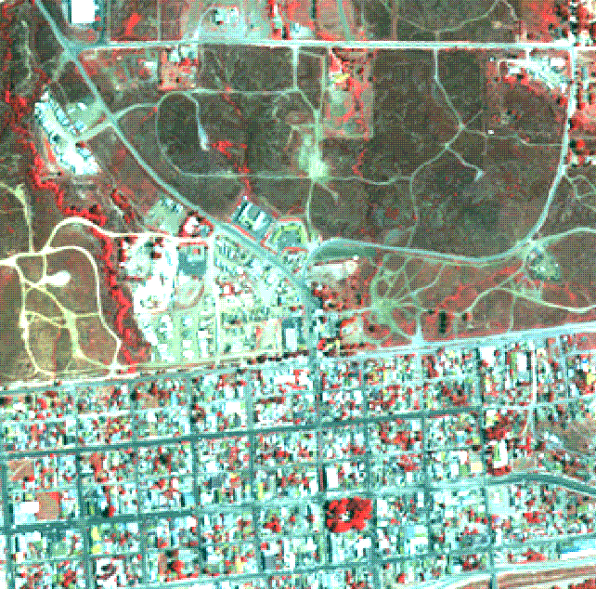
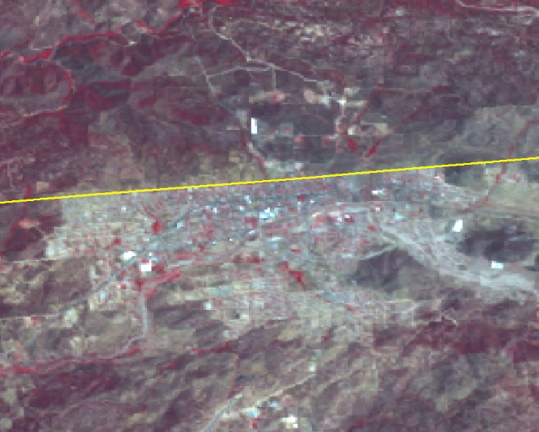
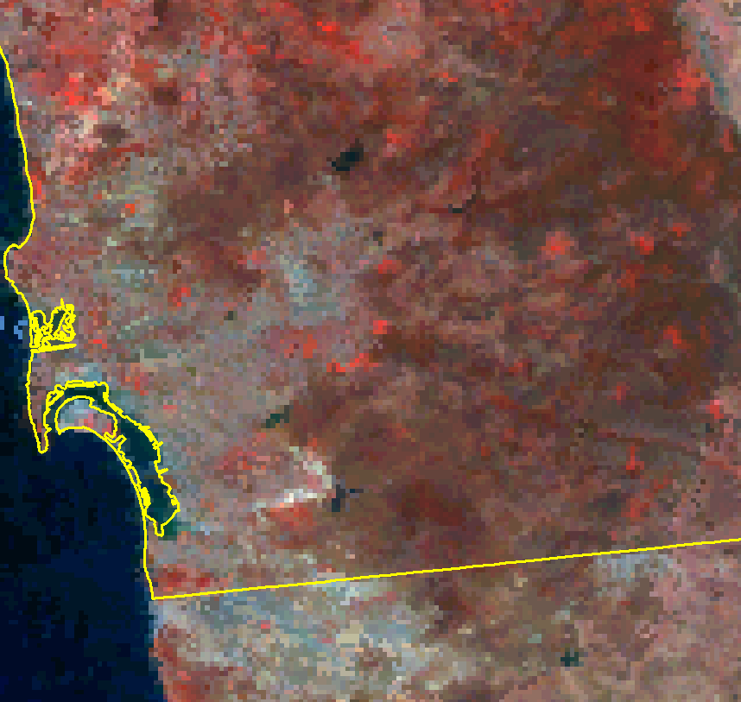
Spatial Scales of Color Infrared Remote Sensing Imagery
High /fine
spatial resolution
High/fine spatial resolution
Commercial Airborne
Multispectral Digital Image (0.01 to 1 m)
Commercial Satellite
Image ( 0.3 to 5 m)
Low/coarse spatial resolution
Moderate/ medium spatial resolution
NASA Landsat TM/ETM+
Satellite Image (30 m)
NASA Terra MODIS Satellite
Image (250 to 1000 m)

Slide 11
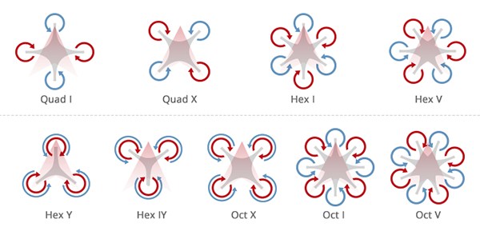
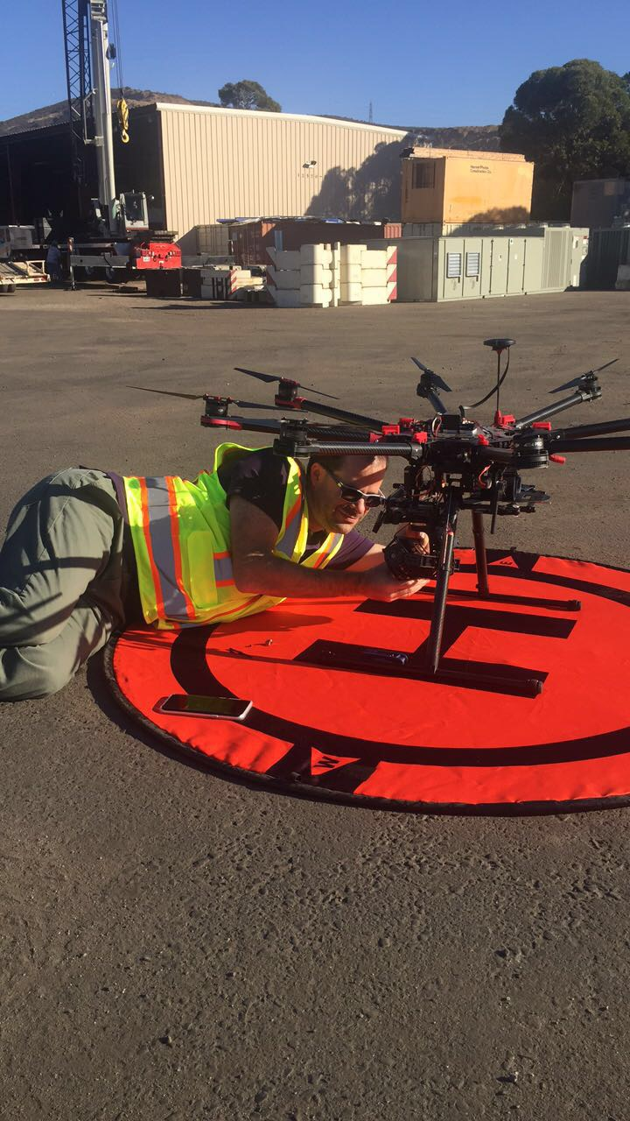
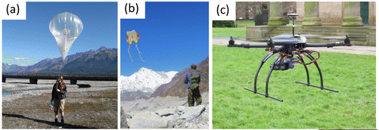
Platforms: Rotary-wing
https://filmora.wondershare.com/drones/types-of-drones.html
Smith, M. W., Carrivick, J. L., & Quincey, D. J. (2016). Structure from motion photogrammetry in physical geography. Progress in Physical Geography, 40(2), 247-275.

Slide 12
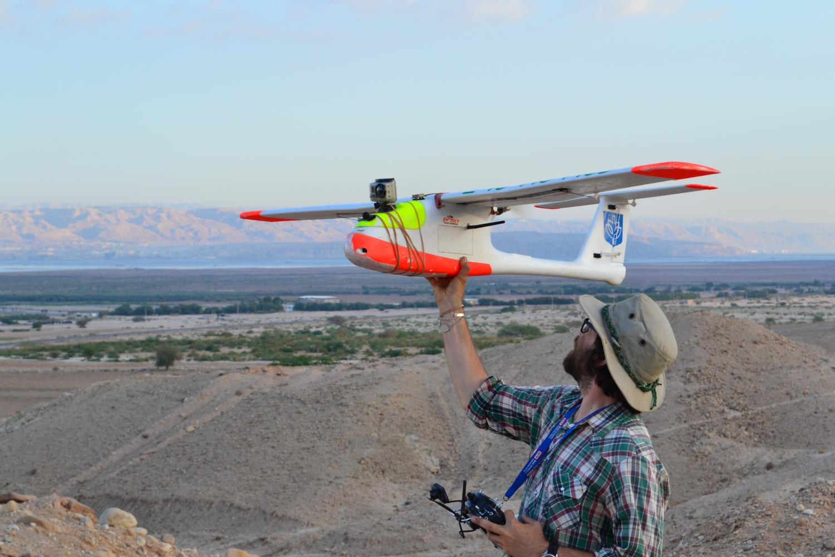
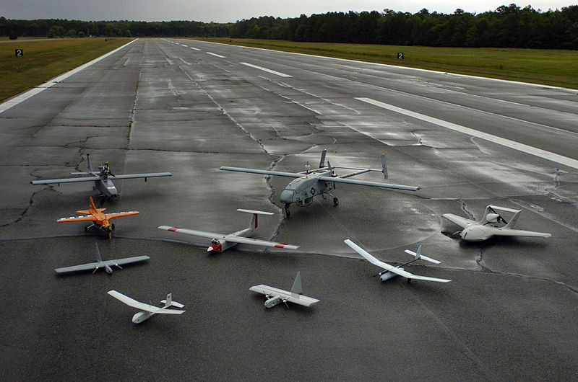
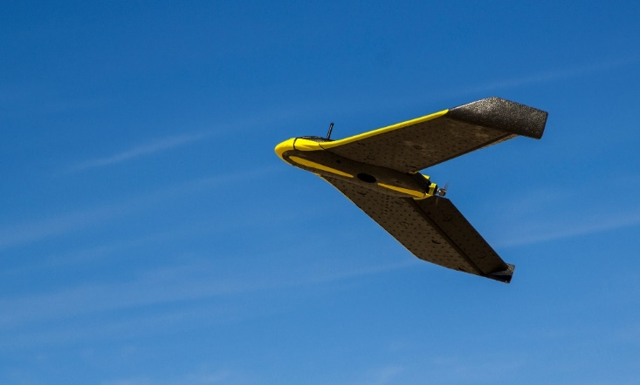
Platforms: Fixed-wing
https://phys.org/news/2016-02-drones-archaeologist-uav-fifa.html
by Photographers Mate 2nd Class Daniel J. McLain
flight-evolved.com/senseFly-ebee-drone/

Slide 13
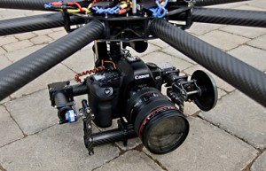
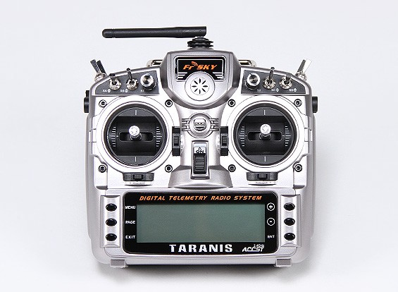
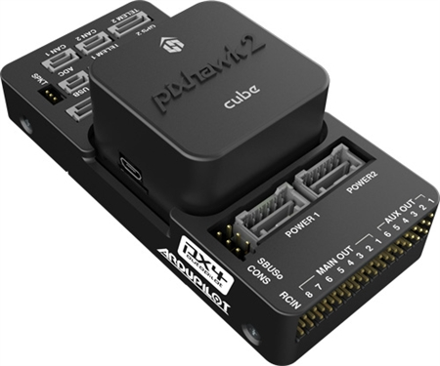
Controllers
Radio controller
(manual)
Flight controller
(autonomous)
Gimbaled camera mount
http://pixhawk.com/
Global positioning system
Inertial motion unit

Slide 14
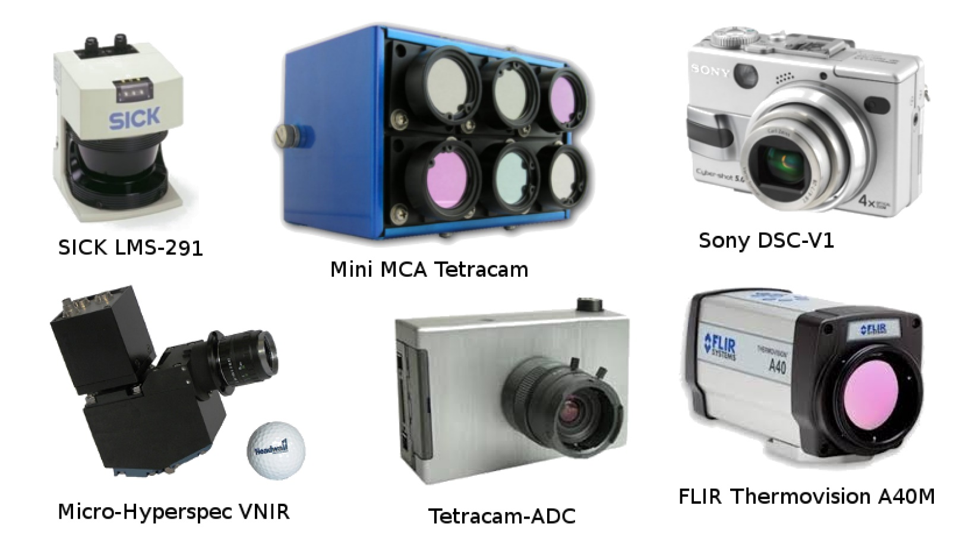
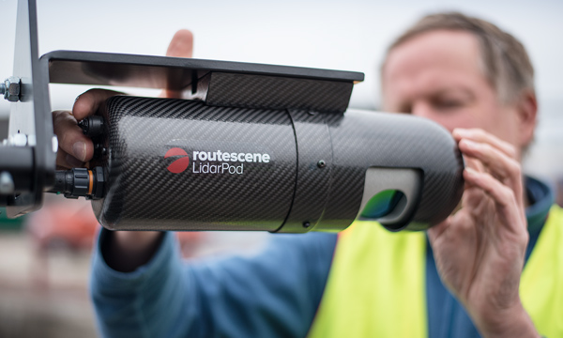
Sensors
Imaging
Light detection and ranging (Lidar)
www.routescene.com
http://www.dronedynamics.com/uav-sensor-solutions/
Salamí, E., Barrado, C., & Pastor, E. (2014). UAV flight experiments applied to the remote sensing of vegetated areas. Remote Sensing, 6(11), 11051-11081.

Slide 15
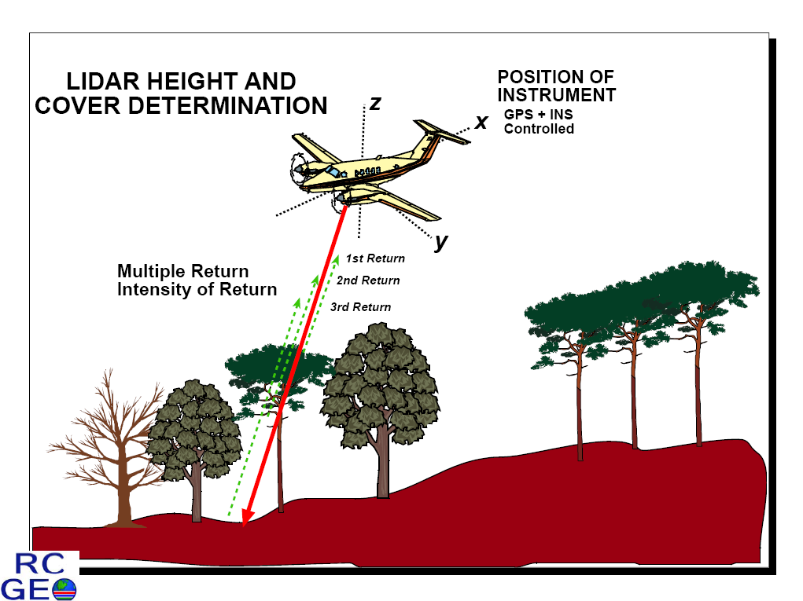
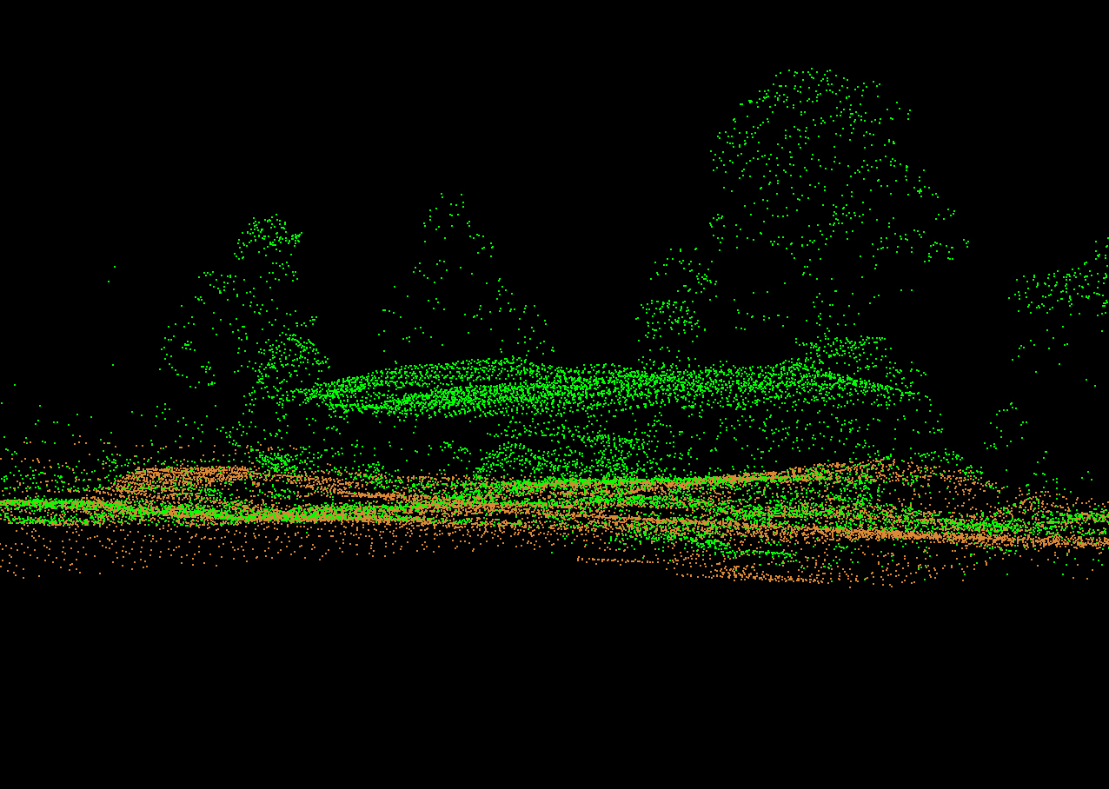
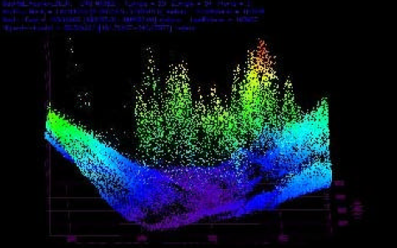
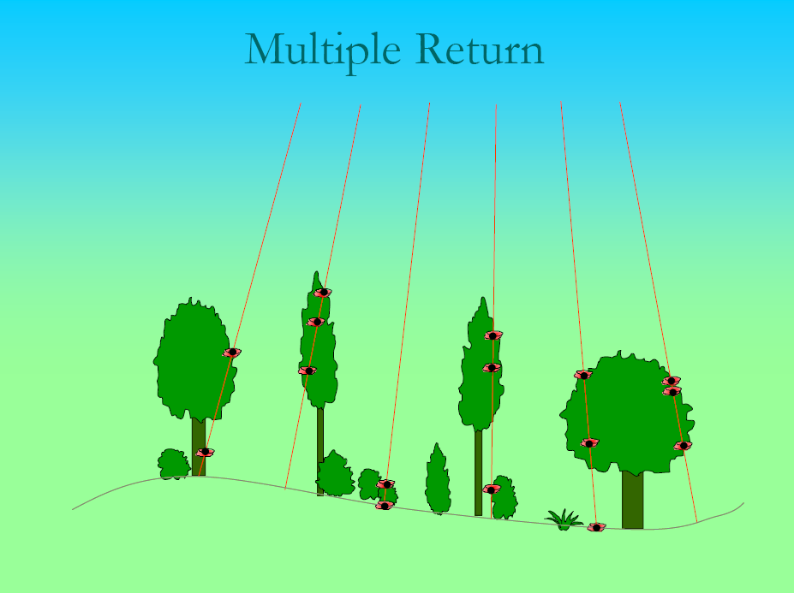
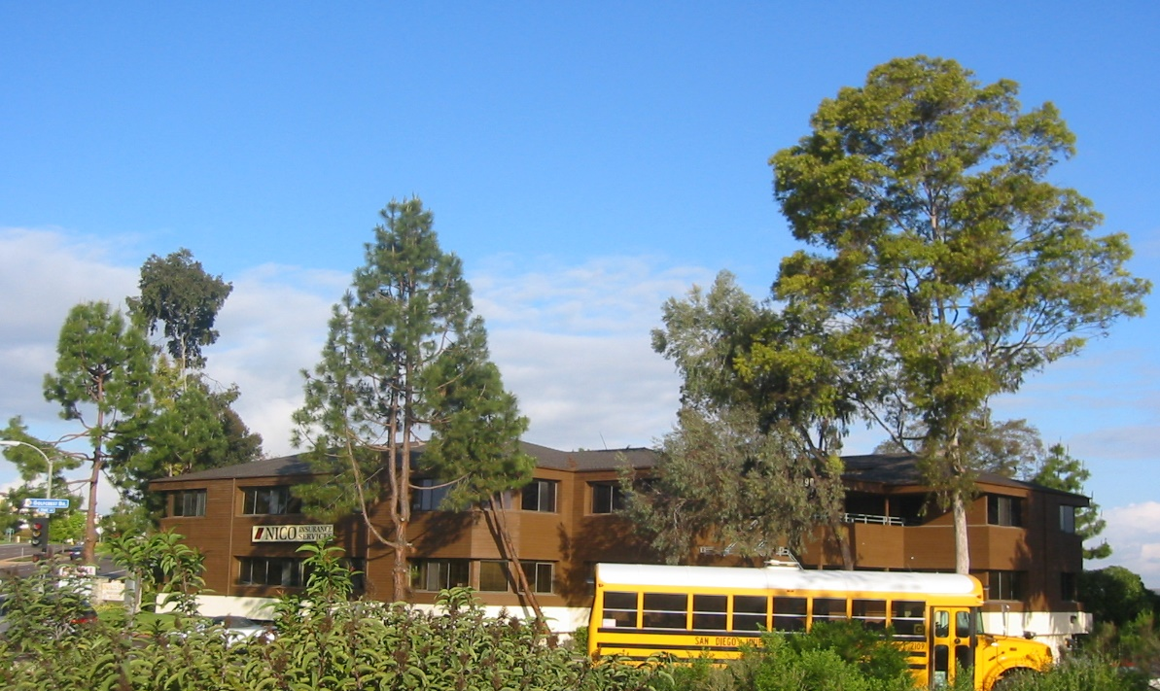
LIDAR – Light Detection and Ranging (Active Sensing)

Slide 16
Software needed.
Flight planning
Image processing
Probably some real photogrammetric software.

Slide 17
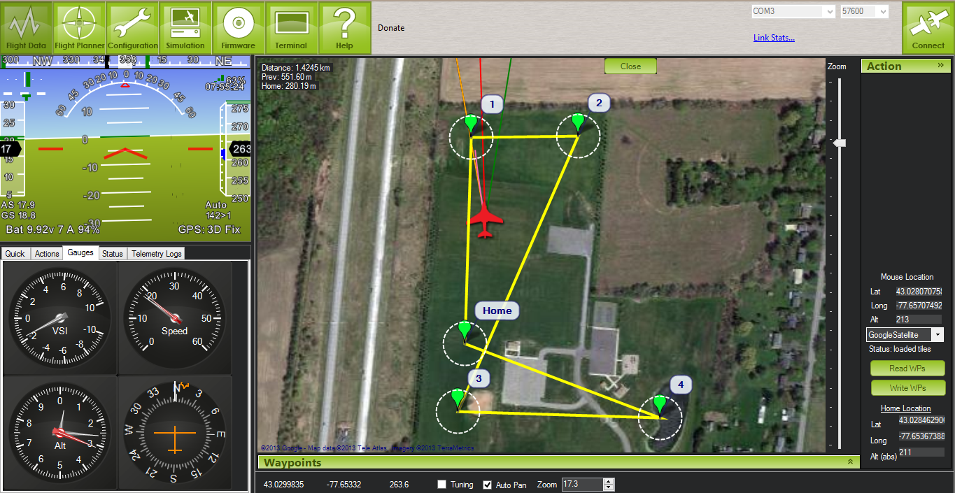
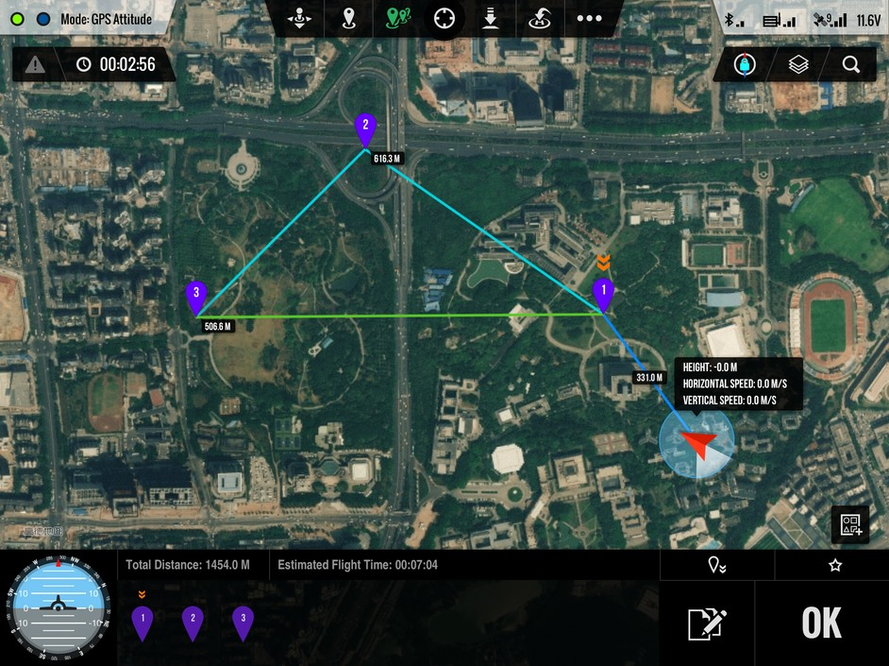
Flight Planning Software
Mission Planner: Ardupilot.com
Mission Planner (DJI): DJI.com
https://www.dronedeploy.com

Slide 18
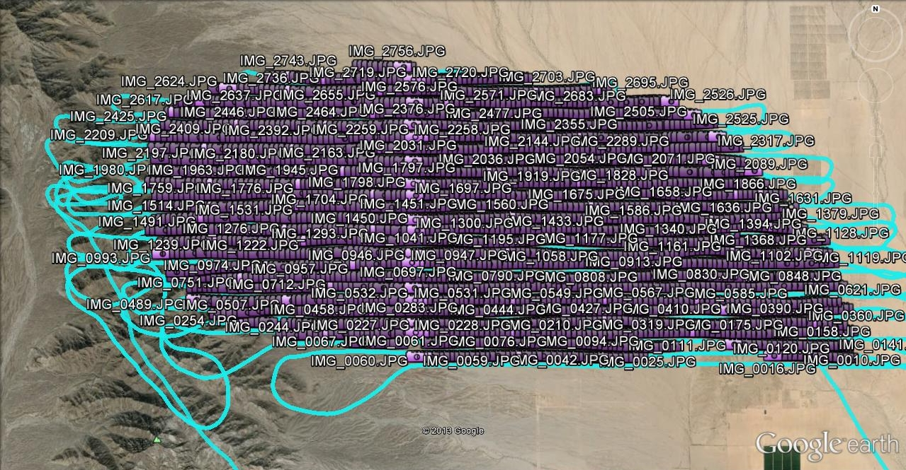
Image Capture Pattern to Support
Structure from Motion processing

Slide 19
Structure from Motion (SfM) Software
Capture overlapping (70-85%) images
https://www.pix4d.com/
https://www.agisoft.com/ - now agisoft metashape. We have ONE license.

Slide 20

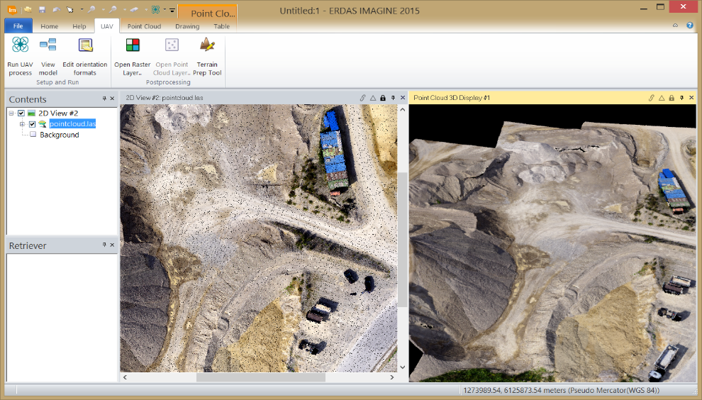
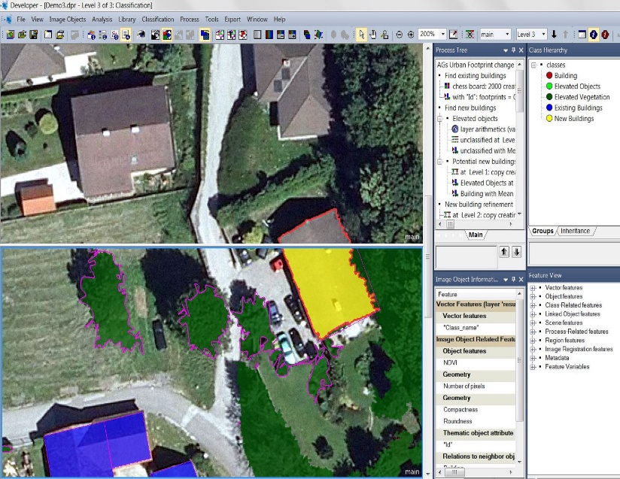

Image Processing Software
Hexagongeospatial.com
Geobia2016.com

Slide 21
Advantages of Drone Imaging
Low platform, sensor and acquisition costs
Ultra-high spatial resolution imagery (sharp detail)
Highly mobile and flexible platform
Able to fly under cloud cover
Real-time imaging potential; timely data/information delivery
Omni-directional viewing capability
Ability to generate detailed digital surface models

Slide 22
Challenges of Drone Imaging
Unstable platforms and sensors in some weather conditions (wind, precipitation, extreme cold and heat)
Limited duration (short battery life)
Altitude and line-of-sight operation limitation
Limited areal coverage
Safety and liability

Slide 23
General Products/Applications of Drone Imaging
Ultra-high spatial resolution imagery and orthoimage mosaics
3-D topography, vegetation canopy, structure heights
3-D changes over time: erosion/sedimentation, volume changes, plant growth/decline, construction/destruction, etc.
Vegetation/crop types and condition
Detection and tracking of people, animals, vehicles
Inspection of built/infrastructure features (wear and damage)
Calibration and validation for piloted airborne and satellite image-derived products

Slide 24
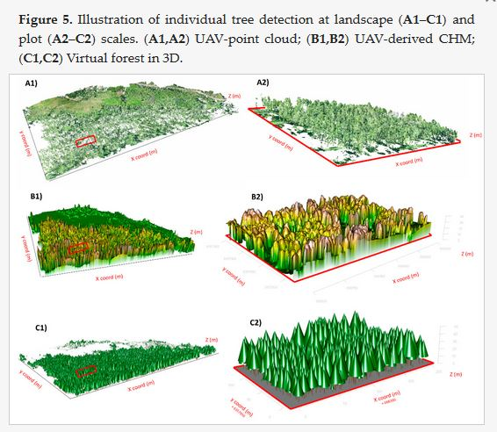
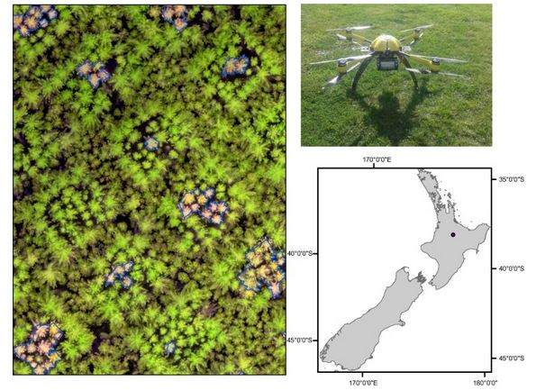
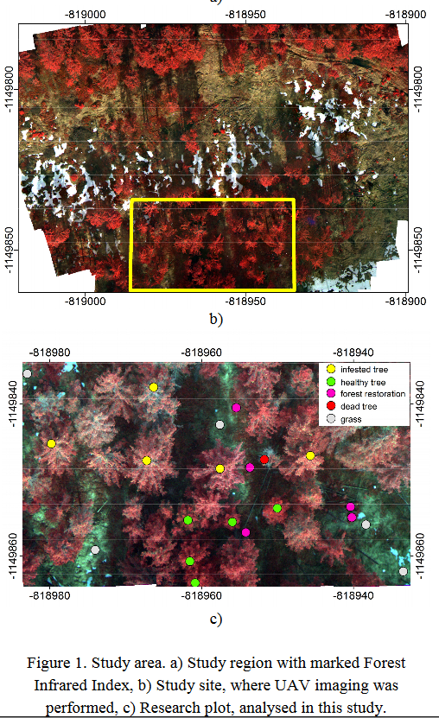
Natural Vegetation Monitoring (Eric and cacti)
Minařík, R., & Langhammer, J. (2016). Use of multispectral UAV photogrammetry for detection and tracking of forest disturbance dynamics. International Archives of the Photogrammetry, Remote Sensing & Spatial Information Sciences, 41.
Dash, J. P., Watt, M. S., Pearse, G. D., Heaphy, M., & Dungey, H. S. (2017). Assessing very high resolution UAV imagery for monitoring forest health during a simulated disease outbreak. ISPRS Journal of Photogrammetry and Remote Sensing, 131, 1-14.
Mohan, M., Silva, C. A., Klauberg, C., Jat, P., Catts, G., Cardil, A., ... & Dia, M. (2017). Individual Tree Detection from Unmanned Aerial Vehicle (UAV) Derived Canopy Height Model in an Open Canopy Mixed Conifer Forest. Forests, 8(9), 340.

Slide 25
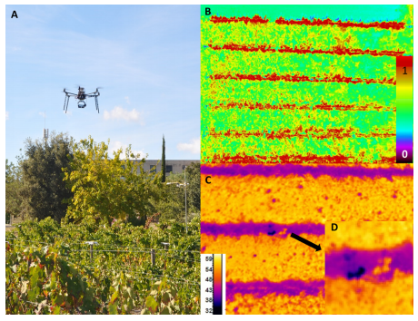
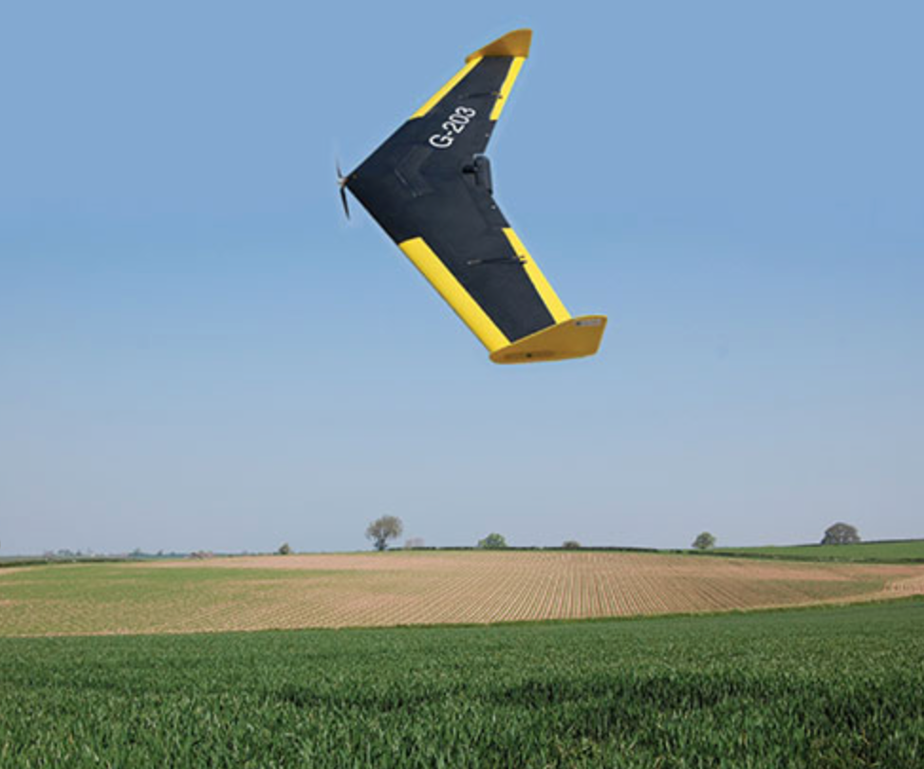
Precision Agriculture
Gago, J., Douthe, C., Coopman, R., Gallego, P., Ribas-Carbo, M., Flexas, J., ... & Medrano, H. (2015). UAVs challenge to assess water stress for sustainable agriculture. Agricultural Water Management, 153, 9-19.
Nexdrone.com

Slide 26
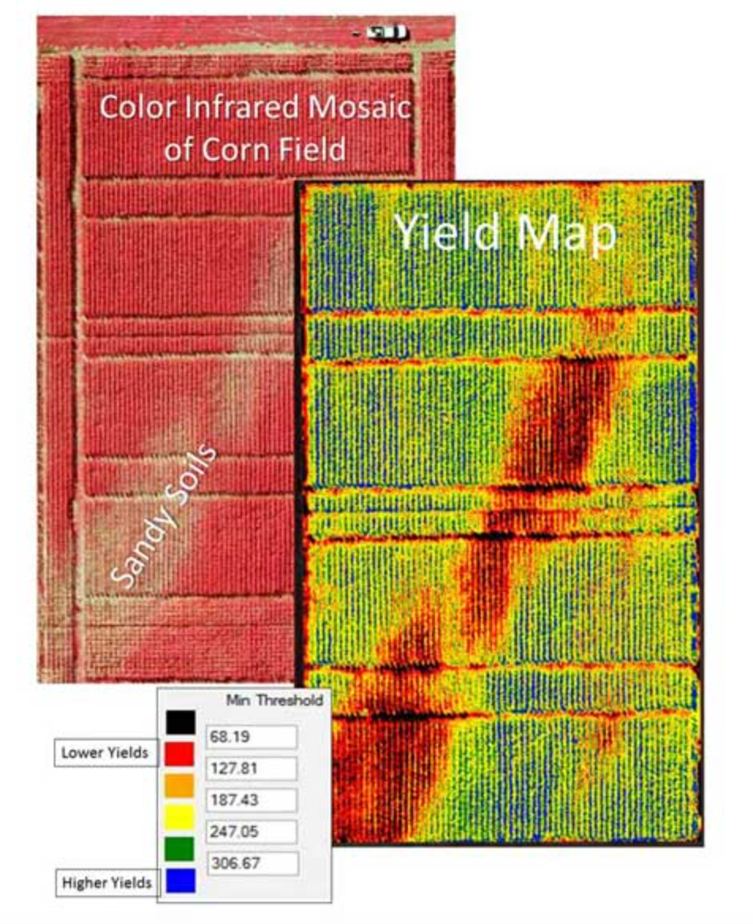
Crop Yield Based on Drone Color Infrared Imagery

Slide 27
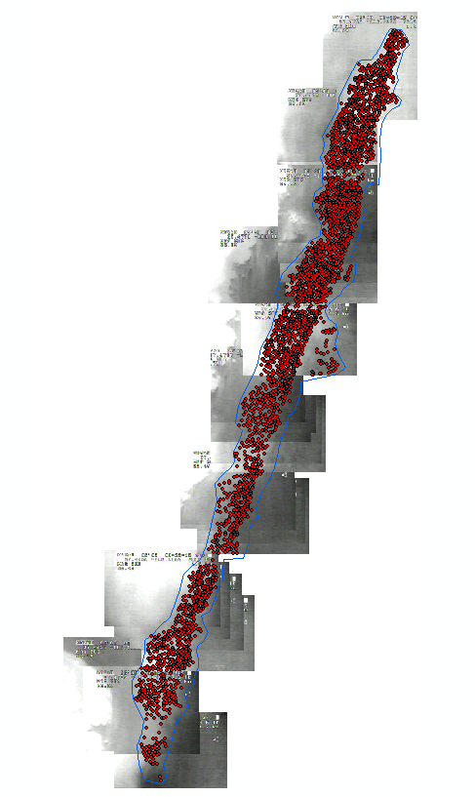
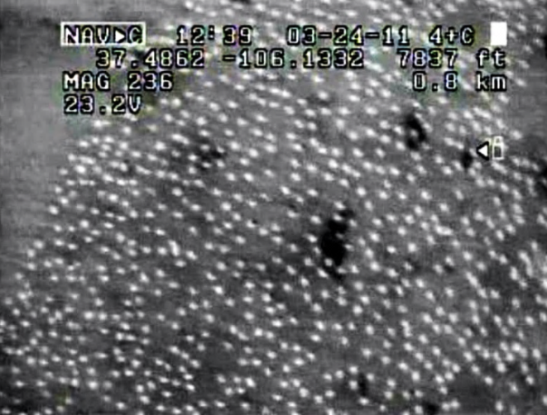



Animal Tracking and Population Estimates
Developing methods to estimate Sandhill Crane abundance for natural resource management.
Courtesy of Corey Plank, BLM
Execution of this UAS mission cost $2,645, compared to similar fixed wing manned aircraft surveys that cost $4,310 up to $35,000 if contracted privately.

Slide 28



3-D Earth Surface Applications
Geomorphology – landform analysis and dynamics
Hydrology – channel erosion, erosion and deposition studies, catchment topography
Clapuyt, F., Vanacker, V., & Van Oost, K. (2016). Reproducibility of UAV-based earth topography reconstructions based on Structure-from-Motion algorithms. Geomorphology, 260, 4-15.
Lucieer, A., Jong, S. M. D., & Turner, D. (2014). Mapping landslide displacements using Structure from Motion (SfM) and image correlation of multi-temporal UAV photography. Progress in Physical Geography, 38(1), 97-116.

Slide 29


3-D Urban Surface Applications
Li, M., Nan, L., Smith, N., & Wonka, P. (2016). Reconstructing building mass models from UAV images. Computers & Graphics, 54, 84-93.

Slide 30



Archaeological Surveys (Reconstruction)
Saleri, R., Pierrot-Deseilligny, M., Bardiere, E., Cappellini, V., Nony, N., De Luca, L., & Campi, M. (2013, October). UAV photogrammetry for archaeological survey: The Theaters area of Pompeii. In Digital Heritage International Congress (DigitalHeritage), 2013 (Vol. 2, pp. 497-502). IEEE.

Slide 31


Civil Engineering (Construction)
Ham, Y., Han, K. K., Lin, J. J., & Golparvar-Fard, M. (2016). Visual monitoring of civil infrastructure systems via camera-equipped Unmanned Aerial Vehicles (UAVs): a review of related works. Visualization in Engineering, 4(1), 1.

Slide 32



Disaster Emergency Response (Destruction)
Zhou, J. P., GONG, J. H., WANG, T., WANG, D. C., YANG, L. Y., ZHAO, X. J., ... & ZHAO, Z. M. (2008). Study on UAV remote sensing image acquiring and visualization management system for the area affected by 5· 12 Wenchuan earthquake. Journal of Remote Sensing, 12(6), 877-884.

Slide 33


Hail Damage: Aided by Machine Learning Classifiers
https://dronelife.com – a online mag for more articles if interested
Notes:
“In a vertical solution like Kespry, data travels seamlessly from the drone to the cloud for processing and cloud apps for specific analysis. Using AI and machine learning for data analysis translates into enhanced information, delivered quickly: for the insurance industry, for example, customers using the Kespry Cloud can benefit from detailed roof models, inspection-quality images and tools like automated hail damage detection. These are tools that make it fast and easy to generate accurate and consistent assessments across the enterprise: a benefit that directly impacts the bottom line.”
Article just mentions “AI machine learning algorithms” for how the hail locations are detected.

Slide 34



Infrastructure Inspection
Stokkeland, M., Klausen, K., & Johansen, T. A. (2015, June). Autonomous visual navigation of unmanned aerial vehicle for wind turbine inspection. In Unmanned Aircraft Systems (ICUAS), 2015 International Conference on (pp. 998-1007). IEEE.

Slide 35






Gravel Pit Volumetric Analysis
Courtesy of Corey Plank, BLM
Cooperative, multi-project effort (BLM, sheriff’s department)
Included gravel pit volumetric change estimation, landslide monitoring and dinosaur quarry mapping
Cost-effective effort supported gravel pit compliance inspection
    Traditional aerial mapping: $10,000
    UAS mission: $120
DEM Hillshade
Orthophotography
Volumetric Change (meters)
35

Slide 36







Wildfire – Prescribed Burn Spread
Thermal Infrared Imaging of Prescribed Burn
Courtesy of Corey Plank, BLM

Slide 37


Law Enforcement
Ozcan, A. H., Unsalan, C., & Reinartz, P. (2015, June). Sparse people group and crowd detection using spatial point statistics in airborne images. In Recent Advances in Space Technologies (RAST), 2015 7th International Conference on (pp. 307-310). IEEE.

Slide 38





Low-cost Platforms, Cameras and GPS Triggering System
NEOS, LTD.
TerraPan Labs
Action Drone
CESAR
Digital single lens reflex (DSLR) camera
Small digital camera
Color infrared
digital camera
GPS triggering

Slide 39

Repeat station imaging
(RSI) approach
Capture image over time from same location in sky using GPS navigation and triggering
Replicates view geometry
Process frame-by-frame

Slide 40



Rapid and Detailed Assessment of
Post-hazard Damage to Hyper-critical Infrastructure
Doug Stow, Christopher Lippitt, Lloyd Coulter,
Stewart Walker, Hubiao Lan, Susan Bogus and Sunil Kumar
w/ University of New Mexico# and BAE Systems^
Stewart Walker
Sunil Kumar

Slide 41




Post-Earthquake Damage to Hyper-critical Infrastructure
Power plants
Bridges
Dams
Hospitals
San Diego State University

Slide 42


Repeat Station Imaging: Post-hazard Damage Assessment
octocopter
DSLR camera
RTK GPS
gyro-stabilized mount

Slide 43

Repeat Station Imaging: Post-hazard Damage Assessment

Slide 44




Slide 45


SCIENCE APPLICATIONS – Animal Detection/Tracking
Lisein, J., Vermeulen, C., Bouché, P., & Lejeune, P. (2012). Feasibility study for elephant inventory with an Unmanned Aerial Vehicle.

Slide 46


SCIENCE APPLICATIONS – Animal Detection/Tracking
Gonzalez, L. F., Montes, G. A., Puig, E., Johnson, S., Mengersen, K., & Gaston, K. J. (2016). Unmanned Aerial Vehicles (UAVs) and artificial intelligence revolutionizing wildlife monitoring and conservation. Sensors, 16(1), 97.
Van Andel, A. C., Wich, S. A., Boesch, C., Koh, L. P., Robbins, M. M., Kelly, J., & Kuehl, H. S. (2015). Locating chimpanzee nests and identifying fruiting trees with an unmanned aerial vehicle. American journal of primatology, 77(10), 1122-1134.

Slide 47



SCIENCE APPLICATIONS – Vegetation Condition
Vegetation: https://www.jcu.edu.au/uav

Slide 48


Public Sector– Civil Engineering
Kim, M. S., Lee, S. W., Hong, Y. K., Baek, S. C., & Hong, W. H. (2016). A Study on the Roof Slope Calculation of the Detached House by Utilizing UAV.

Slide 49
https://www.amazon.com/DJI-Mavic-Air-Quadcopter-ActiveTrack-dp-B086X7QKHD/dp/B086X7QKHD
https://www.youtube.com/watch?v=nQDcDZ6rmGE

Slide 50
Small Satellite Imaging Systems:
Constellation of Drones in Space
Dove https://www.satimagingcorp.com/satellite-sensors/other-satellite-sensors/dove-3m/
SkySats https://earth.esa.int/eogateway/missions/skysat

